Slide 1
Statistics and Probability Theory
Lecture 19
Fasih ur Rehman

Slide 2
Last Class
Covariance
Correlation
Discrete Distributions

Slide 3
Today’s Agenda
Uniform Distributions
Bournollie’s Process
Binomial Distribution

Slide 4
Discrete Uniform Distribution
If the random variable X assumes the values x₁,x₂, …. x_{k}with equal probabilities, then the discrete uniform distribution is given by
$$f\left(x;k\right)=\frac{1}{k}$$

Slide 5
Explanation / Examples

Slide 6
Theorem
The mean and variance of uniform PDF f(x;k) is
$μ=\frac{1}{k}\sum_{i=1}^{k}{x_{i}}$
and
$$σ^{2}=\frac{1}{k}\sum_{i=1}^{k}{\left(x_{i}−μ\right)2}$$

Slide 7
Example
Mean and variance of rolling of a die experiment

Slide 8
Bournoulli’s Process / Trail
The Bournoulli’s process possesses following properties
The experiments consists of repeated trails
The probability of success is same in each trail
There are n trails and n is constant
The n – trails are independent.

Slide 9
Binomial Distribution
A Bernoulli trial can result in a success with probability p and a failure with probability q = 1 — p. Then the probability distribution of the binomial random variable X, the number of successes in n independent trials, is
$$b\left(x;n,p\right)=\left({n \atop x}\right)p^{x}q^{n−x}, x=0, 1, 2,…, n$$

Slide 10
Explanation

Slide 11
Example
The probability that a certain kind of component will survive a shock test is 3/4. Find the probability that exactly 2 of the next. 4 components tested survive.

Slide 12
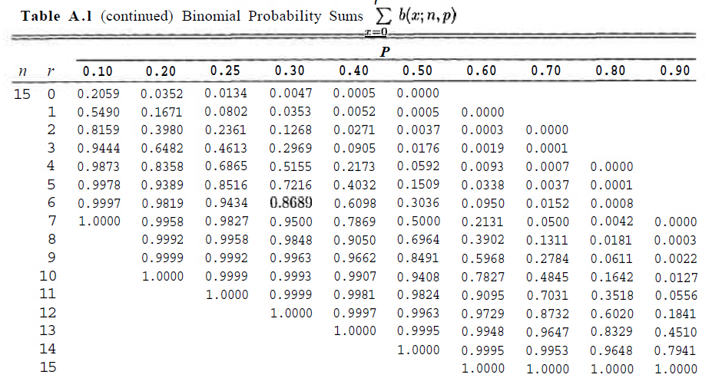
Table of Binomial Sum

Slide 13
Example
The probability that a. patient recovers from a rare blood disease is 0.4. If 15 people are known to have contracted this disease, what is the probability that (a) at least 10 survive, (b) from 3 to 8 survive, and (c) exactly 5 survive?

Slide 14
Example
A large chain retailer purchases a certain kind of electronic device from a manufacturer. The manufacturer indicates that the defective rate of the device is 3%.
(a) The inspector of the retailer randomly picks 20 items from a shipment. What is the probability that there will be at least one defective item among these 20?

Slide 15
Example
(b) Suppose that the retailer receives 10 shipments in a month and the inspector randomly tests 20 devices per shipment. What is the probability that there will be 3 shipments containing at least one defective device?

Slide 16
Summary
Uniform Distributions
Bournollie’s Process
Binomial Distribution

Slide 17
References
Probability and Statistics for Engineers and Scientists by Walpole
Schaum outline series in Probability and Statistics

