Slide 1
Statistics and Probability Theory
Lecture 20
Fasih ur Rehman

Slide 2
Last Class
Discrete Distributions
Uniform Distributions
Bournoulli’s Process
Binomial Distribution

Slide 3
Today’s Agenda
Binomial Distribution

Slide 4
Theorem
The mean of a binomial distribution is np

Slide 5
Example
Find the mean and variance of the binomial random variable of example on slide 13 of last lect.

Slide 6
Example
An impurity exists in 30% of all drinking wells in a certain rural community. 10 wells were randomly selected for testing. (a) What is the probability that exactly three wells have the impurity assuming that the conjecture is correct? (b) What is the probability that more than three wells are impure?

Slide 7
Poisson’s Experiment and Process
Experiments yielding numerical values of a random variable X, the number of outcomes occurring during a given time interval or in a specified region, are called Poisson experiments.
Poisson Experiment is derived from the Poisson’s Process.

Slide 8
Poisson’s Process
A process is called a Poisson Process if
the process has no memory
The probability that a single outcome will occur during a very short time interval or in a small region is proportional to the length of the time interval or the size of the region and does not depend on the number of outcomes occurring outside this time interval or region.
The probability that more than one outcome will occur in such a short time interval or fall in such a small region is negligible.
The number X of outcomes occurring during a Poisson experiment is called a Poisson random variable, and its probability distribution is called the Poisson distribution.

Slide 9
Poisson Distribution
The probability distribution of the Poisson random variable X, representing the number of outcomes occurring in a given time interval or specified region denoted by t, is
$$P\left(x;λt\right)= \frac{e^{−λt}{(λt)}^{x}}{x!} ;x=0, 1, 2, ….$$
Table A.2 of the text contains the sums
$$P\left(r;λt\right)=\sum_{x=0}^{r}{P(x;λt)}$$

Slide 10
Example
If on average 2 cars enter a certain area per minute. What is the probability that during any given minute 4 or more cars will enter the area.

Slide 11
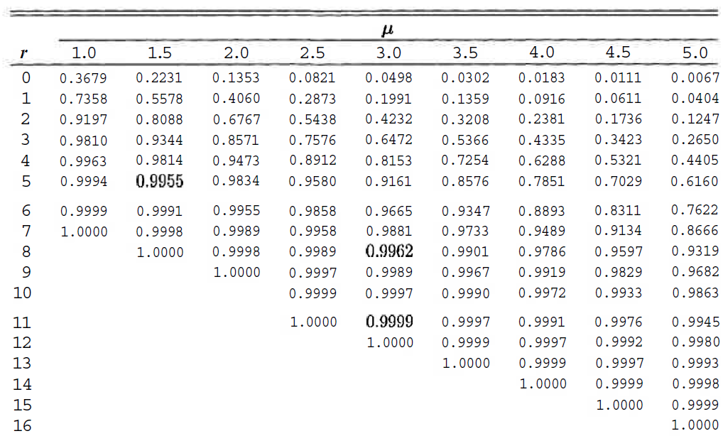
Table A.2

Slide 12
Example
During a laboratory experiment the average number of radioactive particles passing through a counter in 1 millisecond is 4. What is the probability that 6 particles enter the counter in a given millisecond?

Slide 13
Example
Ten is the average number of oil tankers arriving each day at a certain port city. The facilities at the port can handle at most 15 tankers per day. What is the probability that on a given day tankers have to be turned away?

Slide 14
Summary
Binomial Distribution
Poisson Distribution

Slide 15
References
Probability and Statistics for Engineers and Scientists by Walpole
Schaum outline series in Probability and Statistics

