Slide 1
Statistics and Probability Theory
Lecture 22
Fasih ur Rehman

Slide 2
Last Class
Poisson Distribution
Uniform Distribution

Slide 3
Today’s Agenda
Uniform Distribution
Normal Distribution

Slide 4
Uniform Distribution
The density function of the continuous uniform random variable X on the interval [A, B] is
$$f\left(x;A,B\right)=\left\{\begin{aligned}\frac{1}{B−A} for A≤x≤B \\ 0 elsewhere\end{aligned}\right.$$
Uniform distribution is also called rectangular distribution

Slide 5
Mean of Uniform Distribution $μ=\frac{A+B}{2}$

Slide 6
Variance of Uniform Distribution $σ^{2}=\frac{{(B−A)}^{2}}{12}$

Slide 7
Normal Distribution
A continuous random variable X having the bell-shaped distribution is called a normal random variable. Density of X is denoted by n(x, μ, σ).
The density of the normal random variable X, with mean μ and variance σ², is
$$n\left(x;μ,σ\right)=\frac{1}{√2πσ}e^{−\frac{1}{{2σ}^{2}}{(x−μ)}^{2}}for −∞<x<∞$$

Slide 8
Normal Distribution

Slide 9
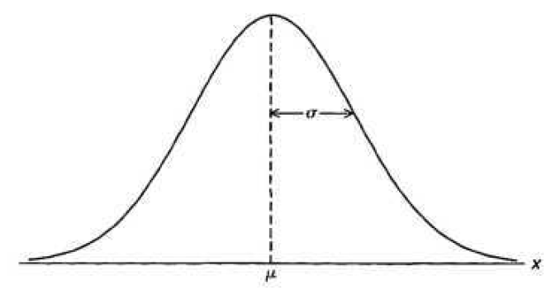
Properties of Normal Distribution
The mode, which is the point on the horizontal axis where the curve is a maximum, occurs at x = μ
The curve is symmetric about a vertical axis through the mean μ .
The curve has its points of inflection at x = p ± σ, is concave downward if p — σ < X < p + σ, and is concave upward otherwise.

Slide 10
Properties of Normal Distribution
The normal curve approaches the horizontal axis asymptotically as we proceed in either direction away from the mean.
The total area under the curve and above the horizontal axis is equal to 1.

Slide 11
Mean of Normal Distribution

Slide 12
Variance of Normal Distribution

Slide 13
Summary
Uniform Distribution(Contd.)
Normal Distributions

Slide 14
References
Probability and Statistics for Engineers and Scientists by Walpole
Schaum outline series in Probability and Statistics

