Slide 1
Statistics and Probability Theory
Lecture 23
Fasih ur Rehman

Slide 2
Last Class
Uniform Distribution
Normal Distribution

Slide 3
Today’s Agenda
Normal Distribution (cont.)

Slide 4
Normal Distribution
$$n\left(x;μ,σ\right)=\frac{1}{√2πσ}e^{−\frac{1}{{2σ}^{2}}{(x−μ)}^{2}}for −∞<x<∞$$
Mean of the distribution is μ while its variance is σ
Constant factor $\frac{1}{σ√2π}$ makes the area under the gaussian/normal curve equal to 1.
The curve is symmetric w. r. t. the axis defined by x = μ

Slide 5
Normal Distribution

Slide 6
Normal Distribution
Also
$$P((μ−1.96σ)<X<(μ+1.96σ)≈95\%$$
$$P((μ−2.58σ)<X<(μ+2.58σ)≈99\%$$
$$P((μ−3.29σ)<X<(μ+3.29σ)≈99.9\%$$

Slide 7
Standard Normal Distribution
The distribution of a normal random variable with mean 0 and variance 1 is called a standard normal distribution.

Slide 8
Maxima of Normal Distribution

Slide 9
Normal Distribution
Normal Probability for interval
$$P((a<X<b)=F\left(b\right)−F(a)$$
These values are available in tables

Slide 10
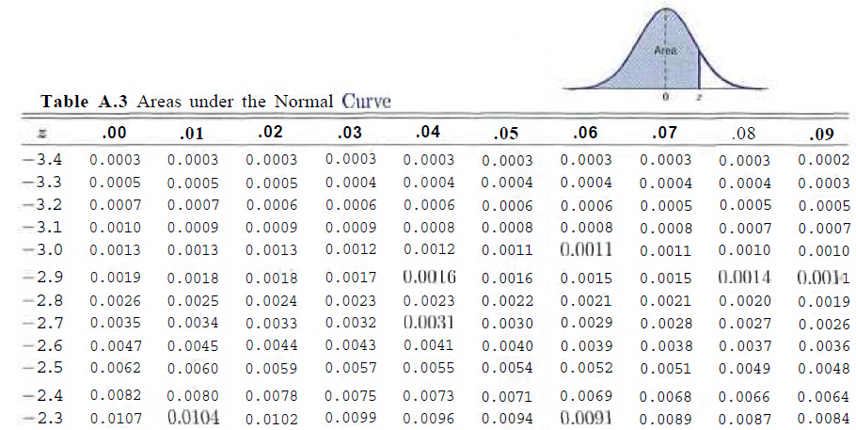
Area under the Normal Curve

Slide 11
Example
Given Standard Normal Dist. find area under the curves that lies to the right of z = 1.84 and between z = -1.97 to 0.86.

Slide 12
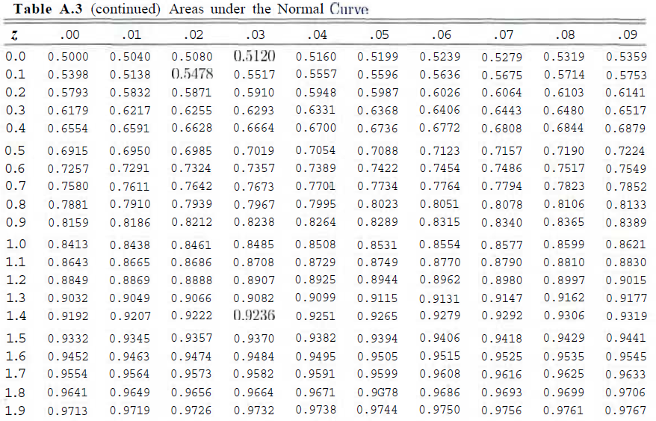
Table A.3

Slide 13
Table A.3

Slide 14
Example

Slide 15
Summary
Normal Distributions

Slide 16
References
Probability and Statistics for Engineers and Scientists by Walpole
Schaum outline series in Probability and Statistics

