Slide 1
Statistics and Probability Theory
Lecture 24
Fasih ur Rehman

Slide 2
Last Class
Uniform Distribution
Normal Distribution

Slide 3
Today’s Agenda
Normal Distribution (cont.)

Slide 4
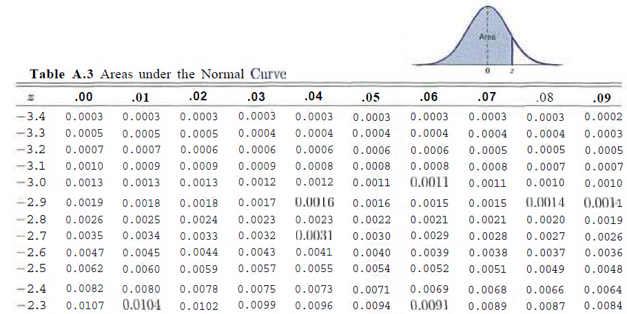
Area under the Normal Curve

Slide 5
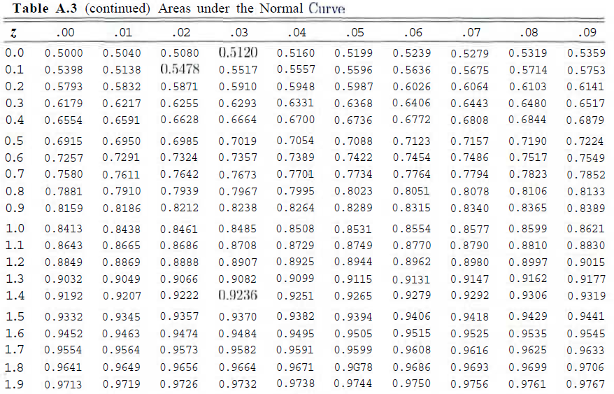
Table A.3

Slide 6
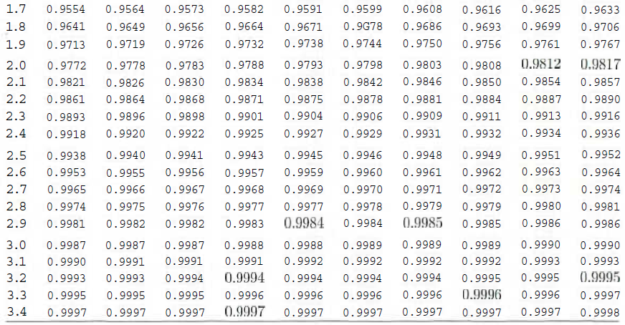
Table A.3 (Cont.)

Slide 7
Example
Given a standard normal distribution, find the value of k such that
: P(Z > k) = 0.3015
: P(k < Z < -0.18) = 0.4197

Slide 8
Example
Given a random variable X having a normal distribution with μ = 50 and σ = 10, find the probability that X assumes a value between 45 and 62.

Slide 9
Example
Given that X has a normal distribution with μ 300 and σ = 50, find the probability that X assumes a value greater than 362.

Slide 10
Example
Given a normal distribution with μ = 40 and σ = 6, find the value of x that has
(a) 45% of the area to the left, and
(b) 14% of the area to the right.

Slide 11
Example
A certain type of storage battery lasts, on average, 3.0 years with a standard deviation of 0.5 year. Assuming that the battery lives are normally distributed, find the probability that a given battery will last less than 2.3 years.

Slide 12
Example
An electrical firm manufactures light bulbs that have a life, before burn-out, that is normally distributed with mean equal to 800 hours and a standard deviation of 40 hours. Find the probability that a bulb burns between 778 and 834 hours.

Slide 13
Example
The buyer of ball bearing sets specifications on the diameter to be 3.0 ± 0.01 cm. The diameter of a ball bearing has a normal distribution with mean 3.0 and standard deviation 0.005. On the average, how many manufactured ball bearings will be scrapped?

Slide 14
Example
Gauges are used to reject all components where a certain dimension is not within the specification l.50±d. This measurement is normally distributed with mean 1.50 and standard deviation 0.2. Determine the value d such that the specifications cover 95% of the measurements.

Slide 15
Summary
Normal Distributions

Slide 16
References
Probability and Statistics for Engineers and Scientists by Walpole
Schaum outline series in Probability and Statistics

