Slide 1
Statistics and Probability Theory
Lecture 25
Fasih ur Rehman

Slide 2
Last Class
Normal Distribution

Slide 3
Today’s Agenda
Normal Gamma and Exponential Dist.

Slide 4
Normal Approximation to the Binomial
If X is a binomial random variable with mean μ = np and variance σ² = npq then the limiting form of the distribution of
$$Z= \frac{X−np}{√npq}$$
$$as n→∞ is the standard normal distribution n(z;0,1)$$

Slide 5
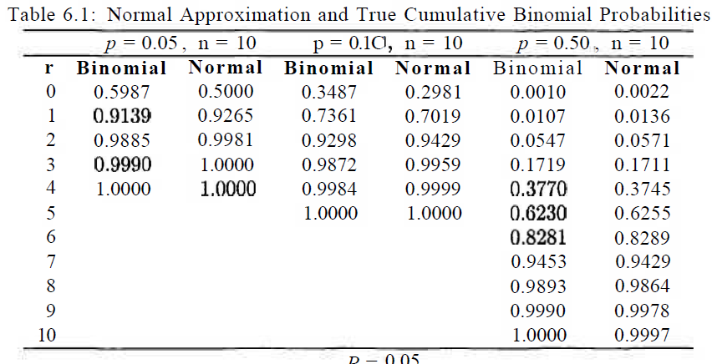
Comparison

Slide 6
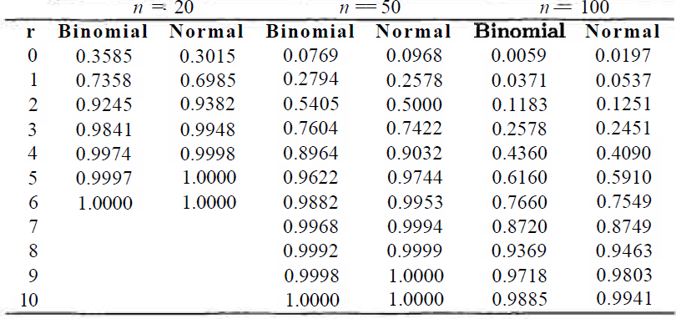
Comparison

Slide 7
Explanation

Slide 8
Example
The probability that a patient recovers from a rare blood disease is 0.4. If 100 people are known to have contracted this disease, what is the probability that less than 30 survive?

Slide 9
Example
A multiple-choice quiz has 200 questions each with 4 possible answers of which only 1 is the correct answer. What is the probability that sheer guesswork yields from 25 to 30 correct answers for 80 of the 200 problems about which the student has no knowledge?

Slide 10
Symmetry and Skewness

Slide 11
Gamma Distribution
A Gamma Function is defined by
$$Γ\left(α\right)=\int_{0}^{∞}{x^{α−1}e^{−x}dx for α>0}$$
integrating by parts and manipulating results we get
$$Γ\left(α\right)=(α−1)Γ(α−1)$$
and

Slide 12

Properties of Gamma Function
$Γ\left(n\right)=n!Γ\left(1\right)$
$Γ\left(1\right)=1$
$Γ\left(\frac{1}{2}\right)=√π$

Slide 13
Gamma Distribution
The continuous random variable X has a gamma distribution, with parameters $α$ and $β$, if its density function is given by
$$f\left(x;α,β\right)=\left\{\begin{aligned}\frac{1}{β^{α}Γ(α)}x^{α−1}e^{−x/β}. x>0 \\ 0. elsewhere\end{aligned}\right.$$
where $α>0$ and $β>0$

Slide 14
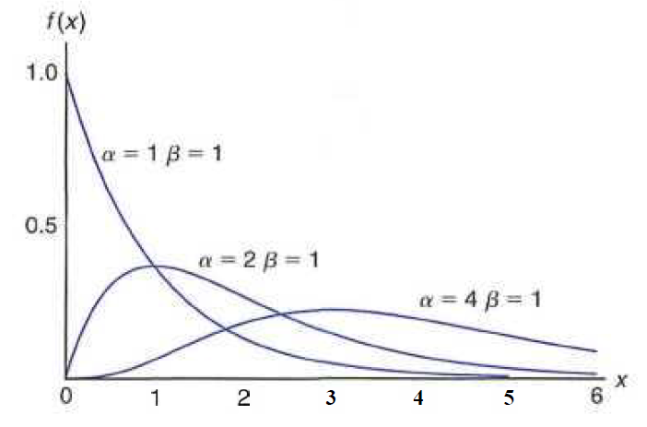
Gamma Distribution

Slide 15
Exponential Distribution
Special case of Gamma function with α = 1
The continuous random variable X has an exponential distribution, with parameter $β$, if its density function is given by
$$f\left(x;β\right)=\left\{\begin{aligned}\frac{1}{β}e^{−x/β}. x>0 \\ 0. elsewhere\end{aligned}\right.$$
where $β>0$

Slide 16
Gamma Distribution

Slide 17
Mean and Variance
The mean and variance of the gamma distribution are
$$μ=αβ and σ^{2}= αβ^{2}$$
The mean and variance of the exponential distribution are
$$μ=β and σ^{2}= β^{2}$$

Slide 18
Summary
Normal Approximation to Binomial Distributions
Gamma Distribution
Exponential Distribution

Slide 19
References
Probability and Statistics for Engineers and Scientists by Walpole
Schaum outline series in Probability and Statistics

