Slide 1
Statistics and Probability Theory
Lecture 27
Fasih ur Rehman

Slide 2
Last Class
Estimation of Parameters
Maximum Likelihood Method/Estimate

Slide 3
Today’s Agenda
MLE
Confidence Interval

Slide 4
Example
Apply MLE to exponential distribution for estimation of β

Slide 5
Example
It is known that a sample of 12, 11.2, 13.5, 12.3, 13.8, and 11.9 comes from a population with the density function
$$f\left(x;θ\right)=\left\{\begin{aligned}\frac{θ}{x^{θ+1}} for x>1 \\ 0 e.w\end{aligned}\right.$$
Find MLE for θ

Slide 6
Example (Cont.)

Slide 7
Confidence Interval
Confidence intervalsfor an unknown parameter θ of some distribution are intervals $θ_{1}≤θ≤θ_{2}$ that contain θ not with certainty but with a high probability $γ$ which we can choose, 95% and 99% are popular.
Interval denoted by
$γ$ is called the confidence level, and $θ_{1}and θ_{2}$are called the lowerand upper confidence limits.

Slide 8
Confidence Interval
Lower and Upper Confidence limits depend on $γ$
The larger we choose $γ$ the smaller is the error probability $1−γ$ but the longer is the confidence interval.
If confidence level goes to 1, length of the interval goes to infinity.
Mid point of the confidence interval as approximation of θ and half the length as error bound.

Slide 9
Procedure
Take $x_{1},…, x_{2}$ as single observations of Random Variables X₁, … , X_{n}.
Then
$θ_{1}=θ_{1}(x_{1},…, x_{2})$ and
$$θ_{2}=θ_{2}(x_{1},…, x_{2})$$
In the confidence interval we observe values of two random variables
$$Θ_{1}=Θ_{1}(x_{1},…, x_{2})$$
$$Θ_{2}=Θ_{2}(x_{1},…, x_{2})$$
Then

Slide 10
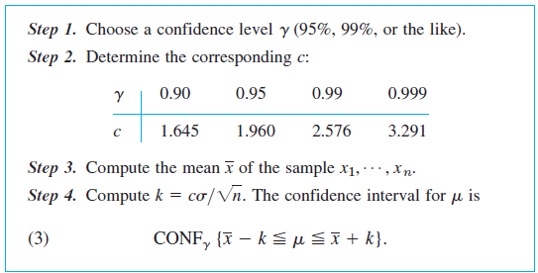
Confidence Interval for Mean of ND
It’s assumed that variance is known

Slide 11
Example
Determine a 95% confidence interval for the mean of a normal distribution with variance 9 using a sample n = 100 values with mean 5. How large must n be for this confidence interval of length L = 0.4

Slide 12
Example
Height of 100 male students from 1456 students has estimated mean = 67.45” and variance = 2.39”. Find 95% and 99% confidence interval for estimation of the mean height.

Slide 13
Example
Mean and variance estimated from sample of 200 ball bearings are 0.824” and 0.042”. Find 95% and 99% confidence interval for this estimate.

Slide 14
Regression Analysis
In regression analysis one of the two variables, call it x, can be regarded as an ordinary variable because we can measure it without substantial error or we can even give it values we want. x is called the independent variable, or sometimes the controlled variable because we can control it.
The other variable, Y, is a random variable, and we are interested in the dependence ofY on x.

Slide 15
Least Squares Principle
The straight line should be fitted through the given points so that the sum of the squares of the distances of those points from the straight line is minimum, where the distance is measured in the vertical direction.

Slide 16
Summary
Confidence Interval

Slide 17
References
Probability and Statistics for Engineers and Scientists by Walpole
Advanced Engineering Mathematics by E Kreyszig.

