Slide 1
Statistics and Probability Theory
Lecture 30
Fasih ur Rehman

Slide 2
Last Class
Regression Analysis (Normal Fit)
Correlation

Slide 3
Regression and Correlation

Slide 4
Today’s Agenda
Correlation (Continuous variable)

Slide 5
Correlation
Let f(x) and g(x) be two continuous functions, of x. The correlation coefficient is defined by
$$C_{n}=\frac{1}{\sqrt{E_{f}E_{g}}}\int_{−∞}^{∞}{f\left(x\right)g\left(x\right)dx}$$
where
$$E_{f}=\int_{−∞}^{∞}{{f(x)}^{2}dx}$$
and
$$E_{g}=\int_{−∞}^{∞}{{g(x)}^{2}dx}$$

Slide 6
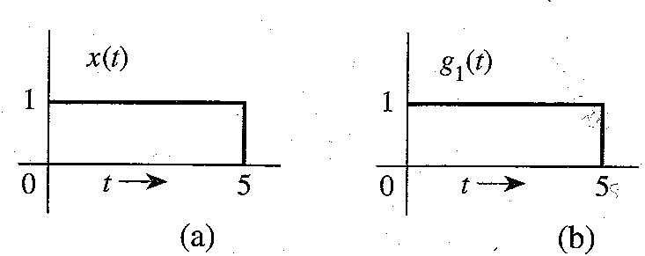
Example

Slide 7
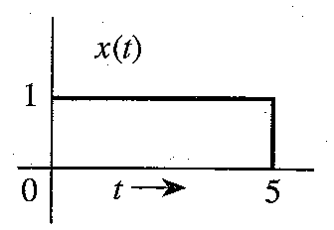
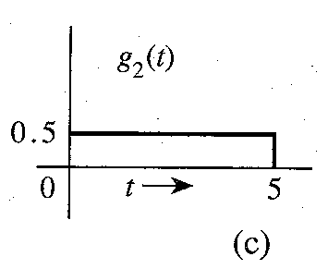
Example

Slide 8
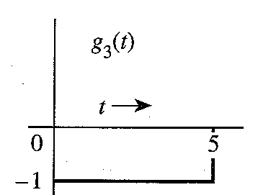
Example

Slide 9
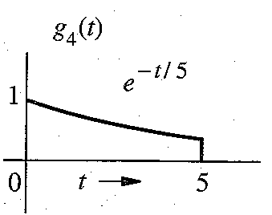
Example

Slide 10
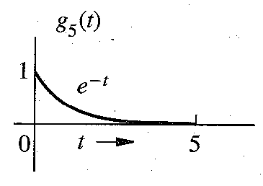
Example

Slide 11
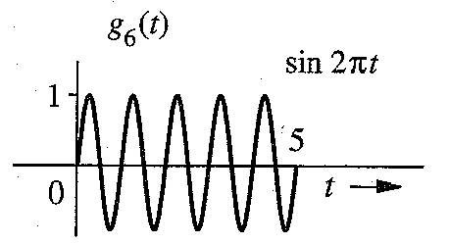
Example

Slide 12
Summary
Correlation (Continuous Variables)

Slide 13
References
Probability and Statistics for Engineers and Scientists by Walpole
Advanced Engineering Mathematics by E Kreyszig.
Modern Analog and Digital Communication Systems by B. P. Lathi

