Slide 1
Statistics and Probability Theory
Lecture 32
Fasih ur Rehman

Slide 2
Last Class
Revision (1st half)

Slide 3
Today’s Agenda (Revision)
Statistical Independence
Mean of a joint distribution
Covariance and Correlation
Discrete Uniform Distribution
Bournoulli’s Process & Binomial Distribution
Poisson’s Process and Poisson’s Distribution
Continuous Uniform Distribution
Normal Distribution
Gamma and Exponential Distribution
Estimation of Parameters
Maximum Likelihood Method
Confidence Interval
Regression and Correlation Analysis

Slide 4
Statistical Independence
Let X and Y be two random variables, discrete or continuous, with joint probability distribution f(x,y) and marginal distributions g(x) and h(y), respectively. The random variables X and Y are said to be statistically independent if and only if
$$f\left(x,y\right)=g\left(x\right)h(y)$$
for all (x, y) within their range

Slide 5
Covariance
Let X and Y be random variables with joint probability distribution f(x, y). The covariance of X and Y is
$$μ_{xy}=E\left[\left(X−μ_{x}), (Y−μ_{y}\right)\right]=\sum_{x}{\sum_{y}{(x−μ_{x})(x−μ_{y})f\left(x,y\right)}}$$
if X and Y are discrete and
$$μ_{xy}=E\left[\left(X−μ_{x}), (Y−μ_{y}\right)\right]=\iint_{−∞}^{∞}{(x−μ_{x})(x−μ_{y})f\left(x,y\right)}dxdy$$
if X and Y are continuous.

Slide 6
Correlation
Let X and Y be random variables with covariance σ_{xy} and standard deviations σ_{x} and σ_{y} respectively. The correlation coefficient of X and Y
$$ρ_{xy}=\frac{σ_{xy}}{σ_{x}σ_{y}}$$

Slide 7
Discrete Uniform Distribution
If the random variable X assumes the values x₁,x₂, …. x_{k} with equal probabilities, then the discrete uniform distribution is given by
$f\left(x;k\right)=\frac{1}{x} for x= x_{1 }x_{2}….x_{k}$

Slide 8
Bournoulli’s Process / Trail
The Bournoulli’s process possesses following properties
The experiments consists of repeated trails
The probability of success is same in each trail
There are n trails and n is constant
The n – trails are independent.

Slide 9
Binomial Distribution
A Bernoulli trial can result in a success with probability p and a failure with probability q = 1 — p. Then the probability distribution of the binomial random variable X, the number of successes in n independent trials, is
$$b\left(x;n,p\right)=\left({n \atop x}\right)p^{x}q^{n−x}, x=0, 1, 2,…, n$$

Slide 10
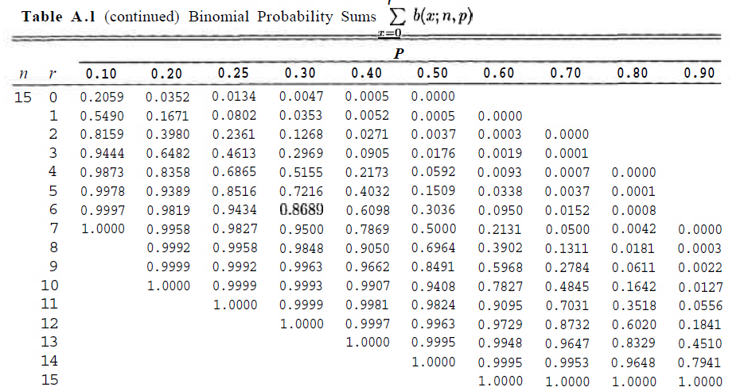
Table of Binomial Sum

Slide 11
Poisson’s Experiment and Process
Experiments yielding numerical values of a random variable X, the number of outcomes occurring during a given time interval or in a specified region, are called Poisson experiments.
Poisson Experiment is derived from the Poisson’s Process.

Slide 12
Poisson’s Process
A process is called a Poisson Process if
the process has no memory
The probability that a single outcome will occur during a very short time interval or in a small region is proportional to the length of the time interval or the size of the region and does not depend on the number of outcomes occurring outside this time interval or region.
The probability that more than one outcome will occur in such a short time interval or fall in such a small region is negligible.
The number X of outcomes occurring during a Poisson experiment is called a Poisson random variable, and its probability distribution is called the Poisson distribution.

Slide 13
Poisson Distribution

Slide 14
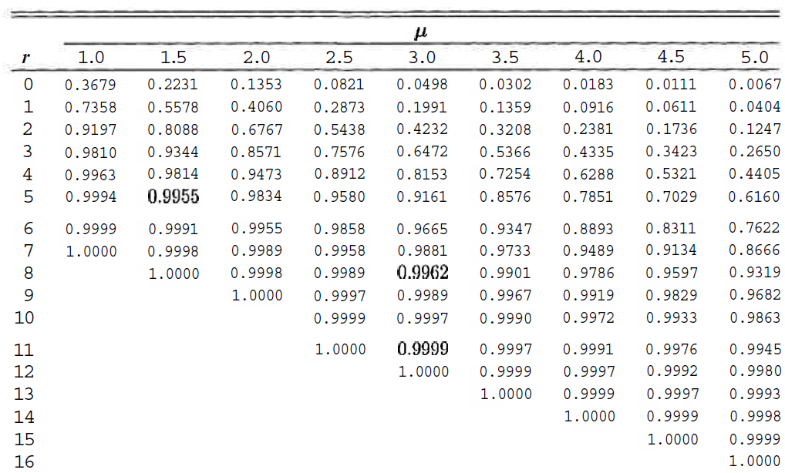
Table A.2

Slide 15
Uniform Distribution
The density function of the continuous uniform random variable X on the interval [A, B] is
$$f\left(x;A,B\right)=\left\{\begin{aligned}\frac{1}{B−A} for A≤x≤B \\ 0 elsewhere\end{aligned}\right.$$
Uniform distribution is also called rectangular distribution

Slide 16
Normal Distribution
A continuous random variable X having the bell-shaped distribution is called a normal random variable. Density of X is denoted by n(x, μ, σ).
The density of the normal random variable X, with mean μ and variance σ², is
$$n\left(x;μ,σ\right)=\frac{1}{√2πσ}e^{−\frac{1}{{2σ}^{2}}{(x−μ)}^{2}}for −∞<x<∞$$

Slide 17
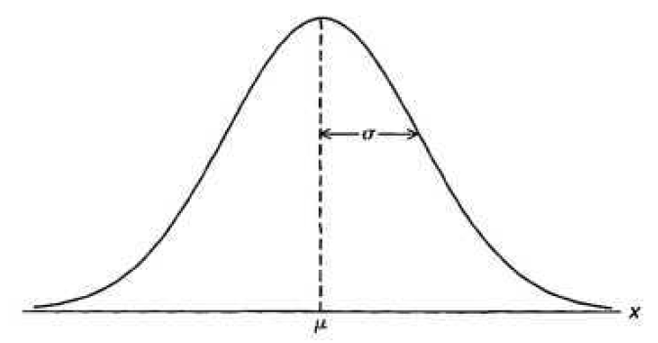
Properties of Normal Distribution
The mode, which is the point on the horizontal axis where the curve is a maximum, occurs at x = μ
The curve is symmetric about a vertical axis through the mean μ .
The curve has its points of inflection at x = p ± σ, is concave downward if p — σ < X < p + σ, and is concave upward otherwise.

Slide 18
Properties of Normal Distribution
The normal curve approaches the horizontal axis asymptotically as we proceed in either direction away from the mean.
The total area under the curve and above the horizontal axis is equal to 1.

Slide 19
Normal Distribution
Smaller the σ narrower is the curve i.e. the function goes to zero very fast.
The curve has its point of inflection at $x= μ±σ$
$$P((μ−σ)<X<(μ+σ)≈68\%$$
$$P((μ−2σ)<X<(μ+2σ)≈95.5\%$$
$$P((μ−3σ)<X<(μ+3σ)≈99.7\%$$

Slide 20
Normal Distribution
Also
$$P((μ−1.96σ)<X<(μ+1.96σ)≈95\%$$
$$P((μ−2.58σ)<X<(μ+2.58σ)≈99\%$$
$$P((μ−3.29σ)<X<(μ+3.29σ)≈99.9\%$$

Slide 21
Standard Normal Distribution
The distribution of a normal random variable with mean 0 and variance 1 is called a standard normal distribution.

Slide 22
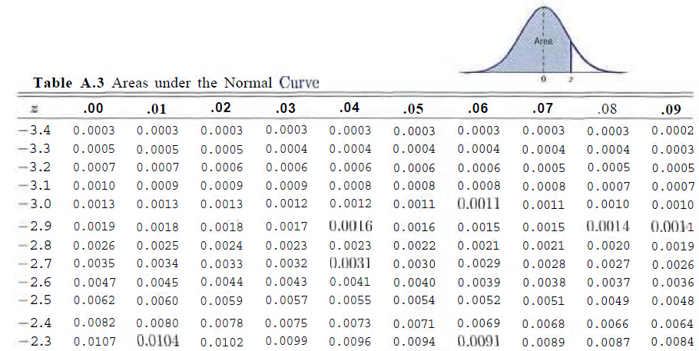
Area under the Normal Curve

Slide 23
Estimation of Parameters
Population and Sample
A point estimate of a parameter is a number (point on the real line), which is computed from a given sample and serves as an approximation of the unknown exact value of the parameter of the population.
An interval estimate is an interval (“confidence interval”) obtained from a sample.

Slide 24
Maximum Likelihood Method

Slide 25
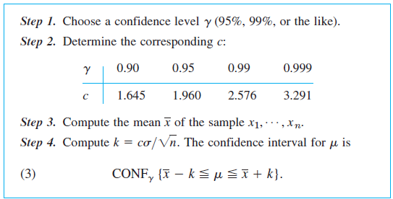
Confidence Interval for Mean of ND
It’s assumed that variance is known

Slide 26
Regression Analysis
In regression analysis one of the two variables, call it x, can be regarded as an ordinary variable because we can measure it without substantial error or we can even give it values we want. x is called the independent variable, or sometimes the controlled variable because we can control it.
The other variable, Y, is a random variable, and we are interested in the dependence ofY on x.

Slide 27
Least Squares Principle
The straight line should be fitted through the given points so that the sum of the squares of the distances of those points from the straight line is minimum, where the distance is measured in the vertical direction.

Slide 28
Normal Fit

Slide 29
Correlation
Let X and Y be random variables with covariance σ_{xy} and standard deviations σ_{x} and σ_{y} respectively. The correlation coefficient of X and Y
$$ρ_{xy}=\frac{σ_{xy}}{σ_{x}σ_{y}}$$

Slide 30
Correlation Analysis
Correlation Coefficient for a Discrete Data set is defined as
r = S_{xy}/(S_{xx}S_{yy})^{1/2}
The Correlation Coefficient r describes strength of linear relation and sign its direction
If r = 1 all (x,y) lie on st line with +ve slope and vice versa
If r > 0, the pattern in scattergram runs from bottom left to top right and vice versa
Magnitude of r is closer to 1 means strong linear relation and closer to 0 signifies weak relation.

Slide 31
Correlation

Slide 32
Summary
Revision of 2nd half of the course

Slide 33
References
Probability and Statistics for Engineers and Scientists by Walpole
Schaum Outline Series on Probability and Statistics.
Advanced Engineering Mathematics by E Kreyszig.

