Slide 1
Sukuk (1)

Slide 2
Summary of the Previous Lecture
We studied the following concepts of Islamic investment funds in our previous class;
Principles of Islamic investment funds.
Modes of investment of funds and their management under Islamic financial system.
Equity fund
Ijarah funds
Commodity funds
Murabaha funds
Bai al Dain
Mixed funds
Challenges being faced by Islamic funds
Opportunities in the market

Slide 3
Learning outcomes
After this lecture you will be able to understand the concept of Sukuk regarding their
Definition
Introduction
Objectives of Sukuk
Shariah Bases of Sukuk Issue
Basics of Sukuk
Sukuk in Secondary Market
Sukuk – Guiding principles

Slide 4
Learning outcomes
Advantage of Sukuk – Issuer
Advantage of Sukuk – Investor
Parties Involved
Popular Sukuks
Sukuk al Murabaha
Sukuk al Ijarah
Sukuk al Musharakah
Sukuk Growth
Controversies in different types of Sukuks
Differences between Sukuk and Bonds

Slide 5
Definition
Sukuk is the Arabic name for a financial certificate.
Its an Islamic alternative to the conventional interest bearing bonds.
Sukuk is a Trust certificate in which investor returns are derived from legal or beneficial ownership of assets.

Slide 6
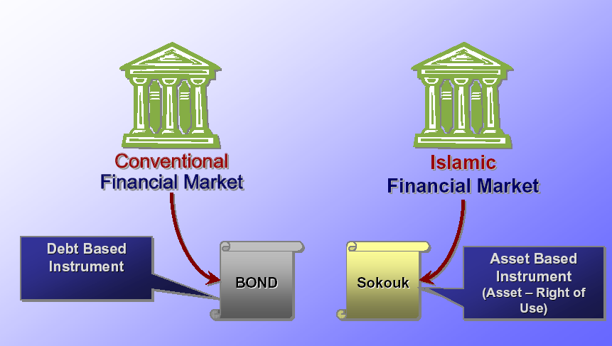
Bond
Sukuk

Slide 7
Introduction of Sukuk
Sukuk refer to securitization, a process in which ownership of the underlying assets is transferred to a large number of investors.
These are certificates of equal redeemable value representing undivided share in ownership of tangible assets of particular projects or specific investment activity and services.

Slide 8
Introduction of Sukuk
Its great potential is in transforming an asset’s future cash flow into present cash flow .
Sukuk may be issued on existing as well as specific assets that may become available at a future date.

Slide 9
Objectives of Sukuk
Objective of Sukuk is to enable organizations
To raise capital in a Shariah -compliant fashion , whilst at the same time
Expanding the investor base and
Offering investment opportunities to new groups.

Slide 10
Shariah Bases of Sukuk Issue
Equity Based: Conditions of Musharakah and Mudarabah
Salam based – salam Rules
Ijarah based – Rules of Ijarah

Slide 11
Basics of Sukuk
While a conventional bond is a promise to repay a loan, Sukuk constitutes partial ownership in a debt (Sukuk Murabaha), asset (Sukuk Al Ijara), project (Sukuk Al Istisna), business (Sukuk Al Musharakah), or investment (Sukuk Al Istithmar).
Sukuk structures replicate the cash flows of conventional bonds, and are listed on exchanges and tradable in the secondary markets.

Slide 12
Basics of Sukuk
Sukuk is popularly known as Sharia compliant ‘Bond’ whilst in actual fact, it is an asset-backed trust certificate.
In its simplest form Sukuk is a certificate evidencing ownership of an asset.
The Sukuk structures rely on the creation of a Special Purpose Vehicle (SPV).

Slide 13
Basics of Sukuk
SPV would issue Sukuk certificates which represents the ownership of an asset, entitlement to rental incomes.
The return provided to Sukuk holders therefore come in the form of profit from a sale, rental or a combination of both.
Sukuk could be based on Mudaraba, Musharakah, Murabaha, Salam, Istisna, Ijarah or hybrid of all these.

Slide 14
Sukuk in Secondary Market
Sukuk securities are normally purchased and held by the investors, as a result, little of the securities enter the secondary market.
Furthermore, only public Sukuk are able to enter this market, as they are listed on stock exchanges

Slide 15
Secondary Market of Sukuk
Shirkah based and Ijarah Sukuk - Marketing based on the market signals and forces.
Murabaha , Salam and Istisna Sukuk representing a claim only so can be negotiated only at face value.
Instruments representing a pool of different categories are subject to the rules relating to the dominant category in the pool, i.e. proportion of liquid and illiquid assets.

Slide 16
Sukuk – Guiding principles
Islamic certificates of investment referred to as Sukuk involve structuring of pools of Shariah compliant assets.
Investors have an undivided interest in the underlying assets and are therefore entitled to share jointly the related returns.
Could take place through application of various Shariah principles such as Ijarah , Salam, Musharakah , Mudaraba and mixed pools.

Slide 17
Sukuk – Guiding principles
Provision for credit enhancement and/or liquidity enhancement features.
From credit perspective, investors expect the Sukuk issue to represent the same credit risk as that of the ultimate issuer/guarantor.

Slide 18
Advantage of Sukuk - Issuer
Diversify funding source
Create and enhance profile in international market
Pricing benchmark
Secondary liquidity
Sizeable financing.
Ease of clearing and settlement

Slide 19
Advantage of Sukuk - Investor
Diversify Investment
Provides Leveraging Capabilities
Secondary Market Liquidity
Ease of clearing and Settlement
Investment available to Institutional and Retail investors
Allows for many computation of Risk – credit, market, duration etc.

Slide 20
Issuance of Sukuk
Factor to be considered
Identify investors
Rating – by a credit rating agency
Underlying assets
Secondary market considerations
Applicable laws – SECP rules
Cost to the issuers
Drafting of legal documents
Regularity frame work

Slide 21
Parties Involved
Originator : Initial Owner
SPV : Special Purpose Vehicle
Investors: Subscribers.
Receiving /Paying Agent : Banks
Credit enhancement provider : Hedges, Guarantees, Takaful etc.

Slide 22
Parties Involved
Merchant Banker
Credit Rating Agency
Legal & Tax Counsel
Auditor

Slide 23
Key Players in Sukuk Market
Originators:
Sukuk originators are mostly governments ; also Corporate firms
High costs of rating, contract documentation, investment banking and distribution fee.
Sukuk option is not attractive to most Islamic banks due to high proportion of short term assets.

Slide 24
Key Players in Sukuk Market
Investment banks:
Investment banking, underwriting, lead managing and book making services for Sukuk are provided by Islamic banks in cooperation with conventional banks having Islamic windows.
Subscribers of these Sukuk are mostly central banks, private sector Islamic banks and non bank financial institutions.
Sukuks are held by the investors resulting in absence of secondary market
A wider class of investors is essential for active trading.

Slide 25
Some Popular Sukuk
Murabaha Sukuk
This is a process of direct structuring of securities wherein a Special Purpose Vehicle (SPV) invests the funds raised through the sale of Sukuk in Murabaha operations.
The company purchases the asset from the SPV on a Murabaha basis, and the future periodic installments paid by the company to the SPV account for the repayment of the cost and the profit component.

Slide 26
Mudarabah Sukuk (certificates)
Mudarabah certificates or Sukuk represent projects or activities managed on Mudarabah principle.
Any of the partners or any other person is appointed as Mudarib for management of the business.
They entitle their holders share in the specific projects.
Sukuk holder can transfer the ownership by selling the deeds in the securities market at his discretion subject to certain rules.

Slide 27
Mudarabah Sukuk (certificates)
Trading:
If the Mudaraba capital is still in the form of money , the trading of Mudarabah Sukuk would be like exchange of money for money, which is not permissible in Shariah.
If capital is in the form of combination of cash, receivables, goods, real assets and benefits , trade must be based on the market price evolved by mutual consent

Slide 28
Mudarabah Sukuk
Mudarabah as a Basis:
It is not permissible for the issuer to guarantee the capital of the Mudarabah.
Prospectus to the issue can contain a promise by a third party to donate a specific sum, without any counter benefit, to meet losses in a given project, provided such commitment is independent of the Mudarabah contract

Slide 29
Ijarah Sukuk
A key technique to achieve capital protection without amounting to a loan is a binding promise to repurchase certain assets, e.g. in the case of Sukuk Al Ijara , by the issuer.
In the meantime a rent is being paid, which is often benchmarked to an interest rate like KIBOR (which is disliked by Sharia Scholars)

Slide 30
Ijarah Sukuk
Ijarah Sukuk represent ownership of existing or defined and known assets tied up to a lease contract.
Rental of the asset is the return payable to Sukuk holders.
Expenses related to the corpus of the leased asset are the responsibility of the owner.
Therefore, the expected return flow from such Sukuk may not be completely fixed and determined in advance.

Slide 31
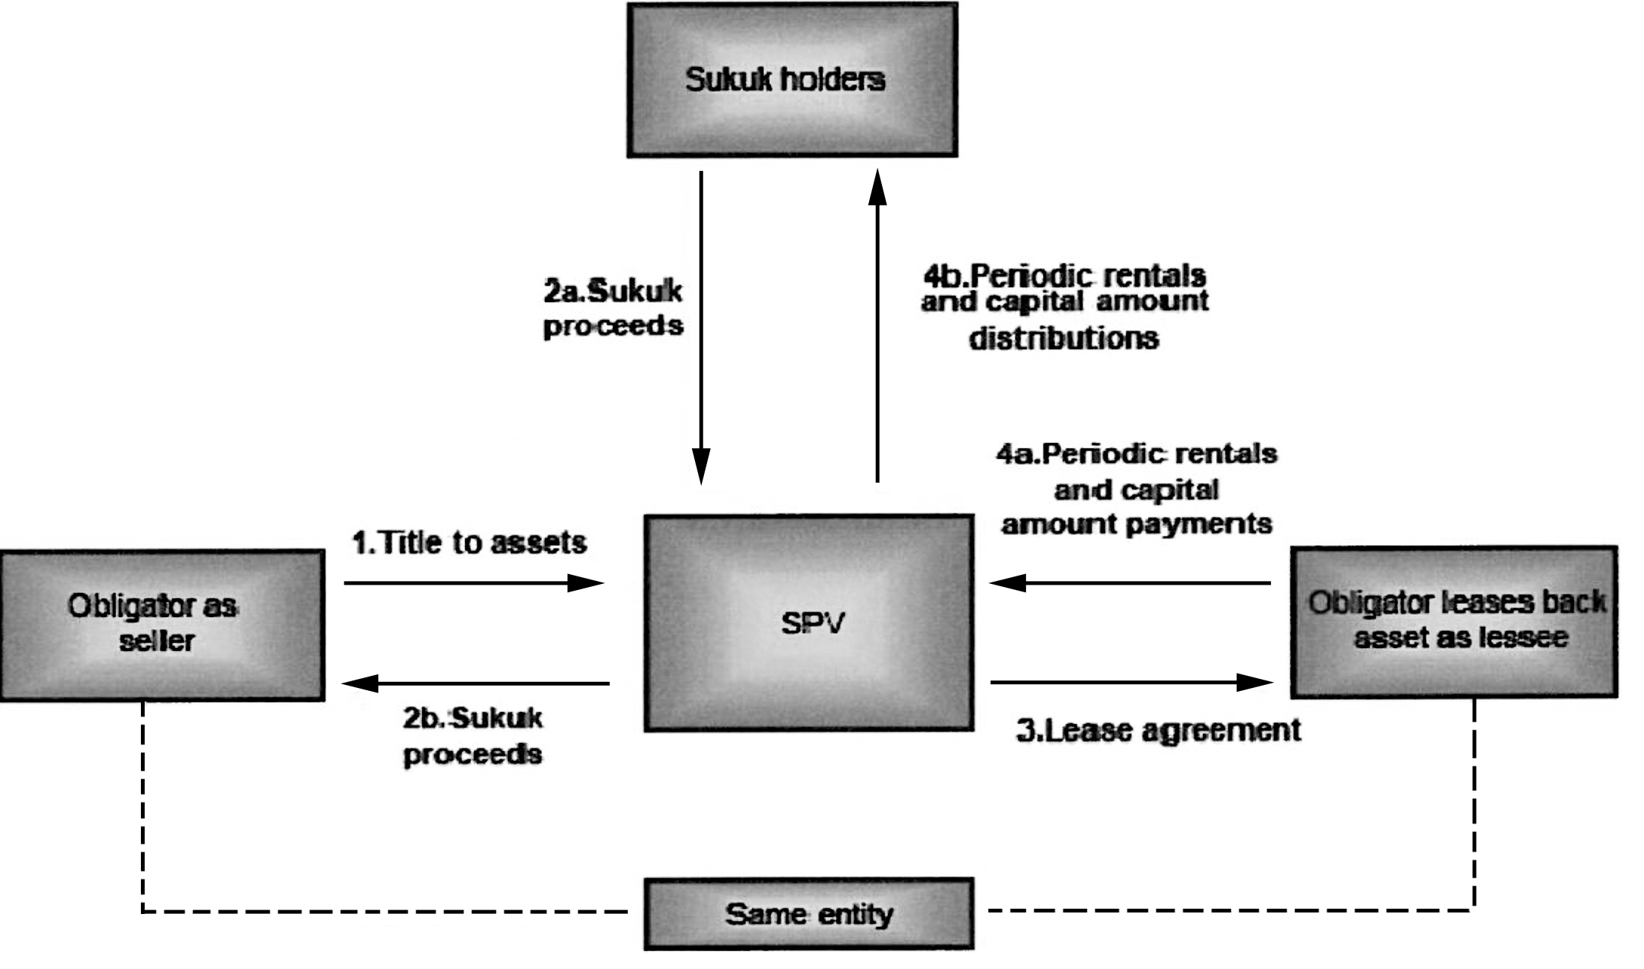
Transaction of Ijarah Sukuk

Slide 32
Ijarah Sukuk
The subscription amounts are used to purchase assets like real estate, motor vehicles, or other equipment for the purpose of leasing them out to their ultimate users.
The ownership of these assets remains with the Fund and the rentals are charged from the users.
These rentals are the source of income for the fund which is distributed pro rated to the subscribers.
Each subscriber is given a certificate to evidence his subscription and to ensure his entitlement to the pro rated share in the income

Slide 33
Ijarah Sukuk
As the lessor can stipulate the rentals in advance, the rentals on Sukuk issue can be indicated in advance with possibility of very small variation that might be possible due to payment of ownership-related un-predictable expenses by the lessor or possibility of any default by the lessee

Slide 34
Ijarah fund
These certificates may be preferably called " Sukuk “
Sukuk represent the pro rated ownership of their holders in the tangible assets of the fund, and not the liquid amounts or debts.
They are fully negotiable and can be sold and purchased in the secondary market.

Slide 35
Ijarah fund
Anyone who purchases these Sukuk, replaces the sellers in the pro rated ownership of the relevant assets and all the rights and obligations of the original subscriber are passed on to him.
The price of these Sukuk will be determined on the basis of market forces, and are normally based on their profitability

Slide 36
Summary of the Lecture
In todays lecture we studies the following concepts of Sukuk.
Basics of Sukuk
Sukuk in Secondary Market
Sukuk – Guiding principles
Advantage of Sukuk – Issuer
Advantage of Sukuk – Investor
Parties Involved
Popular Sukuks

