Slide 1
Sukuk (II)

Slide 2
Summary of the Previous Lecture
We studies the following concepts of Sukuk
Basics of Sukuk
Sukuk in Secondary Market
Sukuk – Guiding principles
Advantage of Sukuk – Issuer
Advantage of Sukuk – Investor
Parties Involved
Popular Sukuks

Slide 3
Learning outcomes
After this lecture you will be able to understand the concept of Sukuk regarding their
Definition
Introduction
Objectives of Sukuk
Shariah Bases of Sukuk Issue
Basics of Sukuk
Sukuk in Secondary Market
Sukuk – Guiding principles

Slide 4
Learning outcomes
Advantage of Sukuk – Issuer
Advantage of Sukuk – Investor
Parties Involved
Popular Sukuks
Sukuk al Murabaha
Sukuk al Ijarah
Sukuk al Musharakah
Sukuk Growth
Controversies in different types of Sukuks
Differences between Sukuk and Bonds

Slide 5
Istisna Sukuk
Istisna can be used for financing the manufacture or construction of houses, plants, projects, bridges, roads and highways.
By way of parallel Istisna contract with subcontractors, Islamic banks can undertake the construction of any asset and its sale for a deferred price.
Full ownership of the constructed item is transferred to the purchaser against the deferred sale price that covers not only the construction costs but also profits.

Slide 6
Salam Sukuk
Salam sale is attractive to the seller whose cash flow is enhanced in advance and to the buyer as the Salam price is normally lower than the prevailing spot price giving him a profit margin.
The possibility of having negotiable Salam certificates is yet to be decided. So far, scholars are not inclined to accept it.

Slide 7
Murabaha Sukuk
Murabaha Sukuk are more likely to be used in respect of purchases of goods by the public sector.
In case the government needs items of huge price, it may purchase them through credit sale by paying in installments.

Slide 8
Murabaha Sukuk
The seller will amortize the cost and return over the period of installments.
Any Murabaha Fund can also issue Murabaha Sukuk, proceeds of which could be used for sale of assets on the basis of Murabaha to give fixed return to the Murabaha Sukuk holders

Slide 9
Mixed Portfolio Securities/Sukuk
Banks may securitize a pool of Musharakah , Ijarah and some Murabaha , Salam, and Istisna contracts.
Return on such securities will depend on chosen mix of contracts

Slide 10
Sukuk Growth
Sukuk are gaining popularity as alternative source of funding.
Growth has been fuelled by strong demand for Shariah compliant assets.
Malaysia and Middle East have emerged as key Sukuk centers
Also issued in Germany, Britain, japan, Philippines , Pakistan, etc.
Ijarah concept is the most popular amongst issuers of global Islamic securities

Slide 11
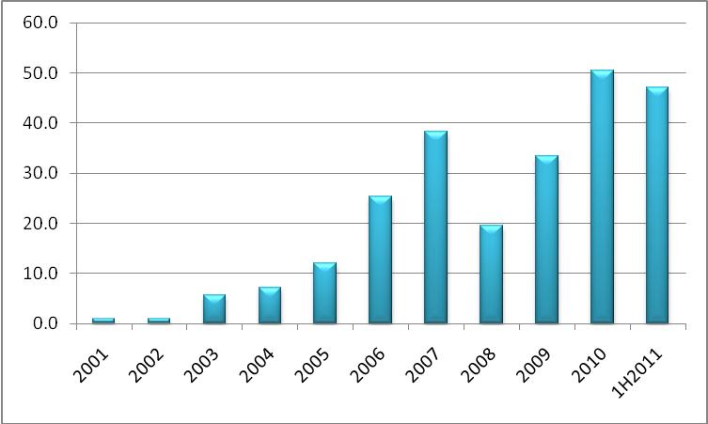
Global Sukuk Issuance (Billion dollars)

Slide 12
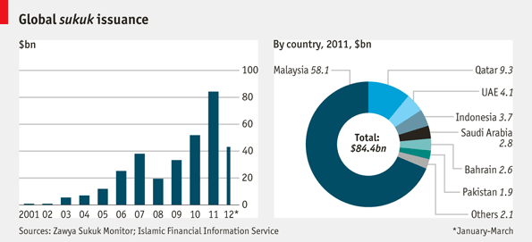
Global Sukuk Issuance

Slide 13
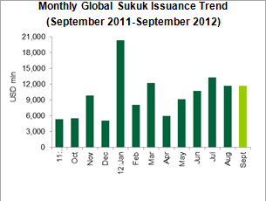

Slide 14
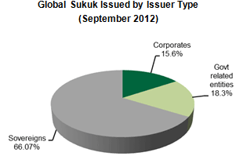

Slide 15
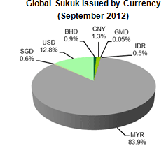

Slide 16
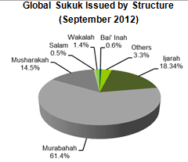

Slide 17
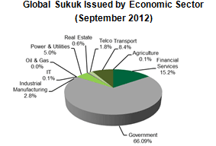

Slide 18
Sukuk for Construction industry
Examples from Pakistan.
WAPDA Sukuk for upraising Mangla Dam
Motorway Sukuk

Slide 19
WAPDA Sukuk
WAPDA’s financing requirement: PKR 8,000 million to (partially) fund the Mangla Dam Raising Project
Key objectives for WAPDA were:
To raise financing in a cost efficient manner
Strengthen its presence in the local financial markets
Diversify and cultivate WAPDA’s investor base
Undertake a landmark transaction which will catalyze the promotion of Islamic Financial instruments and lead the way for other public sector entities

Slide 20
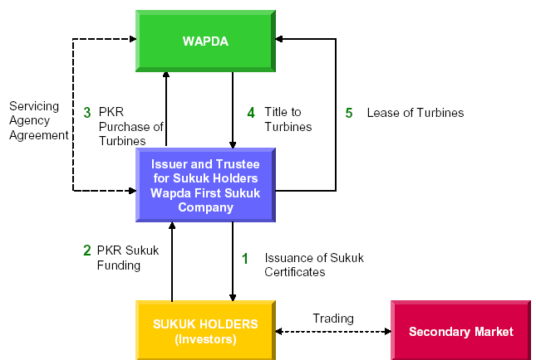
Transaction Structure

Slide 21
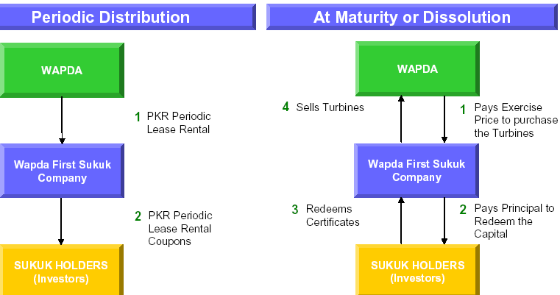
Transaction Structure

Slide 22
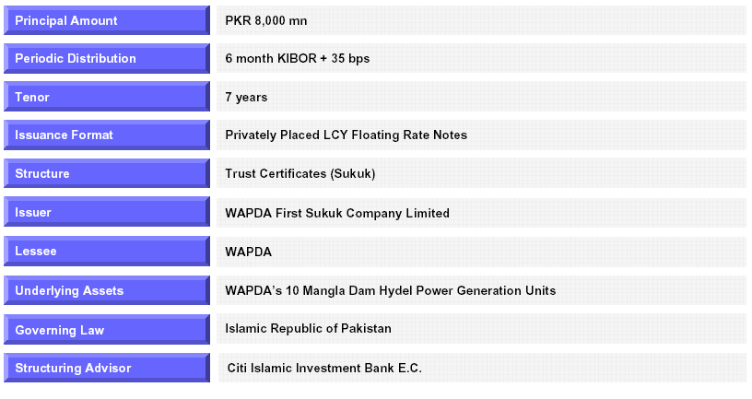
Offer Summery

Slide 23
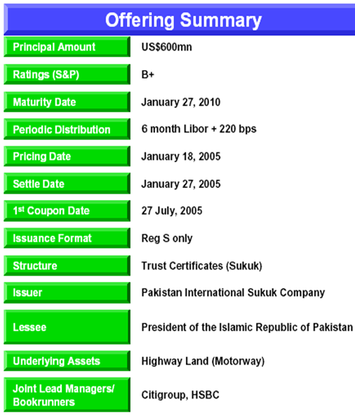
Motorway Sukuk

Slide 24
Sukuk versus Conventional Bonds
Sukuk
Income is generated from assets
Return is expected
Negotiability is restricted to specific types of Sukuk
Conventional Bonds
Income is derived from debt instrument.
Return is interest and pre-determined.
Negotiable financial paper

Slide 25
Sukuk versus Conventional Bonds
Sukuk
Sukuk issue is a seller of assets
Sukuk holder is an owner of assets
Seller-Buyer relationship
Business risk-return relationship
Conventional Bonds
Bond issuer is a borrower
Bond holder is a lender
Lender-borrower relationship
Issuer guarantees the payment of face value and periodic interest

Slide 26
Sukuk versus Conventional Bonds
Sukuk
Major risk lays with underlying assets
Return is expected from the underlying assets
Return of investor’s capital cannot be guaranteed
Conventional Bonds
Major risk is with issuer – credit risk
Interest payment is an obligation
Issuer is obligated to return investor’s capital (face value)

Slide 27
Controversies in Sukuk
Sukuk al Musharakah
some Shariah Boards approved the structure
or allowed their respective institutions to invest in such business deals, others have
prevented institutions under their respective supervision to invest in such Sukuk
viewing them Shariah non-compliant.

Slide 28
Controversies in Sukuk
Sukuk al Musharakah
Disagreement arises on the permissibility for one of the Musharakah partners to give an undertaking to purchase the shares or units of the second partner of the Musharakah, at the maturity of the Sukuk, at face value and predetermined price.

Slide 29
Criticism against the Ijarah Sukuk
1. Guarantee in Sukuk issuance:
A third party who is normally the originator of the Sukuk provides a guarantee for the principal capital of the Sukuk.
The originator benefiting from the Sukuk proceeds establishes a Special Purpose Vehicle (SPV) that issues the Sukuk while the originator stands by to provide a guarantee against any shortfall.

Slide 30
Criticism against the Ijarah Sukuk
1. Guarantee in Sukuk issuance:
The first collective resolution issued by the Islamic Fiqh Academy in its resolution 30(5/4) pertaining to Ijarah Sukuk:
"There is no Shariah objection to mention in the prospectus of the issue or in the document of Sukuk the promise of a third party, who is independent personally and in term of financial liability from the two parties to the contract,…………

Slide 31
Criticism against the Ijarah Sukuk
1. Guarantee in Sukuk issuance:
The AAOIFI Shariah Standards No.17. on Investment Sukuk states the
following:
"The prospectus must not include any statement to the effect that the issuer of the certificates accepts the liability to compensate the owner of the certificates up to the nominal value of the certificates in situations other than torts and negligence nor that he guarantees a fixed percentage of profit. It is, however, permitted to an independent third party to provide a guarantee free of charge…………..

Slide 32
Criticism against the Ijarah Sukuk
1. Guarantee in Sukuk issuance:
Whereas guaranteeing of capital is prohibited by all schools of Islamic law.
Even if the third party guaranteeing the capital is government, it shall be declared non-permissible as the government treasury is the
property of the whole community and should not be exposed to financial risk and venture of some individuals or entities.

Slide 33
Criticism against the Ijarah Sukuk
2. The Sale and Lease Back Structure:
Renting an asset to the party who sold it, has been questioned by scholars.
3. Pricing of Sukuk
Muslim economists and Shariah scholars have not come up with an alternative to the interest rate as a readily available indicator of profitability. Hence the use of LIBOR/KIBOR as a benchmark has become part of the practice in Islamic financial institutions.

Slide 34
Criticism against the Ijarah Sukuk
3. Pricing of Sukuk
However, in practice this return is not at all reflecting the rental of the underlying asset but the prevalent interest rate. For example, if there are two real assets which are totally different from each other, then based on market realities we expect to have different rental income on them.
However, it is observed that same rate of return, as reflecting the prevailing interest rate, is paid on them if they are used as underlying assets for two different Sukuk issues

Slide 35
Conclusion
A variety of target-specific Sukuk can be issued, return on which will be either variable or quasi-fixed, not absolutely fixed.
SPVs or the Fund Managers have to bear the ownership related expenses/risks and distribute the net proceeds from the businesses among the Sukuk holders. However, there is provision of any 3rd party guarantee.
Sukuk are widely regarded as controversial due to their perceived purpose of evading the restrictions on Riba .
Conservative scholars do not believe that this is effective, citing the fact that a Sakk (Islamic bond) effectively requires payment for the time-value of money .
Need to ensure the investment of Sukuk are based on halal activities and no riba transaction

Slide 36
Summary of the Lecture
We studies the following topics in todays lecture;
Popular Sukuks
Sukuk al Murabaha
Salam Sukuk
Istisna Sukuk
Sukuk Growth
Controversies in different types of Sukuks
Differences between Sukuk and Bonds

