Slide 1
TAKAFUL (I)
THE ISLAMIC INSURANCE

Slide 2
Summary of the Previous Lecture
In the previous lecture we covered the following topics;
Risks in Islamic financial instruments
Risk Profile of different modes of financing
Mitigation of risk

Slide 3
Mitigating risks
Risks in Islamic financial instruments are complex and change and evolve during the transaction
It is important to know the underlying features of the contracts and risks arising in different modes of financing
Risk management would require knowledge of Islamic contracts and also the appropriate skills to mitigate risks arising in them

Slide 4
Risk Profile of Murabaha
Product | Beginning of transaction | Transaction period | Conclusion of transaction
Murabaha (non-binding) | IFI buys good, delivery not ensured—MR | Price due—CR | IFI receives cash—NR
Murabaha (binding) | IFI buys good, delivery ensured –NR | Price due—CR | IFI receives cash—NR

Slide 5
Risk Profile of Ijarah and Ijarah wa Iqtina
Product | Beginning of transaction | Transaction period | Conclusion of transaction
Ijarah | IFI buys asset—MR | Rent due—CR | Asset remains with IFI –MR
Ijarah wa iqtina | IFI buys asset—MR | Rent due—CR | Asset transferred—NR

Slide 6
Risk Profile of Salam
Product | Beginning of transaction | Transaction period | Conclusion of transaction
Salam | Necessary cash is forwarded as price—CR | Good due—CR | IFI receives good—MR
Parallel Salam | Necessary cash in hand, and commits to sell good—NR | Good due—CR | IFI receives good, delivers good—NR

Slide 7
Risk Profile of Istisna
Product | Beginning of transaction | Transaction period | Conclusion of transaction
Istisna | IFI commits to manufacture asset. | Cost of production—MR Price due—CR | IFI delivers asset and receives cash –NR
Parallel Istisna | IFI commits to manufacture asset, subcontracts. | Price due—CR Seller delay in delivery/not according to specification—CPR | Seller delivers asset, IFI delivers asset, receives cash –NR

Slide 8
Risk Profile of Mudarabah and Musharakah
Product | Beginning of transaction | Transaction period | Conclusion of transaction
Mudarabah | IFI invests (buys non-voting shares) | Profit share/return due—CPR | Principal due: Cash—NR Equity—MR
Musharakah | IFI invests (buys voting shares) | Profit share/return due—CPR | Principal due: Cash—NR Equity—MR
Diminishing Musharakah | IFI invests (buys voting shares) | Profit share/return due—CPR | Asset/equity transferred—NR

Slide 9
Learning Outcomes
After this lecture you should be able to understand the:
Concept of Insurance
Objections against conventional Insurance system
Difference between Takaful and conventional insurance

Slide 10
What is Insurance
Insurance provides the means for people to transfer the burden of uncertainty (of financial loss) to the insurer, for an agreed financial consideration called the premium
The insurer promises to provide financial compensation to the insured should a specified loss occur.
Its an effective risk transfer mechanism by which individuals or organizations can exchange the uncertainty of financial loss (or risk) for the certainty of premium.

Slide 11
What is Insurance
Insurance in fact is an act of taking precautionary measures against possible dangers/losses arising out of uncertain events.
Muslim traders used to travel across the continents and their voyages often faced troubles and incurred losses. To protect them from the possible losses Arab traders used to insure their caravans in the second century of Islamic era.

Slide 12
Objections to Conventional Insurance
Scholars view the insurance contract as an exchange contract – money is exchanged for money over time.
This brings about the problem of Gharrar (which leads to Maisir) and in investments aspect, Riba.
Elements of:
Uncertainty – Gharrar
Gambling – Maisir
Interest – Riba
Investment Profit belongs to the Company

Slide 13
Uncertainty – Gharrar
Conventional insurance contract is basically a contract of exchange, i.e. buying and selling whereby policy is sold as goods, with the premium as the price or consideration.
The consideration must be certain for exchange contract.
Gharrar in insurance contracts pertains to “deliverability” of subject matter, i.e. uncertainty as to:
Whether the insured will get the compensation promised?
How much the insured will get?
When will the compensation be paid?
Thus, it involves an element of uncertainty in the subject matter of the insurance sales contract, which renders it void under the Islamic law.

Slide 14
Gambling – Maisir
“Insurance is a contract upon speculation. Good faith forbids either party from concealing what he privately knows, to draw the other into a bargain, from his ignorance of that fact, and his believing to the contrary” (Lord Mansfield – 1766).
The insured loses the money paid for the premium when the insured event does not occur.
The company will be in deficit if claims are higher than premium.

Slide 15
Interest – Riba
“ …. Allah has permitted trade and forbidden riba” (2 : 275)
Insurance funds are invested in financial instruments which contain the element of Riba.

Slide 16
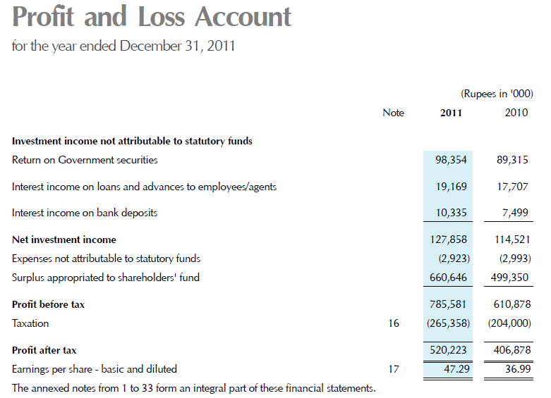
http://www.statelife.com.pk/doc/State_life_AR_(1_to_32).pdf

Slide 17
Comparing Takaful to Conventional Insurance
Issue | Conventional Insurance | Takaful
Organization Principle | Profit for shareholders | Mutual for participants
Basis | Risk Transfer | Co-operative risk sharing
Value Proposition | Profits maximization | Affordability and spiritual satisfaction
Laws | Secular/Regulations | Sharia plus regulations
Ownership | Shareholders | Participants
Management status | Company Management | Operator
Form of Contract | Contract of Sale | Cooperative, Islamic contracts of Wakala or Mudarbah with Tabar’ru (contributions)
Investments | Interest based | Sharia compliant, Riba-free
Surplus | Shareholders’ account | Participants’ account

Slide 18
Islamic Insurance (Takaful)

Slide 19
Meaning of Takaful
Takaful is derived from the Arabic word ‘Kafala’ which mean guarantee.
Takaful means mutual protection and joint guarantee.
Takaful refer to mutual contribution of funds or to create a pool of funds to compensate or protect the participants against any accident or loss.

Slide 20
Shariah Legitimacy from Quran
And cooperate in righteousness and piety, but do not cooperate in sin and aggression. And fear Allah; indeed, Allah is severe in penalty. (5:2)
Takaful is a form of mutual help (ta’awun) in extending virtue by helping others who are in need / in hardship .

Slide 21
Shariah Legitimacy from Hadith
Prophet (pbuh) has said, “tie the camel first, then put your trust in Allah” (At-Tirmidhi)
The hadith implied a strategy to mitigate/reduce risk.
Takaful provides a strategy of risk mitigation or reduction by virtue of collective risk taking that distributes risks and losses to a large number of participants.

Slide 22
Judicial Opinions and Fatwas confirming validity of Takaful
Fatwa issued in Judicial Conference held in Makkah in Shaban 1398 AH.
Verdict of Supreme Court of Egypt on Dec. 27, 1926.
Unanimous resolutions and fatwa by Ulama in the Muslim League Conference in Cairo in 1965.
Unanimous decision by Muslim Scholars in seminar held in Morocco on May 6, 1972.

Slide 23
Judicial Opinions and Fatwas confirming validity of Takaful
Fatwa issued by Higher Council of Saudi Arabia in 1397 A.H.
Fatwa Issued by the Fiqh Council of Muslim World League in 1398 A.H.
Fatwa issued by the Fiqh Council of the OIC in 1405 A.H. (1985).

Slide 24
Fiqh Academy Resolution 1985
Islamic Fiqh Academy Jeddah (Dec 1985) issued a Resolution which in summary stated the following:
The commercial Insurance contract… is prohibited (Haram) according to the Shariah.
The alternative Takaful contract which conforms to the principles of Islamic dealings is Halal, being the contract of cooperative insurance, which is founded on the basis of charitable donation and Shariah compliant dealings.

Slide 25
Shariah Legitimacy from Scholars
Dr. Yusuf al Qaradawi a famous Egyptian scholar says,
“Our observation that the modern form of insurance companies and their current practices are objectionable Islamically, does not mean that Islam is against the concept of insurance itself; not in the least – it only opposes the means and methods. If other Insurance practices are employed which do not conflict with Islamic forms of business transaction, Islam will welcome them.”

Slide 26
Decision by Council of Islamic Ideology of Pakistan
The council of Islamic Ideology of Pakistan gave a decision in December 1983, according to the decision
“the contract of Insurance in all its forms, is unlawful, corrupt, false, prohibited and promulgatable.”

Slide 27
Basic Principle behind Takaful
The principle of “fortunate many helping the unfortunate few" is a concept recognized by Islam.

Slide 28
Features of Takaful
Firstly, the participation into a Takaful fund must be performed with utmost sincerity in order to help those faced with difficulties.
Every policy holder would pay his/her subscription in order to assist those who need assistance
Any member or participant suffering a catastrophe or disaster would receive a certain sum of money or financial benefit from a fund, as also defined in the pact, to help him meet the loss or damage

Slide 29
Basic Elements of Takaful
Mutuality and cooperation.
Takaful contract pertains to Tabarruat as against muawadat (contract of exchange) in case of conventional insurance.
Payments made with the intention of Tabarru (contribution)
Eliminates the elements of Gharrar, Maisir and Riba.

Slide 30
Basic Elements of Takaful
Wakalah/Mudarabah basis of operations.
Joint Guarantee / Indemnity amongst participants – shared responsibility.
Constitution of separate “Participants’ Takaful Fund or participant special account (Tabarru / Waqf fund)”.
Constitution of “Shariah Supervisory Board.”
Investments as per Shariah.

Slide 31
Main drivers of Takaful
Piety (individual purification)
Brotherhood (mutual assistance)
Charity (Tabarru or contribution)
Mutual Guarantee
Community well-being as opposed to profit maximization.

Slide 32
Summary of the Lecture
In this lecture we studied the following topics:
Concept of Insurance and Takaful
Objections against conventional Insurance system
Difference between Takaful and conventional insurance
Features of Takaful or Islamic insurance

