Slide 1
Evolution of Islamic Banking in Pakistan

Slide 2
Summary of the Previous Lecture
In previous lecture we covered the following topics
Operations of Takaful
Uses of Takaful
Takaful Model
Wakalah model
Mudarabah model
Hybrid model (Wakalah and Mudarabah)
Takaful types and documents

Slide 3
Wakala Model
Cooperative risk sharing occurs among participants where a takaful operator earns a fee for services (as a Wakeel or Agent) and does not participate or share in any underwriting (guaranteeing) results as these belong to participants as surplus or deficit. Under the Al- Wakala model, the operator may also charge a fund management fee and performance incentive fee.

Slide 4
Wakalah Model
Shareholder’s fund
Wakalah fee
e.g. 30%
Investment
Contribution received from the participants
Profit from Investment
Minus
General Takaful Fund
As a gift or manner deemed fit by the Takaful company
Expenses
Claim
Net Surplus
Tabarru Contribution
e.g. 70%
Retakaful
Cancellation
Reserve

Slide 5
Mudaraba Model
The surplus is shared between the participants with a takaful operator. The sharing of such profit (surplus) may be in a ratio of 50% each or 60% and 40% etc. as mutually agreed between the contracting parties. Generally, these risk sharing arrangements allow the takaful operator to share in the underwriting results from operations as well as the favorable performance returns on invested premiums.

Slide 6
Mudarabah Model
Shareholder’s fund
30% e.g.
Investment
Profit from Investment
70%
Participant’s Account
Withdrawals
Death
Contribution received from the participants
Payable to participa-nts
Surrender
Maturity
Participant's Special Account
Net Surplus
Minus
Claim
Retakaful
Reserve

Slide 7
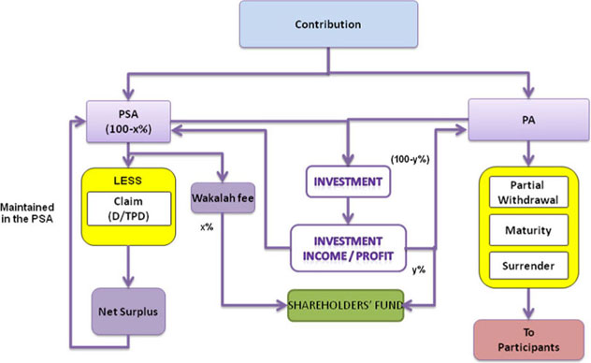
Hybrid Model (Wakalah and Mudarabah
D – Death, TPD – Total permanent disability, PA – Participant’s Account, PSA – Participant’s Special Account (Tabarru Fund or Waqf fund)

Slide 8
Learning outcomes
After this lecture you will be able to understand the following topics;
Islamic banking in Pakistan
Social and political background
History of Islamic banking in Pakistan
Islamic banking operations in Pakistan
Some facts and figures about Islamic banking in Pakistan

Slide 9
ISLAMIC BANKING IN PAKISTAN
Most of the Muslim countries were colonized by the western powers and inherited the conventional banking system mainly facilitating the import export requirements of the foreign businesses.
Local population was reluctant to use the services of those banks in the beginning but with the passage of time commercial banking became highly important for the trade activities.
Contrary to the Sharia requirements commercial banks were established and kept on expanding their businesses and networks in the country.

Slide 10
Social and Political Background
According to the World Fact Book, Pakistan is a home of about 190 million people, 96.4% Muslims and 3.6% non Muslims.
Variety of ethnic groups with different language, culture and history.
Common things are the religion and national language Urdu.
Before partition the British ruled the area and took the power from the then ruling Muslim rulers. Because of this reason Muslims were the victims of the British government and were kept away from many opportunities (education, trade, and economic activities)
At the time of partition literacy rate was very low in Pakistan and majority of population (82.7%) was based in rural areas.

Slide 11
Social and Political Background
A small number of elite is controlling the nations wealth and the state, 22 families owned 66% of the industrial wealth and controlled 87% of the assets of the banking and insurance companies. (Dr. Mehbulul Haq; April 1968)
Corruption in Pakistan is widespread, particularly in the government and lower levels of police forces. The country has had a consistently poor ranking at the Transparency International's Corruption Perceptions Index with scores of 2.5 in 2011, 2.3 in 2010, and 2.5 in 2009 out of 10. In 2011, Pakistan ranked 134 on the index with 42 countries ranking worse. In 2012, Pakistan's ranking dropped even further from 134 to 139, making Pakistan the 34th most corrupt country in the world, tied with Azerbaijan, Kenya, Nepal, and Nigeria.

Slide 12
Social and Political Background
Corruption is estimated to be at least Rs. 500 billion. annually, which amounts to 90 per cent of the budget (More liberal estimates give Rs. 1500 billion, which is 75 per cent of the GDP). (Prof. Khurshid Ahmad 1998)
According to calculations performed by Transparency International, Pakistan has lost an unbelievably high amount, more than Rs8.5 trillion (US $94 billion), in corruption, tax evasion and bad governance during the last four years of Prime Minister Yousuf Raza Gillani’s tenure.

Slide 13
Social and Political Background
An adviser of Transparency International acknowledged that "Pakistan does not need even a single penny from the outside world if it effectively checks the menace of corruption and ensures good governance".
The Transparency International also noted that the four years of the present regime under Gilani had been the worst in terms of corruption and bad governance in the country’s history. NAB chairman declared that corruption to the tune of 40 billion US dollars was being done annually in the country.

Slide 14
Social and Political Background
As a consequence it is highly required to implement an economic system that can take care of the deprivations.
Consequently few attempts were made to share the economic wealth among the nation like Z.A Bhutto's nationalization during 70's; and Ziaul Haq during 80's and now the State Bank is assigned the responsibility to provided Islamic Financial system in the country.

Slide 15
History of Islamic Banking in Pakistan
Council of Islamic Ideology (CII) was appointed the task to prepare a draft of Interest free economy in 1977.
In February 1979 President announced that interest will be removed from the economy in a period of 3 years. At the first step House Building Finance Corporation (HBFC), National Investment Trust (NIT), and Mutual Funds Investment Corporation (MFIC) were selected for removal of interest in their operations.

Slide 16
History of Islamic Banking in Pakistan
CII advised reduction of dependence on interest bearing foreign loans as it was not possible to eliminate interest in it, techniques of PLS and Qard e Hasna.
In 1981 government ordered banks to establish separate counters for deposit on PLS basis; and it continued till June 1985.
Government announced the discontinuation of the parallel systems from July 1985.

Slide 17
History of Islamic Banking in Pakistan
The movement towards the interest free economy suffered a setback when in August 1985 banks were allowed to invest even their Profit and Loss sharing deposits in interest bearing government securities.
In 1991 the Federal Shariah Council declared the procedure adopted by the banks in 1985 as un-Islamic.

Slide 18
History of Islamic Banking in Pakistan
In response the government and some banks made appeals to the Shariah appellate Bench of the supreme court of Pakistan. In 1999 the Shariah Appellate Bench of Supreme court rejected the appeals and directed all laws on interest banking to be ceased.
The government set up a high level commission, task forces and committees to institute and promotes Islamic Banking on a parallel basis with the conventional banking system.

Slide 19
History of Islamic Banking in Pakistan
In 2004 the State Bank of Pakistan (SBP) established a dedicated Islamic Banking Department (IDB) and established a Shariah Board to regulate and approve guidelines for the emerging Islamic Banking industry.

Slide 20

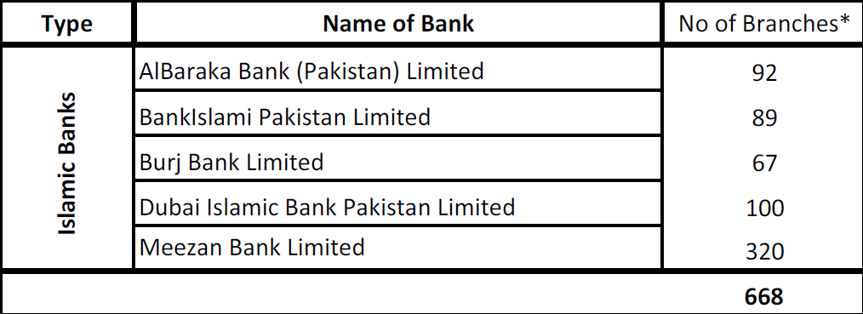
Islamic Banks Operating in Pakistan

Slide 21
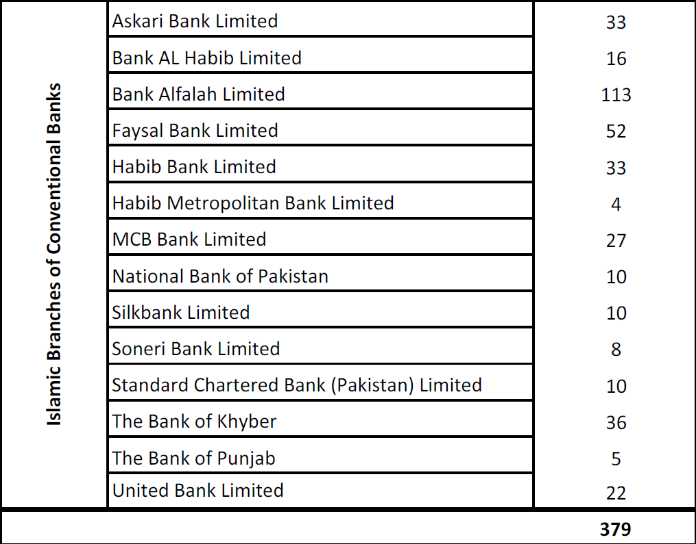
Islamic Branches of Conventional Banks

Slide 22
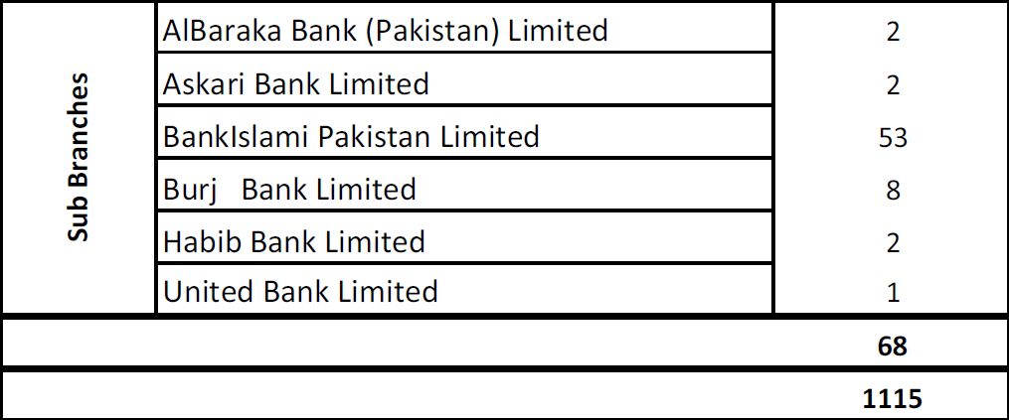
Sub Branches of Different Banks
Total number of branches (Islamic & Conventional banks)

Slide 23
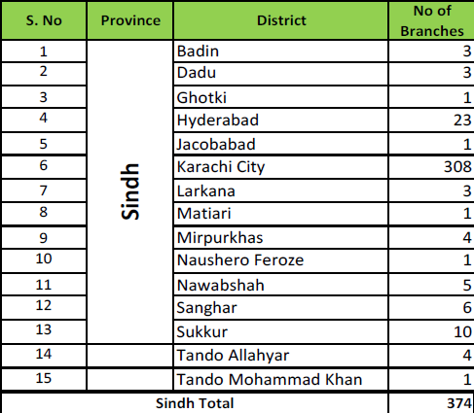
District Wise Islamic Banking Branches

Slide 24
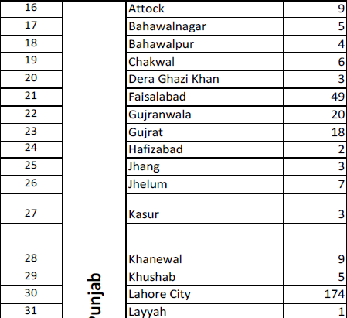
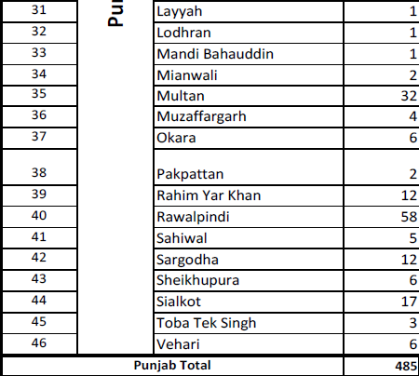
District Wise Islamic Banking Branches
Punjab
Punjab

Slide 25
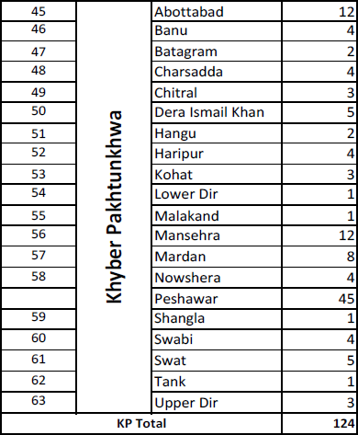
District Wise Islamic Banking Branches

Slide 26
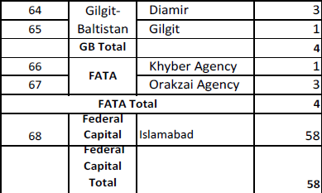
District Wise Islamic Banking Branches

Slide 27
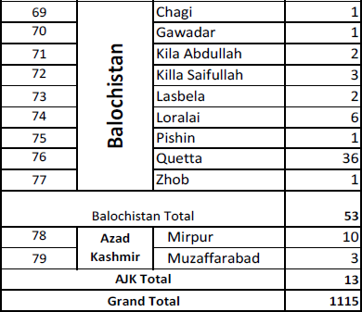
District Wise Islamic Banking Branches

Slide 28
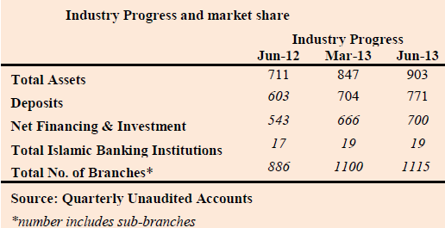
Islamic Banking Industry and Market Share

Slide 29
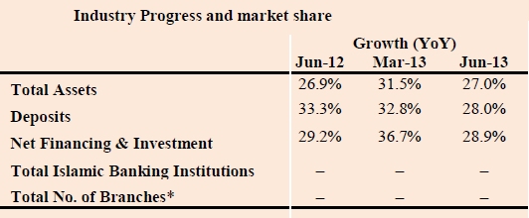
Islamic Banking Industry and Market Share

Slide 30
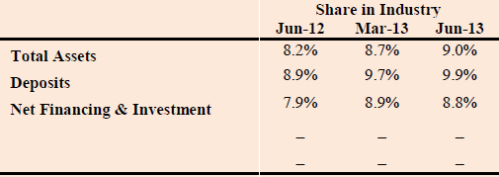
Islamic Banking Industry and Market Share

Slide 31
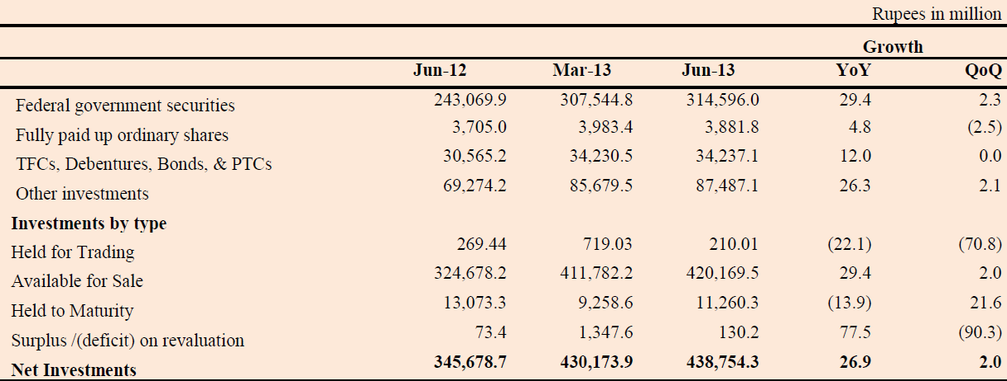
Investments

Slide 32
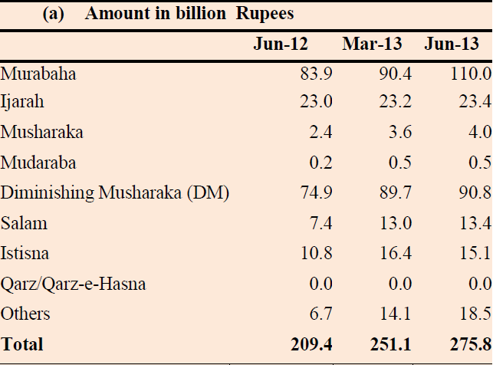
Financing Mix

Slide 33
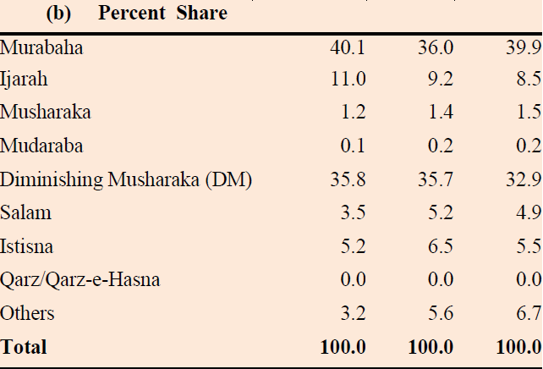
Financing Mix

Slide 34
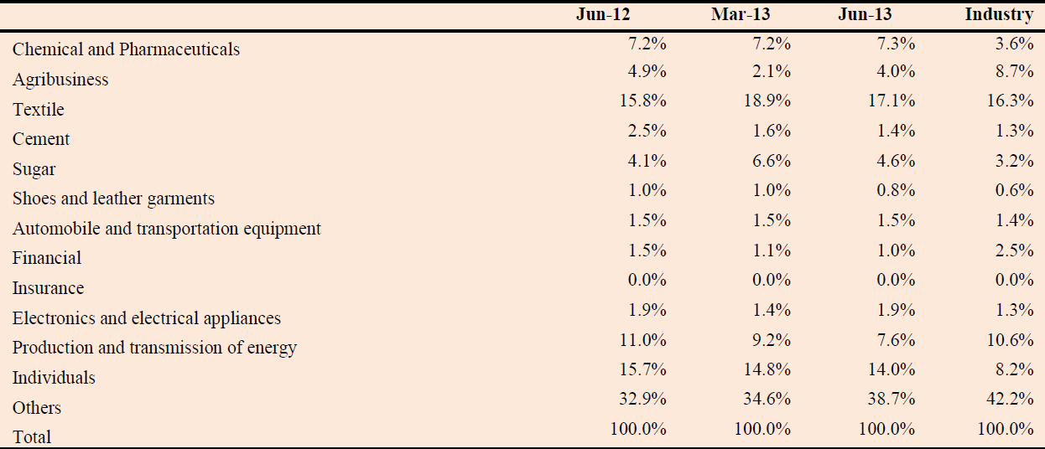
Financing Concentration – Percent share

Slide 35
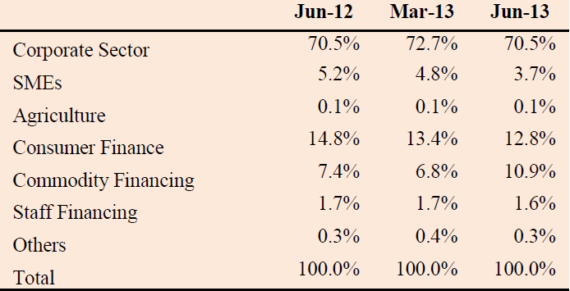
Client Wise Financing Portfolio – (Share Percent)

Slide 36
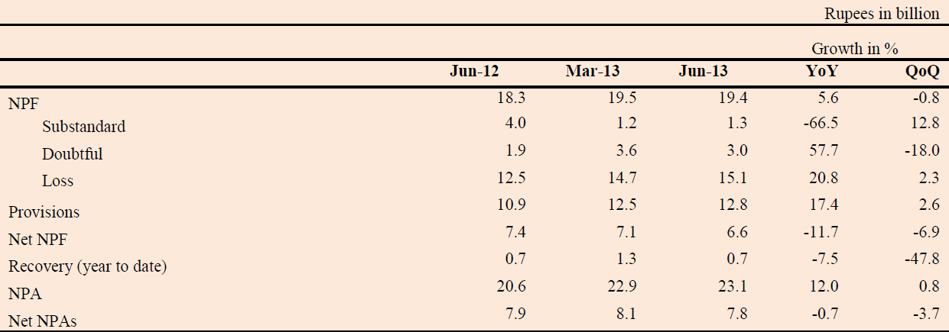
Non Performing Financing and Assets

Slide 37
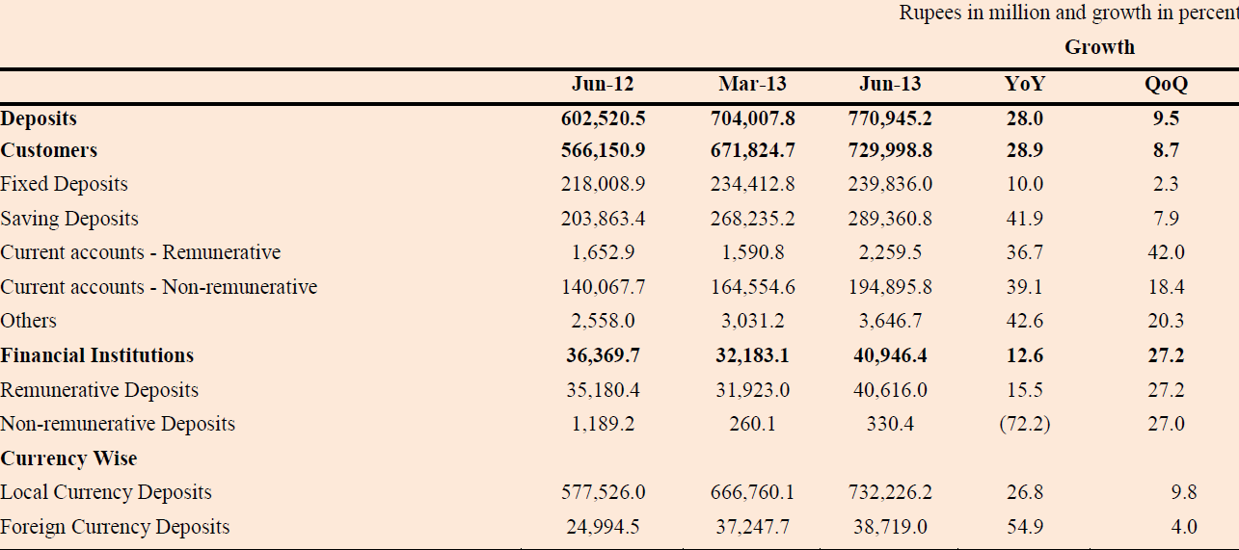
Break up of Deposits

Slide 38
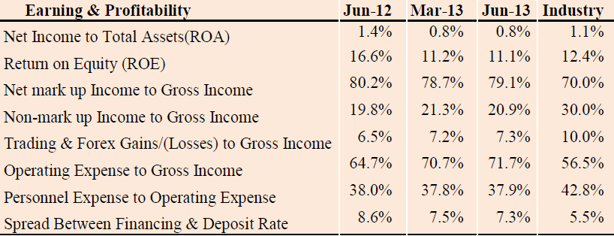
Earning and Profitability

Slide 39
Summary of the Lecture
In this lecture we tried to understand
The introduction and evolution of Islamic banking in Pakistan.
Facts and figures reflecting the performance of Islamic banks.

