Slide 1
Course Revision
From Lecture 2 to 6

Slide 2
Summary of the Previous Lecture
In the previous lecture we discussed the evolution of Islamic banking system in Pakistan.

Slide 3
Learning outcomes
In this lecture we will have a revision of lectures we have studied before and it will help better understand the concepts and eliminate confusions.

Slide 4
Lecture 2: Salient Features
Allah is the Sustainer
God is Real Owner of Everything and Man is Merely a Trustee
Everything Created for Service and Use of Man
Concept of Halal and Haram
System of Sadaqat and Zakat
Prohibition of Interest
Ban on Hoarding of Wealth
Policy of Moderation
Condemnation of Monasticism and Materialism
Equity and not Equality

Slide 5
Lecture 3 Principle of Islamic Economic System
Money as potential capital
Prohibition of Interest
Risk Sharing
Sanctity of Contracts
Sharia Approved Activities
Individual Liberty
Right to Own Property
Economic Inequality and Charity
Social Equality
Circulation of Wealth

Slide 6
Lecture 4 Introduction
Economic problems of mankind have always been a key issue in the history. Every nation on the face of the earth irrespective of its belief and ideology strives to achieve at least a reasonable level of economic and social well being as per its ambitions.
This quest to resolve the economic problems have resulted in many economic systems; but they have either completely failed or partially succeeded in finding an equitable and balanced solution. Islam has also provided an economic system to keep the economic life of the individual and nation as a whole on the lines of equity and prosperity.

Slide 7
Lecture 4 Why Do We Need an Economic System?
To engage in economic activities peacefully is vital to our survival
To earn the reward of ones labor, expertise, and efforts
A market place that determines our demand and supply phenomenon in a free and fair environment
A system that ensures labor rewards and eradicate the curses like slavery and victimization

Slide 8
Lecture 4 Why do we need an economic system?
A system that accommodates the innovative ways of doing things (trading over the internet without having sophisticated infrastructure)
To ensure self satisfaction, achievement and security
To raise the quality of life and living standard to a level where no body would feel deprived.

Slide 9
Lecture 4 The existing economic system?
Some of the known economic systems are;
Capitalism
Socialism
Communism
Islamic economic system

Slide 10
Lecture 4 Capitalism
A system based on private ownership of factors of production
A system based on economic freedom
A free market economy that will determine the demand and supply of the system and rewards based on individual’s skills, ability, and effort.
A system that operates more close to human psychology of ownership and liberty.

Slide 11
Lecture 4 Capitalism
Types of Capitalism
Degree of competition, role of the government interventions and regulations, and scope of public ownership leads towards various forms of capitalism, i.e.
Laissez-faire capitalism
Welfare Capitalism
State Capitalism

Slide 12
Lecture 3 1. Laissez-faire capitalism
Laisser-faire is an economic environment in which transactions between private parties are free from government restrictions, tariffs, and subsidies, with only enough regulations to protect property rights.

Slide 13
Lecture 4 2. Welfare Capitalism
Welfare capitalism refers to capitalist economies that include comprehensive social welfare policies. Alternatively, welfare capitalism refers to the practice of businesses providing welfare services to their employees.

Slide 14
Lecture 4 3. State Capitalism
State capitalism is characterized by the dominance of state-owned business enterprises in the economy.
An economic system in which commercial economic activity is undertaken by the state, with management and organization of the means of production in a capitalist manner - maintaining the conditions of wage labor arising from centralized ownership.

Slide 15
Lecture 4 Advantages of Capitalism
Proponents of capitalism argue that it creates more prosperity than any other economic system, and they claim that its benefits are mainly to the ordinary person.

Slide 16
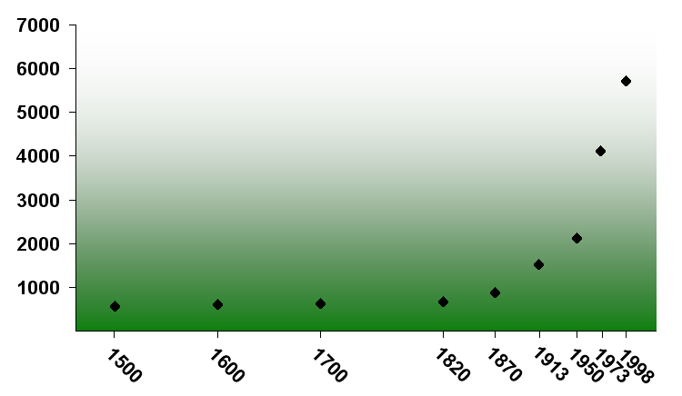
World GDP per capita between 1500 and 1998 expressed in the 1990's International dollars
Graph is derived from data in Table B-18. (World GDP) and Table B-10. (World Population) published in The World Economy: A Millennial Perspective by Angus Maddison, OECD, Paris 2001 ISBN 92-64-18998-X (http://en.wikipedia.org/wiki/Capitalism)

Slide 17
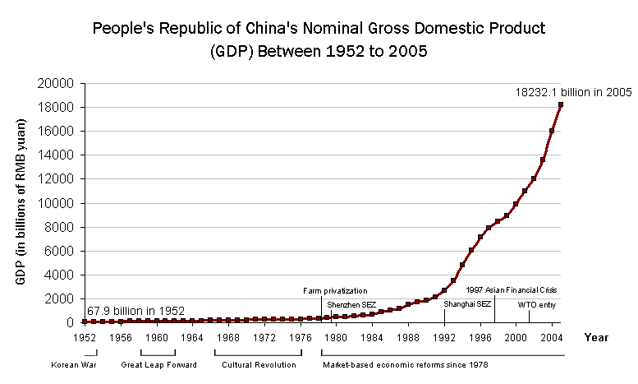

Slide 18
Lecture 4 Advantages of Capitalism
Increasing GDP per capita has resulted in
Improved living standard
Availability of basic needs of the society, i.e. food, housing, clothing, and health care.
More opportunities for the entrepreneurs to initiate new business ventures.

Slide 19
Lecture 4 Advantages of Capitalism
Right to own factors of production
Profit maximization
Economic freedom, free market and competition (if healthy competition it leads towards economic growth and innovation)
Banking and financial institutions and markets for smooth international transactions

Slide 20
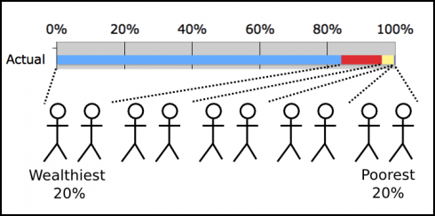
Lecture 4 Disadvantages of Capitalism
Disparities in distribution of wealth
Actual U.S. distribution of wealth. Data from Holder and Arieli (2011)

Slide 21
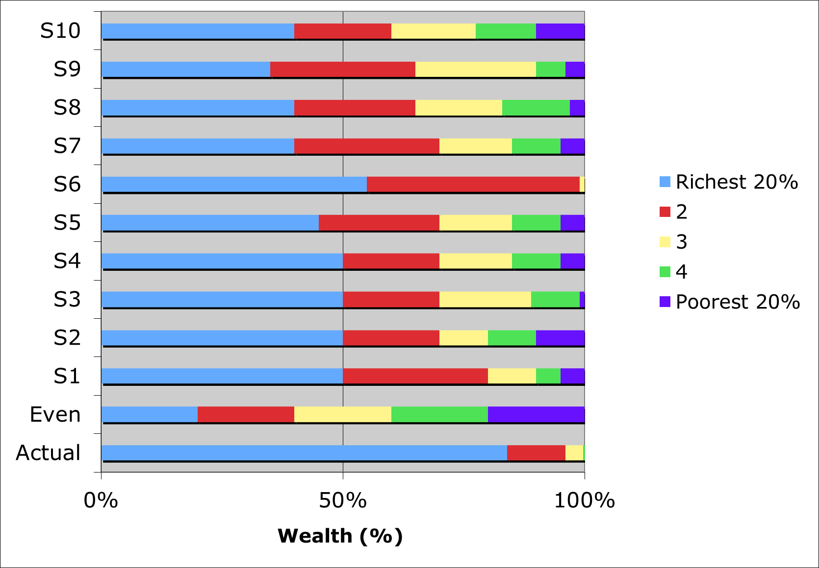
Distribution of Wealth among Households in 2011
Exercise on distribution of wealth by Lensyl Urbano with student groups
http://montessorimuddle.org/2011/03/03/exercise-on-wealth-distribution/

Slide 23
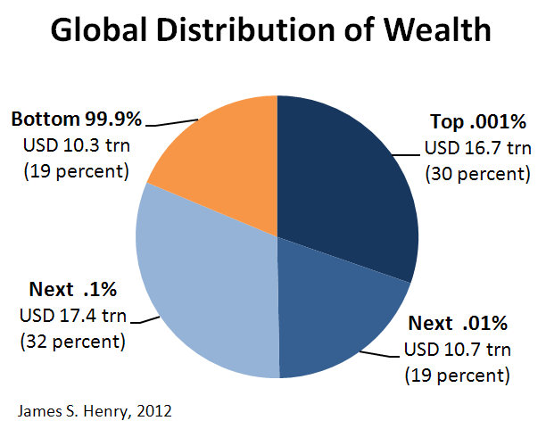
http://www.taxjustice.net/cms/upload/pdf/The_Price_of_Offshore_Revisited_Presser_120722.pdf

Slide 24
Lecture 4 Disadvantages of Capitalism
Unrestricted and uncontrolled economic freedom and uncontrolled right of private ownership has resulted in exploitation.
Labor is exploited by the capitalist
Farm worker is exploited by the landlord
Poor is exploited by the rich
Servant is exploited by the master
People are exploited by the rulers
Wealth is the objective of everyone through fair or foul means.

Slide 25
Lecture 4 Disadvantages of Capitalism
Cut throat competition in the market leads towards the mergers of smaller businesses into big organizations and thus monopolize the market.
Monopoly results in inflation and create obstacles for the new businesses thus leads to unemployment.

Slide 26
Lecture 4 Islamic Economic System Versus Capitalism
Right to own property
Capitalism believes in the private ownership of the means of production, distribution and exchange which are managed and controlled by individuals or groups of individuals for private profit. And it leads to the concentration of wealth in few hands.
Islamic concept of ownership is unique, i.e. Allah is the real owner of everything.
Islam allows legal ownership subject to moral obligations.
Laws of inheritance also distribute the wealth among the heirs to avoid concentration of wealth.

Slide 27
Lecture 4 Islamic Economic System Versus Capitalism
Economic Freedom
In Capitalism Every individual has an unbridled liberty to engage in any kind of profitable businesses moral or immoral such as gambling, prostitution, smuggling, black marketing, profiteering, hoarding, speculation, fraud, adulteration, etc. Wealth becomes the religion and faith which lead to selfishness, hatred, mistrust, etc.
Islam allows freedom but within the bounds of Shariah. Halal and Haram are made clear in all economic activities. Interest, bribery, embezzlement, prostitution, sale of wine, narcotics, short weighing and measuring, gambling, speculation, monopoly, extravagant spending, etc. are not allowed in Islam.

Slide 28
Lecture 4 Islamic Economic System Versus Capitalism
Monopoly
Under capitalism greed of wealth leads the businesses to monopolize the markets and charge higher prices and leads to the destruction of small businesses which result in unemployment.
Islam strictly forbids unhealthy competition and monopolies. Prophet (pbuh) said, “whoever monopolies is a sinner.” Commodities and services of common interest are strictly not allowed to be monopolized.

Slide 29
Lecture 4 Islamic Economic System Versus Capitalism
Institution of Banking and Interest
Interest based financial institutions are the back bone of the capitalism. Financial institutions or banks are the sources of capital for all the business activities.
Islam categorically condemns the interest based businesses and institutions rather it encourages trade.

Slide 30
Lecture 4 Islamic Economic System Versus Capitalism
Exploitation
In a capitalist society every dominant part of the society (with few exceptions) exploit the poor or weak in the society.
Islam strictly prohibits every tool of exploitation such as usury, bribery, gambling, etc. The weaker classes of the society like women, orphans, slaves, laborers, tenants, consumers, etc. have been protected against their exploiters through legislation by Islam.

Slide 31
Lecture 4 Islamic Economic System Versus Capitalism
Distribution of wealth
In capitalism polarization into rich and poor takes place in the society. People are divided into different classes based on the wealth they possess. It can result into chaos and riots among the people in the society.
Islam ensures fair and equitable distribution of wealth and economic resources. System of Zakat and Sadqat is in place, hoarding of wealth is prohibited

Slide 32
Lecture 5 Major Differences among the Systems
1. Liberty to Earn
Capitalism is a voluntary economic system where people trade in a free market and earn product of their labor and can trade it against the product of others labor. Unbridled liberty leads to so many immoral activities that cause the destruction of the health, moral values and economic conditions of the nations.
In Communism and socialism (to a large extent) the product of peoples labor is confiscated by the state to distribute it equally among the public. People have to lose their earning in a coercive environment, e.g. many Ukrainian farmers were killed because they tried to conceal the grains of their sustenance.
Islamic economic system allows individuals to operate in a free market but all the activities should be Sharia Compliant.

Slide 33
Lecture 5 Major Differences among the Systems
2. Liberty to own
Capitalism allows the people to own as much they can and lust to accumulate more and more wealth leads towards unfair means of earning and an imbalance is the distribution of wealth.
Communism and socialism restrict the right of ownership, in communism no individual has the right to own property.
Islam allows the people to own property as much they want but with the unique concept that Allah is the owner of everything; and holds the followers accountable regarding the legality of property (Sharia compliance and also apply obligatory taxes like Zakat and encourages Sadaqat).

Slide 34
Lecture 5 Major Differences among the Systems
3. Distribution of wealth
Capitalism leads to unfair distribution of wealth (as discussed in the previous lecture) which creates so many social problems.
Socialism and communism claim equal distribution of wealth which is against the laws of nature, as it will limit the desire to work.
Islam allows the people to earn using Halal means and get rich, also Islam allows the people to be poor and rich but not to the extent that it create classes in the society.

Slide 35
Lecture 5 Major Differences among the Systems
4. Reward of labor in Capitalism Socialism and Islamic Economic System
Capitalism, Socialism and Islamic economic system recognizes the hard work of the laborers by paying them accordingly, where as communism doesn’t recognize it. Recognition and sense of achievement makes people more productive and innovative.

Slide 36
Lecture 5 Major Differences among the Systems
5. Innovativeness of the system
Freedom of production and marketing, sense of achievement and recognition in Islamic economic system and Capitalism result in more sophisticated, innovative and useful products in the economy.
Socialism and Communism being controlled form of economies where state determines what to produce, how much to produce and for whom to produce, leads to stagnation and low growth in the economy

Slide 37
Lecture 5 Major Differences among the Systems
6. Social Structure
Socialism and Communism diminishes and eliminate the class distinctions; Islam also doesn’t believe in class system rather sets the piety as the standard of being respectable.
Capitalism on the other hand has created classes in the societies based on the level of wealth people possess.

Slide 38
Lecture 5 Major Differences among the Systems
7. Ways of Change
In Socialism and Communism governments and workers are the agents of change and they even control the ideologies and desires of the people.
In Capitalism free market would determine the change in production, while government only regulates the business practices.
Islam allows change through the forces of the market provided that it doesn’t go against the religious and moral values of the society.

Slide 39
Lecture 5 Major Differences among the Systems
8. Religion
Capitalism, Socialism, and Islam give the people right to follow the religion.
Communism bans the religion, which is against the human nature. Majority of the people in the world do have a religion or want to follow the religion.

Slide 40
Lecture 6 Money in Islam
Please watch the video again, it will help understand the concept of evolution of money and how it is creating and promoting debt in the economy.

Slide 41
Lecture 6: Deposit Multiplication
Deposit = 100,000
Fractional Reserve Requirement = 10%
Reserve = 10% | Loan = Deposit
10,000 | 90,000
9000 | 81,000
8100 | 72,900
7290 | 65,610
6561 | 59,049
5904.9 | 53,144
5314.41 | 47,830
4782.969 | 43,047
4304.6721 | 38,742
3874.20489 | 34,868
3486.784401 | 31,381
3138.105961 | 28,243
2824.295365 | 25,419
2541.865828 | 22,877
2287.679245 | 20,589
- | -
- | -
100,000 | 900,000

Slide 42
Summary of the Lecture
In this lecture we revised the course from lecture 2 to 6.

