Slide 1
Revision of Lectures 23 to 27

Slide 2
Summary of the Previous Lecture
We revised following topics in the previous lecture
Ijarah
Applications of Islamic Finance
Islamic Investment Funds
Sukuk

Slide 3
Risk
Existence of uncertainty about future outcomes
Difference between expected and actual result
Uncertainty can be classified as general and specific
General: ignorance of any potential outcome, e.g. after the investment in stocks of a company, the company goes default.
Specific: when probabilities can be assigned to potential outcomes—this is usually referred to as risk, e.g. depending upon the financial conditions of the company what are chances of default.

Slide 4
Risks
Risk is measured by the variability or volatility of outcomes using statistical tools like variance or standard deviation.
Costs involved with higher volatility can lead to bankruptcy

Slide 5
Risk
Objectives of risk management
To reduce volatility in the probable outcomes.
To eliminate costly lower tail outcomes
To maintain a certain risk profile
The value maximization

Slide 6
Risk
Classification of Risks
Business risks and financial risks
Business risk relates to uncertainty arising from the nature of firm’s business, e.g. decreased revenues, higher costs, high turnover, etc.
Financial risks relates to movements in the financial market (Interest rates, economic conditions, etc.)
Systematic risk and unsystematic risks
Systematic risk is associated with overall market
Unsystematic risk is linked to the specific asset or firm

Slide 7
Total Risk = Systematic Risk + Unsystematic Risk
Systematic Risk
Factors such as changes in nation’s economy, tax reform by the government, or a change in the world economic situation or the exchange rate movements.
STD DEV OF PORTFOLIO RETURN
Unsystematic risk
Total
Risk
Systematic risk
NUMBER OF SECURITIES IN THE PORTFOLIO

Slide 8
Total Risk = Systematic Risk + Unsystematic Risk
Unsystematic Risk
Factors unique to a particular company or industry. For example, the death of a key executive or strike by the employees of the company.
STD DEV OF PORTFOLIO RETURN
Unsystematic risk
Total
Risk
Systematic risk
NUMBER OF SECURITIES IN THE PORTFOLIO

Slide 9
Risks faced by Financial Institutions
1. Market Risks
Interest rate/benchmark risk
Equity price risk
Asset/Commodity price risk
Currency risk (Foreign exchange rates)
2. Credit Risks
Trade credit (settlement) risk
Counter party risk

Slide 10
Risks faced by Financial Institutions
3. Liquidity risk
Funding liquidity risk (the ability to settle obligations immediately when they fall due)
Trading liquidity risk

Slide 11
Risks faced by Financial Institutions
4. Operational risk
People risk (employees turnover)
Technology risk (rapidly changing cost efficient technologies)
Process risk (Obsolete process)
Legal and regulatory risks

Slide 12
Unique Risks in Islamic Banks
1. Contractual Nature of Deposits
PSIA — Mudarabah contracts
Demand deposits— Qard-e-Hasana
2. Fiduciary (trust) risk—PSIA are fiduciary contracts
Lower rate of return than conventional banks or non-compliance with Sharia can be interpreted as breach of contract – fiduciary risk
3. Withdrawal Risk
Lower returns may lead to withdrawal of deposits. To avoid such situations returns (dividends) from shareholders are transferred to depositors-transfer of risks associated with deposits to equity holders.

Slide 13
Unique Risks in Islamic Banks
4. Using PSIA as capital
Difference between restricted and unrestricted PSIA
5. Risks in Islamic financial instruments
As modes are asset-backed or equity based, market risks are important along with credit risks
Market and credit risks intermingle and transform from one kind to another at different stages of transaction

Slide 14
Unique Risks in Islamic Banks
6. Operational Risks
Person risk—lack of qualified human resource who understand/manage risks in Islamic banking
Technology risk - computer software's and IT for IBs
Legal risks
Standardization of contracts
Lack of legislative act and enforcement institutions

Slide 15
Risks in Islamic financial instruments
To understand the risks in Islamic financial instruments, we look at:
The risks at various stages of the transaction: beginning, during, and at the conclusion.
Classify CR and MR according to:
possession time(spot/future)
liquidity of asset/wealth (asset/cash).

Slide 16
Risk classification according to wealth type and time period
Wealth Type | Possession time period
 | Current/spot | Future
Cash | No risks (NR) | CR
Asset | MR | CR/MR

Slide 17
Risk Profile of Murabaha
Product | Beginning of transaction | Transaction period | Conclusion of transaction
Murabaha (non-binding) | IFI buys good, delivery not ensured—MR | Price due—CR | IFI receives cash—NR
Murabaha (binding) | IFI buys good, delivery ensured –NR | Price due—CR | IFI receives cash—NR

Slide 18
Risk Profile of Ijarah and Ijarah wa Iqtina
Product | Beginning of transaction | Transaction period | Conclusion of transaction
Ijarah | IFI buys asset—MR | Rent due—CR | Asset remains with IFI –MR
Ijarah wa iqtina | IFI buys asset—MR | Rent due—CR | Asset transferred—NR

Slide 19
Risk Profile of Salam
Product | Beginning of transaction | Transaction period | Conclusion of transaction
Salam | Necessary cash is forwarded as price—CR | Good due—CR | IFI receives good—MR
Parallel Salam | Necessary cash in hand, and commits to sell good—NR | Good due—CR | IFI receives good, delivers good—NR

Slide 20
Risk Profile of Istisna
Product | Beginning of transaction | Transaction period | Conclusion of transaction
Istisna | IFI commits to manufacture asset. | Cost of production—MR Price due—CR | IFI delivers asset and receives cash –NR
Parallel Istisna | IFI commits to manufacture asset, subcontracts. | Price due—CR Seller delay in delivery/not according to specification—CPR | Seller delivers asset, IFI delivers asset, receives cash –NR

Slide 21
Risk Profile of Mudarabah and Musharakah
Product | Beginning of transaction | Transaction period | Conclusion of transaction
Mudarabah | IFI invests (buys non-voting shares) | Profit share/return due—CPR | Principal due: Cash—NR Equity—MR
Musharakah | IFI invests (buys voting shares) | Profit share/return due—CPR | Principal due: Cash—NR Equity—MR
Diminishing Musharakah | IFI invests (buys voting shares) | Profit share/return due—CPR | Asset/equity transferred—NR

Slide 22
TAKAFUL
THE ISLAMIC INSURANCE

Slide 23
What is Insurance
Insurance provides the means for people to transfer the burden of uncertainty (of financial loss) to the insurer, for an agreed financial consideration called the premium
The insurer promises to provide financial compensation to the insured should a specified loss occur.
Its an effective risk transfer mechanism by which individuals or organizations can exchange the uncertainty of financial loss (or risk) for the certainty of premium.

Slide 24
What is Insurance
Insurance in fact is an act of taking precautionary measures against possible dangers/losses arising out of uncertain events.
Muslim traders used to travel across the continents and their voyages often faced troubles and incurred losses. To protect them from the possible losses Arab traders used to insure their caravans in the second century of Islamic era.

Slide 25
Objections to Conventional Insurance
Scholars view the insurance contract as an exchange contract – money is exchanged for money over time.
This brings about the problem of gharrar (which leads to maisir) and in investments aspect, riba.
Elements of:
Uncertainty – Gharrar
Gambling – Maisir
Interest – Riba
Investment Profit belongs to the Company

Slide 26
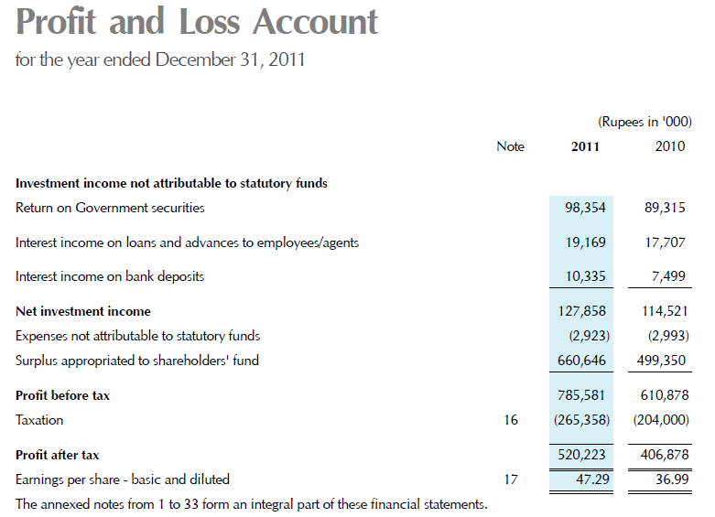
http://www.statelife.com.pk/doc/State_life_AR_(1_to_32).pdf

Slide 27
Meaning of Takaful
Takaful is derived from the Arabic word ‘Kafala’ which mean guarantee.
Takaful means mutual protection and joint guarantee.
Takaful refer to mutual contribution of funds or to create a pool of funds to compensate or protect the participants against any accident or loss.

Slide 28
Decision by Council of Islamic Ideology of Pakistan
The council of Islamic Ideology of Pakistan gave a decision in December 1983, according to the decision
“the contract of Insurance in all its forms, is unlawful, corrupt, false, prohibited and promulgatable.”

Slide 29
Basic Principle behind Takaful
The principle of “fortunate many helping the unfortunate few" is a concept recognized by Islam.

Slide 30
Features of Takaful
Firstly, the participation into a Takaful fund must be performed with utmost sincerity in order to help those faced with difficulties.
Every policy holder would pay his/her subscription in order to assist those who need assistance
Any member or participant suffering a catastrophe or disaster would receive a certain sum of money or financial benefit from a fund, as also defined in the pact, to help him meet the loss or damage

Slide 31
Basic Elements of Takaful
Mutuality and cooperation.
Takaful contract pertains to Tabarruat as against muawadat (contract of exchange) in case of conventional insurance.
Payments made with the intention of Tabarru (contribution)
Eliminates the elements of Gharrar, Maisir and Riba.

Slide 32
Basic Elements of Takaful
Wakalah/Mudarabah basis of operations.
Joint Guarantee / Indemnity amongst participants – shared responsibility.
Constitution of separate “Participants’ Takaful Fund or participant special account (Tabarru / Waqf fund)”.
Constitution of “Shariah Supervisory Board.”
Investments as per Shariah.

Slide 33
Main drivers of Takaful
Piety (individual purification)
Brotherhood (mutual assistance)
Charity (Tabarru or contribution)
Mutual Guarantee
Community well-being as opposed to profit maximization.

Slide 34
Takaful Models

Slide 35
Wakalah Model
Shareholder’s fund
Investment
Wakalah fee
e.g. 30%
Profit from Investment
Contribution received from the participants
Minus
General Takaful Fund
As a gift or manner deemed fit by the Takaful company
Expenses
Claim
Net Surplus
Tabarru Contribution
e.g. 70%
Retakaful
Cancellation
Reserve

Slide 36
Mudarabah Model
Shareholder’s fund
30% e.g.
Investment
Profit from Investment
70%
Participant’s Account
Withdrawals
Contribution received from the participants
Death
Payable to participa-nts
Surrender
Maturity
Participant's Special Account
Minus
Net Surplus
Claim
Retakaful
Reserve

Slide 37
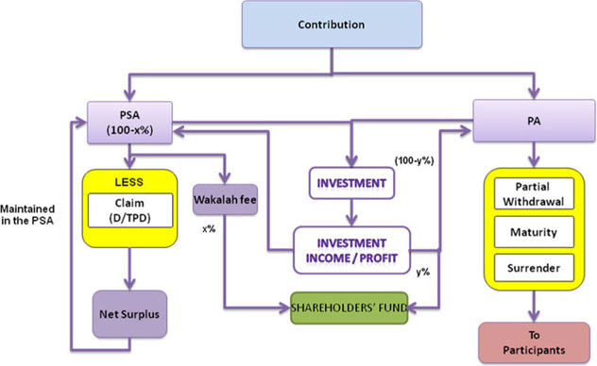
Hybrid Model (Wakalah and Mudarabah
D – Death, TPD – Total permanent disability, PA – Participant’s Account, PSA – Participant’s Special Account (Tabarru Fund or Waqf fund)

Slide 38
Evolution of Islamic Banking in Pakistan

Slide 39
History of Islamic Banking in Pakistan
Council of Islamic Ideology (CII) was appointed the task to prepare a draft of Interest free economy in 1977.
In February 1979 President announced that interest will be removed from the economy in a period of 3 years. At the first step House Building Finance Corporation (HBFC), National Investment Trust (NIT), and Mutual Funds Investment Corporation (MFIC) were selected for removal of interest in their operations.
CII advised reduction of dependence on interest bearing foreign loans as it was not possible to eliminate interest in it, techniques of PLS and Qard e Hasna.

Slide 40
History of Islamic Banking in Pakistan
In 1981 government ordered banks to establish separate counters for deposit on PLS basis; and it continued till June 1985.
Government announced the discontinuation of the parallel systems from July 1985.
The movement towards the interest free economy suffered a setback when in August 1985 banks were allowed to invest even their Profit and Loss sharing deposits in interest bearing government securities.
In 1991 the Federal Shariah Council declared the procedure adopted by the banks in 1985 as un-Islamic.

Slide 41
History of Islamic Banking in Pakistan
In response the government and some banks made appeals to the Shariah appellate Bench of the supreme court of Pakistan. In 1999 the Shariah Appellate Bench of Supreme court rejected the appeals and directed all laws on interest banking to be ceased.
The government set up a high level commission, task forces and committees to institute and promotes Islamic Banking on a parallel basis with the conventional banking system.

Slide 42
History of Islamic Banking in Pakistan
In 2004 the State Bank of Pakistan (SBP) established a dedicated Islamic Banking Department (IDB) and established a Shariah Board to regulate and approve guidelines for the emerging Islamic Banking industry.

Slide 43
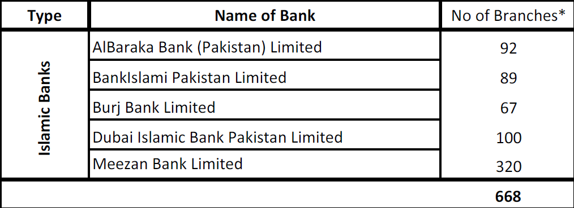
Islamic Banks Operating in Pakistan

Slide 44
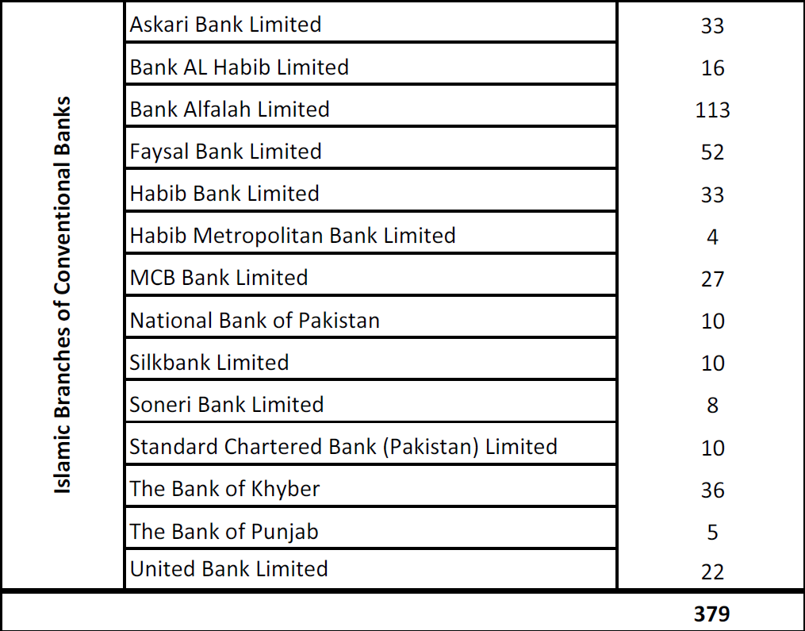
Islamic Branches of Conventional Banks

Slide 45
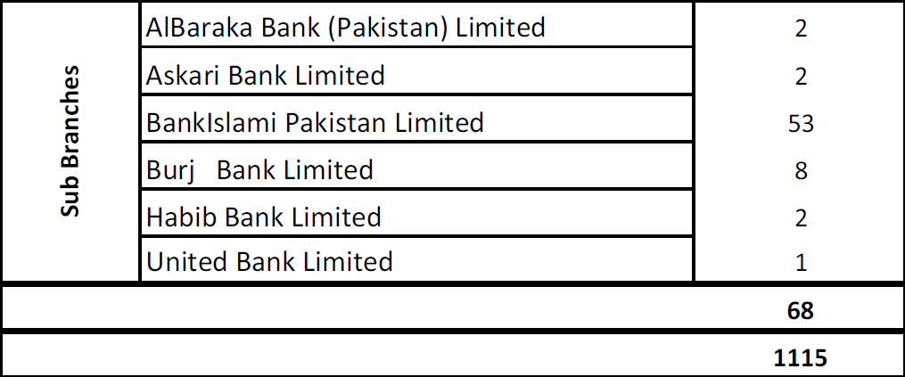
Sub Branches of Different Banks
Total number of branches (Islamic & Conventional banks)

Slide 46
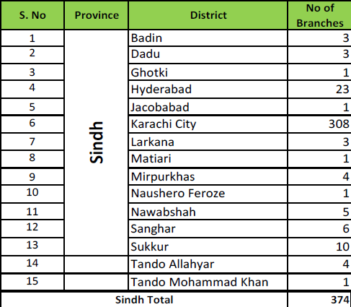
District Wise Islamic Banking Branches

Slide 47
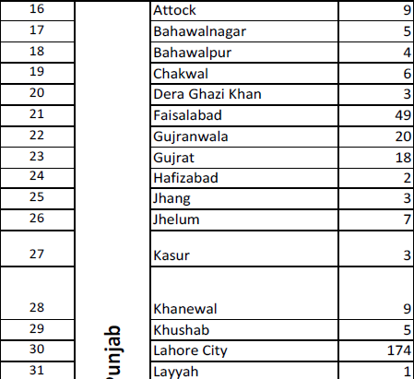
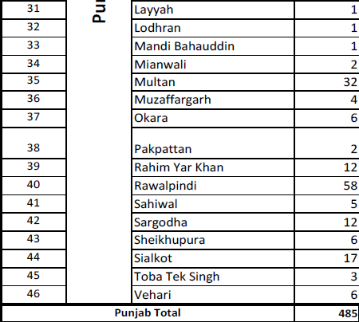
District Wise Islamic Banking Branches
Punjab
Punjab

Slide 48
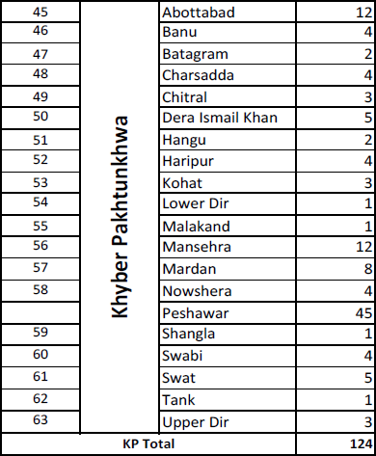
District Wise Islamic Banking Branches

Slide 49
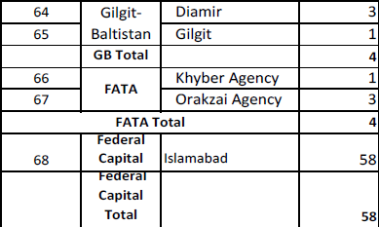
District Wise Islamic Banking Branches

Slide 50
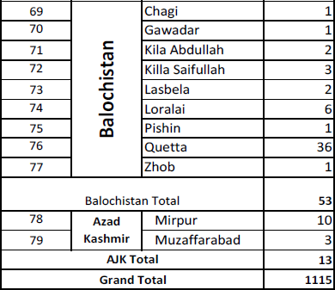
District Wise Islamic Banking Branches

Slide 51
Summary of the Lecture
In this lecture we revised the following topics
Risk Underlying Islamic Financial Modes
Takaful
Evolution of Islamic Banking in Pakistan

