Slide 1
CSC 101 Introduction to Computing Lecture 7
Dr. Iftikhar Azim Niaz
ianiaz@comsats.edu.pk

Slide 2
Last Lecture Summary I
Output Devices
Monitors
CRT, LCD, PDP
Comparing Monitors
Size
Resolution
Refresh rate
Dot pitch

Slide 3
Last Lecture Summary II
Video Cards
Ergonomics and Monitors
Electronic Magnetic Field (EMF)
Data Projectors
LCD Projector
Speakers and Sound Systems
Sound Cards
Headphone and Headsets

Slide 4
Putting Digital Content in Hands
Most computer users can’t imagine working without a printer
Printers give you something you can
touch, carry, and share with others.
Printed documents are essential in most workplaces, where people must share
reports, budgets, memos, and other types of information.
Three types of printers are popular
dot matrix, ink jet, and laser

Slide 5
Outline
Three most commonly used types of printers.
Four criteria to be considered when evaluating printers.
How an image is created by
Dot matrix printer
Ink Jet
Laser
Four types of high-quality printing devices commonly used in business.

Slide 6
Commonly Used Printers
Impact printers
Generate output by striking the paper
Uses an inked ribbon
Most common
Dot Matrix
Line Printer and Band Printers
Non-impact printers
Use methods other than force
Tend to be quiet and fast
Most Common
Ink jet and Laser

Slide 7
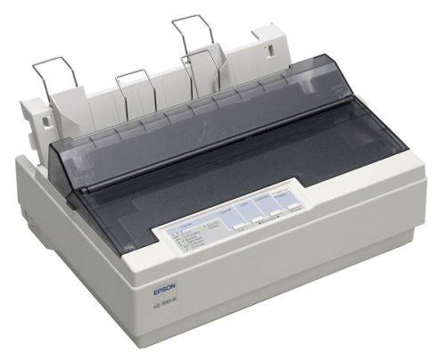
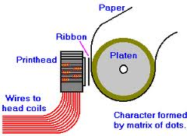
Dot Matrix Printer
Can produce sheets of plain text very quickly
Used to print to multi-sheet pages
Printing on wide-sheet paper
Print head strikes inked ribbon
Speed measured in characters per second (CPS)
Notes:
Teaching Tip
Figure 4B.5 on page 163 provides an excellent rendering of how the print head works. Be sure to refer to the image as you teach.

Slide 8
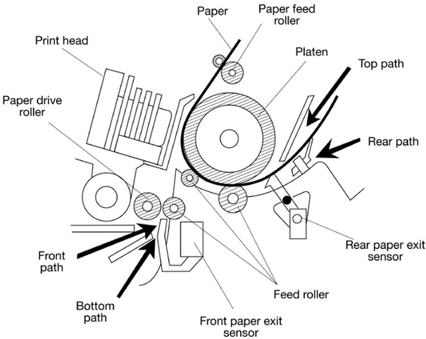
Dot Matrix Printer Parts

Slide 9
Dot Matrix Printhead Mechanism
Print head Mechanism
which contains a cluster (or matrix) of short pins arranged in one or more columns.
Printer can push any of the pins out in any combination.
By pushing out pins in various combinations, the print head can create alphanumeric characters
Forms a character by creating a series of dots.
Notes:
Teaching Tip
Figure 4B.5 on page 163 provides an excellent rendering of how the print head works. Be sure to refer to the image as you teach.

Slide 10
How Image is created?
When pushed out from the duster, the protruding pins’ ends strike a ribbon
which is held in place between the print head and the paper.
When the pins strike the ribbon, they press ink from the ribbon onto the paper.
More pins that a print head contains, the higher the printer’s resolution
Slowest dot matrix printers create 50 to 70 cps
Fastest more than 500 cps

Slide 11
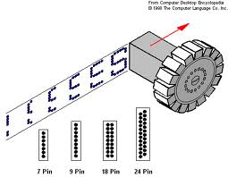
How Image is created?

Slide 12
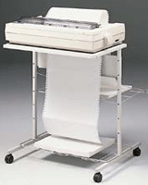
Line Printers
Special type of impact printer.
Uses a special wide print head that can print an entire line of text at one time
Do not offer high resolution but are incredibly fast;
Fastest can print 3,000 lines of text per minute.

Slide 13
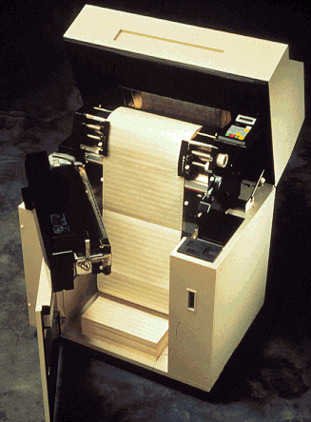
Band Printers
a rotating band embossed with alphanumeric characters.
machine rotates the band to the desired character then a small hammer taps the band, pressing the character against a ribbon.
Very fast and very robust.
Can generate 2,000 lines of text per minute

Slide 14
Impact Printers Advantages
can print on multi-part stationery
make carbon-copies.
Lowest printing cost per page
As the ink is running out, the printout gradually fades rather than suddenly stopping partway through a job.
Able to use continuous paper rather than requiring individual sheets, making them useful for data logging.
Good, reliable workhorses ideal for use in situations where printed content is more important than quality.
Ink ribbon also does not easily dry out

Slide 15
Impact Printers Disadvantages
Creates noise when the pins or typeface strike the ribbon to the paper.
Can only print lower-resolution graphics, with limited color performance, limited quality, and lower speeds compared to non-impact printers.
Single-sheet paper may have to be wound in and aligned by hand, which is relatively time-consuming
When printing labels on release paper, they are prone to paper jams

Slide 16
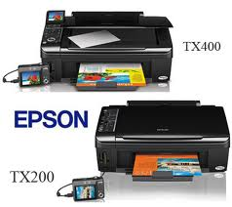
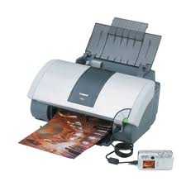
Ink Jet Printers
Non-impact printer
Inexpensive home printer
Sprays ink onto paper
Speed measured in pages per minute (ppm)
Quality expressed as dots per inch (dpi)
Notes:
Insider information
Nearly all of the electronics for the printer is kept in the ink cartridge. Thus, when the cartridge is replaced the printing components of the printer are replaced. Refilling cartridges is OK, but should not be reused more than 2-3 times.

Slide 17
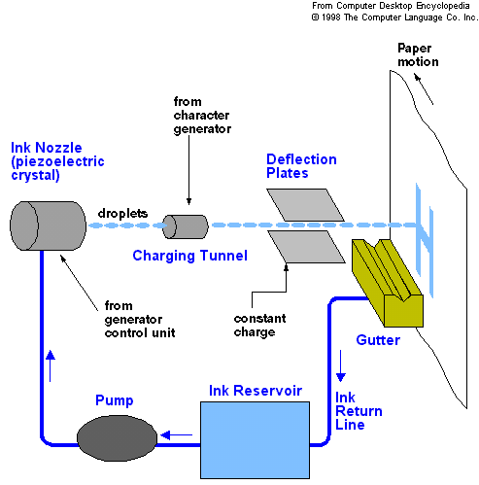
Working of Ink Jet Printer

Slide 18
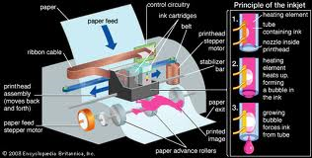
Ink Jet Printer Working

Slide 19
Ink Jet Printer
Color output common using CMYK
Cyan, Magenta, yellow, black
Expensive maintenance is rare
Ink cartridge need to be changed
one cartridge for color printing and a separate black-only cartridge for black-and-white printing
often used to print pictures taken with a digital camera

Slide 20
Ink Jet Printer Advantages
Quieter in operation than impact dot matrix
Can print finer, smoother details through higher print head resolution
Photographic-quality printing are widely available.
Practically no warm up time, and
Lower cost per page.

Slide 21
Ink Jet Printer Disadvantages
(Original) ink is often very expensive.
Many "intelligent" ink cartridges contain a microchip that communicates the estimated ink level to the printer;
lifetime of inkjet prints produced by aqueous inks is shorter than those produced with solvent-based inkjets
Because the ink is water-soluble, care must be taken with inkjet-printed documents to avoid drop of water
nozzles are prone to clogging

Slide 22
Laser Printer
Non-impact printer
Works on a similar process as photocopier
Laser is at the heart of these printers.
Produces high quality documents
Color or black and white
Speed measured in pages per minute
Quality expressed as dots per inch
Notes:
Insider information
The laser printer works on a similar process to a photocopier. The first photocopier as we know it today was invented in Astoria NY in 1938 by Chester Carlson and Otto Kornei.

Slide 23
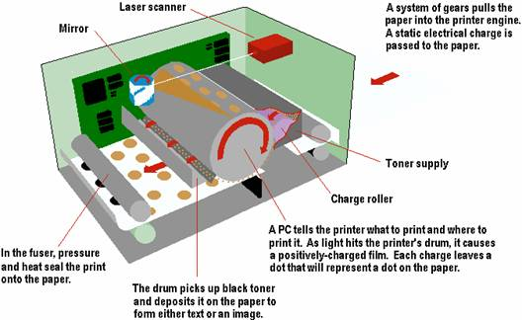
How Laser Creates an Image

Slide 24
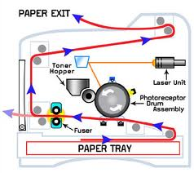
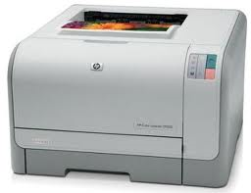
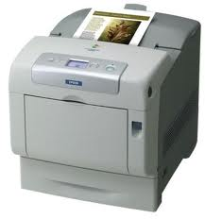
Laser Printer Technology

Slide 25
Laser Color Printing
Works like a single-color model, except that the process is repeated four times and a different toner color is used for each pass.
Four colors used are the same as in the color ink jet printers
Cyan
Magenta
Yellow and
Black.

Slide 26
Laser Printing
Black color printers typically can produce 4 -16 ppm.
For printing graphics, the output can be a great deal slower.
Most have resolutions of 300 or 600 dpi, both horizontally and vertically, but some high-end models have resolutions of 1,200 or 1,800 dpi.
Price starts from Rs. 6,000increases dramatically along with speed and resolution.
Require new toner cartridges after a few thousand pages,

Slide 27
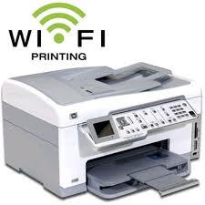
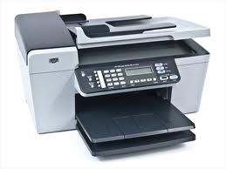
All-In-One Peripherals
Scanner, copier, printer, Fax and e-mail
Popular in home offices
Prices are very reasonable

Slide 28
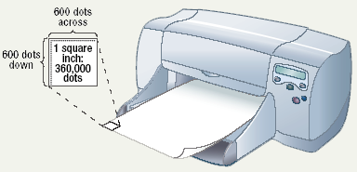
Comparing Printers
Determine what you need
Determine what you can spend
Image quality
dpi
Initial cost
Cost of operating
Speed

Slide 29
High-Quality Printers
Special purpose printers
Used by a print shop
Output is professional grade
Prints to a variety of surfaces

Slide 30
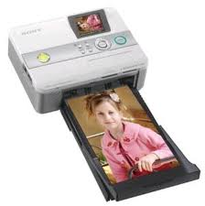
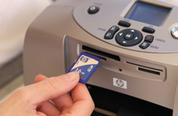
Photo Printers
Produces film quality pictures
Prints very slow
Prints a variety of sizes
Some do not need a computer

Slide 31
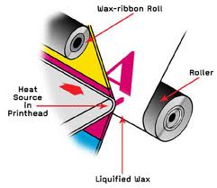
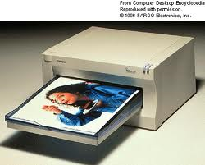
Thermal Wax Printer
Produces bold color output
Color generated by melting wax
Colors do not bleed
Operation costs are low
Output is slow

Slide 32
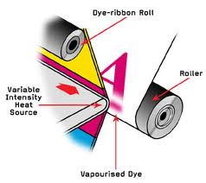
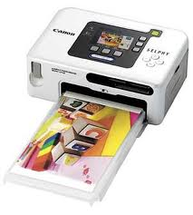
Dye Sublimation Printer
Produces realistic output
Very high quality
Color is produced by evaporating ink
Operation costs are high
Output is very slow

Slide 33
Solid Ink Printer
Excellent Print Quality
Less wastage
Less sensitive to changes in media
Third-party compatible solid-ink can be used

Slide 34
Solid Ink Printer - Advantages
utilizes solid ink sticks
After the ink stick is loaded into the printing device, it is melted and used to produce images on paper in a process similar to offset printing.
sticks are non-toxic and safe to handle.

Slide 35
Solid Ink Printer - Disadvantages
Print durability
Power consumption
Excessive ink usage
Odor
clogged print Heads
High-speed moving parts
Ultraviolet resistance
Lamination

Slide 36
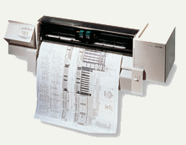
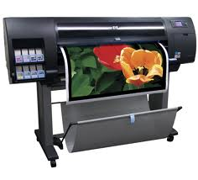
Plotters
Large high quality blueprints
Older models draw with pens
Operational costs are low
Output is very slow

Slide 37
Care and Feeding of Printers
Always read the owner’s manual for instructions
Unplug the printer
Remove the paper
Always place computer at airy place
Clean the outside surfaces with a dry or damp cloth
Use compatible paper with your printer
Don't overfill the paper tray

Slide 38
Summary
Impact Printers and Non Impact Printers
Impact Printers
Dot Matrix,
Line Printers,
Band Printers
Impact Printer Advantages and disadvantages
Non Impact Printers
Ink jet , Laser , All-in-One Peripherals
Comparing Printers

Slide 39
Summary
High Quality Printers
Photo printer
Thermal printer
Dye Sublimation
Solid Ink
Plotter
Care and Feeding of Printers

Slide 40
Recommended Websites
https://en.wikipedia.org/wiki/Category:Impact_printers
https://en.wikipedia.org/wiki/Inkjet_printers
https://en.wikipedia.org/wiki/Laser_printer
https://en.wikipedia.org/wiki/Thermal_transfer_printer
https://en.wikipedia.org/wiki/Dye-sublimation_printer
https://en.wikipedia.org/wiki/Solid_ink
https://en.wikipedia.org/wiki/Plotter

