Slide 1
CSC141- Introduction to Computer Programming
Teacher:
AHMED MUMTAZ MUSTEHSAN
Lecture – 28
Thanks for Lecture Slides:
http://www.deitel.com/Books/C/CHowtoProgram7e/tabid/3635/Default.aspx

Slide 2
Introduction
Storage of data in variables and arrays is only temporary
Data files
Can be created, updated, and processed by C programs
Are used for permanent storage of large amounts of data

Slide 3
The Data Hierarchy
Data Hierarchy:
Bit – smallest data item
Value of 0 or 1
Byte – 8 bits
Used to store a character
Decimal digits, letters, and special symbols
Field – group of characters conveying meaning
Example: your name
Record – group of related fields
Represented by a struct or a class
Example: In a payroll system, a record for a particular employee that contained his/her identification number, name, address, etc.

Slide 4
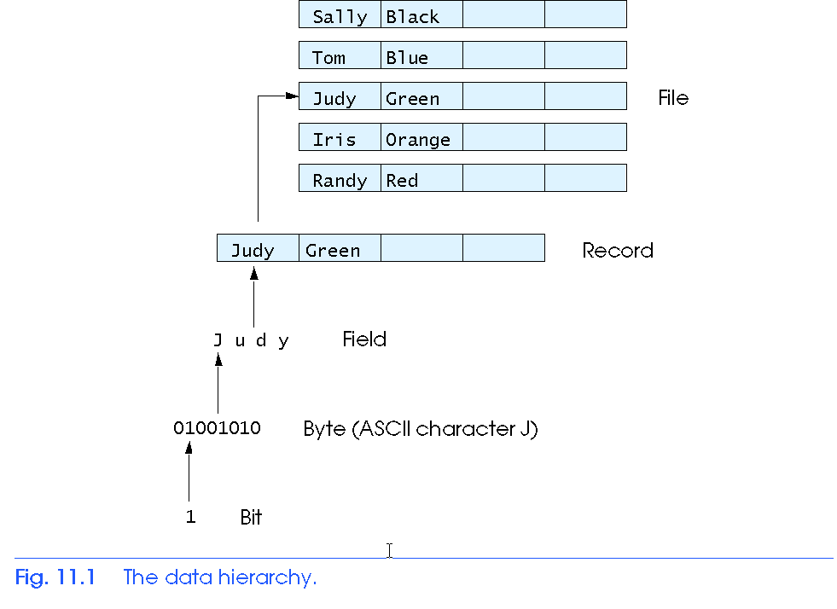
The Data Hierarchy
Data Hierarchy (continued):
File – group of related records
Example: payroll file
Database – group of related files
DBMS

Slide 5
The Data Hierarchy
Data files
Record key
Identifies a record to facilitate the retrieval of specific records from a file
Sequential file
Records typically sorted by key

Slide 6
Files and Streams
C views each file as a sequence of bytes
File ends with the end-of-file marker
Or, file ends at a specified byte
Stream created when a file is opened
Provide communication channel between files and programs
Opening a file returns a pointer to a FILE structure
Example file pointers:
stdin - standard input (keyboard)
stdout - standard output (screen)
stderr - standard error (screen)

Slide 7
Files and Streams
FILE structure
File descriptor
Index into operating system array called the open file table
File Control Block (FCB)
Found in every array element, system uses it to administer the file

Slide 8
Files and Streams

Slide 9
Files and Streams
Read/Write functions in standard library
fgetc
Reads one character from a file
Takes a FILE pointer as an argument
fgetc( stdin ) equivalent to getchar()
fputc
Writes one character to a file
Takes a FILE pointer and a character to write as an argument
fputc( 'a', stdout ) equivalent to putchar( 'a' )
fgets
Reads a line from a file
fputs
Writes a line to a file
fscanf / fprintf
File processing equivalents of scanf and printf

Slide 10
Creating a Sequential Access File
C imposes no file structure
No notion of records in a file
Programmer must provide file structure
Creating a File
FILE *cfPtr;
Creates a FILE pointer called cfPtr
cfPtr = fopen(“clients.dat", “w”);
Function fopen returns a FILE pointer to file specified
Takes two arguments – file to open and file open mode
If open fails, NULL returned

Slide 11
Creating a Sequential Access File
fprintf
Used to print to a file
Like printf, except first argument is a FILE pointer (pointer to the file you want to print in)
feof( FILE pointer )
Returns true if end-of-file indicator (no more data to process) is set for the specified file
fclose( FILE pointer )
Closes specified file
Performed automatically when program ends
Good practice to close files explicitly
Details
Programs may process no files, one file, or many files
Each file must have a unique name and should have its own pointer

Slide 12
Create a sequential file
* Fig. 11.3: fig11_03.c
#include <stdio.h>
int main( void )
{
int account; /* account number */
char name[ 30 ]; /* account name */
double balance; /* account balance */
FILE *cfPtr; /* cfPtr = clients.dat file pointer */
/* fopen opens file. Exit program if unable to create file */
if ( ( cfPtr = fopen( "clients.dat", "w" ) ) == NULL ) {
printf( "File could not be opened\n" );
} /* end if */
else {
printf( "Enter the account, name, and balance.\n" );
printf( "Enter EOF to end input.\n" );
printf( "? " );
scanf( "%d%s%lf", &account, name, &balance );

Slide 13
/* write account, name and balance into file with fprintf */
while ( !feof( stdin ) ) {
fprintf( cfPtr, "%d %s %.2f\n", account, name, balance );
printf( "? " );
scanf( "%d%s%lf", &account, name, &balance );
} /* end while */
fclose( cfPtr ); /* fclose closes file */
} /* end else */
return 0; /* indicates successful termination */
} /* end main */
Output
Enter the account, name, and balance.
Enter EOF to end input.
? 100 Jones 24.98
? 200 Doe 345.67
? 300 White 0.00
? 400 Stone -42.16
? 500 Rich 224.62
? ^Z

Slide 14
Creating a Sequential Access File

Slide 15
Creating a Sequential Access File

Slide 16
Reading Data from a Sequential Access File
Reading a sequential access file
Create a FILE pointer, link it to the file to read
cfPtr = fopen( “clients.dat", "r" );
Use fscanf to read from the file
Like scanf, except first argument is a FILE pointer
fscanf( cfPtr, "%d%s%f", &accounnt, name, &balance );
Data read from beginning to end
File position pointer
Indicates number of next byte to be read / written
Not really a pointer, but an integer value (specifies byte location)
Also called byte offset
rewind( cfPtr )
Repositions file position pointer to beginning of file (byte 0)

Slide 17
Reading and printing a sequential file
/* Fig. 11.7: fig11_07.c
#include <stdio.h>
int main( void )
{
int account; /* account number */
char name[ 30 ]; /* account name */
double balance; /* account balance */
FILE *cfPtr; /* cfPtr = clients.dat file pointer */
/* fopen opens file; exits program if file cannot be opened */
if ( ( cfPtr = fopen( "clients.dat", "r" ) ) == NULL ) {
printf( "File could not be opened\n" );
} /* end if */
else { /* read account, name and balance from file */
printf( "%-10s%-13s%s\n", "Account", "Name", "Balance" );
fscanf( cfPtr, "%d%s%lf", &account, name, &balance );

Slide 18
/* while not end of file */
while ( !feof( cfPtr ) ) {
printf( "%-10d%-13s%7.2f\n", account, name, balance );
fscanf( cfPtr, "%d%s%lf", &account, name, &balance );
} /* end while */
fclose( cfPtr ); /* fclose closes the file */
} /* end else */
return 0; /* indicates successful termination */
} /* end main */
Output
Account Name Balance
100 Jones 24.98
200 Doe 345.67
300 White 0.00
400 Stone -42.16
500 Rich 224.62

Slide 19
Credit inquiry program
/* Fig. 11.8: fig11_08.c
#include <stdio.h>
/* function main begins program execution */
int main( void )
{
int request; /* request number */
int account; /* account number */
double balance; /* account balance */
char name[ 30 ]; /* account name */
FILE *cfPtr; /* clients.dat file pointer */
/* fopen opens the file; exits program if file cannot be opened */
if ( ( cfPtr = fopen( "clients.dat", "r" ) ) == NULL ) {
printf( "File could not be opened\n" );
} /* end if */
else { /* display request options */
printf( "Enter request\n"
" 1 - List accounts with zero balances\n"
" 2 - List accounts with credit balances\n"
" 3 - List accounts with debit balances\n"
" 4 - End of run\n? " );

Slide 20
scanf( "%d", &request );
/* process user's request */
while ( request != 4 ) {
/* read account, name and balance from file */
fscanf( cfPtr, "%d%s%lf", &account, name, &balance );
switch ( request ) {
case 1:
printf( "\nAccounts with zero balances:\n" );
/* read file contents (until eof) */
while ( !feof( cfPtr ) ) {
if ( balance == 0 ) {
printf( "%-10d%-13s%7.2f\n",
account, name, balance );
} /* end if */
/* read account, name and balance from file */
fscanf( cfPtr, "%d%s%lf",
&account, name, &balance );
} /* end while */

Slide 21
break;
case 2:
printf( "\nAccounts with credit balances:\n" );
/* read file contents (until eof) */
while ( !feof( cfPtr ) ) {
if ( balance < 0 ) {
printf( "%-10d%-13s%7.2f\n",
account, name, balance );
} /* end if */
/* read account, name and balance from file */
fscanf( cfPtr, "%d%s%lf",
&account, name, &balance );
} /* end while */
break;
case 3:
printf( "\nAccounts with debit balances:\n" );

Slide 22
/* read file contents (until eof) */
while ( !feof( cfPtr ) ) {
if ( balance > 0 ) {
printf( "%-10d%-13s%7.2f\n",
account, name, balance );
} /* end if */
/* read account, name and balance from file */
fscanf( cfPtr, "%d%s%lf",
&account, name, &balance );
} /* end while */
break;
} /* end switch */

Slide 23
rewind( cfPtr ); /* return cfPtr to beginning of file */
printf( "\n? " );
scanf( "%d", &request );
} /* end while */
printf( "End of run.\n" );
fclose( cfPtr ); /* fclose closes the file */
} /* end else */
return 0; /* indicates successful termination */
} /* end main */

Slide 24
Output
Enter request
1 - List accounts with zero balances
2 - List accounts with credit balances
3 - List accounts with debit balances
4 - End of run
? 1
Accounts with zero balances:
300 White 0.00
? 2
Accounts with credit balances:
400 Stone -42.16
? 3
Accounts with debit balances:
100 Jones 24.98
200 Doe 345.67
500 Rich 224.62
? 4
End of run.

Slide 25
Reading Data from a Sequential Access File
Sequential access file
Cannot be modified without the risk of destroying other data
Fields can vary in size
Different representation in files and screen than internal representation
1, 34, -890 are all ints, but have different sizes on disk
300 White 0.00 400 Jones 32.87 (old data in file)
If we want to change White's name to Worthington,
300 Worthington 0.00
300 White 0.00 400 Jones 32.87
Data gets overwritten
300 Worthington 0.00ones 32.87

Slide 26
Random-Access Files
Random access files
Access individual records without searching through other records
Instant access to records in a file
Data can be inserted without destroying other data
Data previously stored can be updated or deleted without overwriting
Implemented using fixed length records
Sequential files do not have fixed length records
0
100
200
300
400
500
}
byte offsets
}
}
}
}
}
}
100 bytes
100 bytes
100 bytes
100 bytes
100 bytes
100 bytes

Slide 27
Creating a Randomly Accessed File
Data in random access files
Unformatted (stored as "raw bytes")
All data of the same type (int, for example) uses the same amount of memory
All records of the same type have a fixed length
Data not human readable

Slide 28
Creating a Randomly Accessed File
Unformatted I/O functions
fwrite
Transfer bytes from a location in memory to a file
fread
Transfer bytes from a file to a location in memory
Example:
fwrite( &number, sizeof( int ), 1, myPtr );
&number – Location to transfer bytes from
sizeof( int ) – Number of bytes to transfer
1 – For arrays, number of elements to transfer
In this case, "one element" of an array is being transferred
myPtr – File to transfer to or from

Slide 29
Creating a Randomly Accessed File
Writing structs
fwrite( &myObject, sizeof (struct myStruct), 1, myPtr );
sizeof – returns size in bytes of object in parentheses
To write several array elements
Pointer to array as first argument
Number of elements to write as third argument

Slide 30
Creating a random-access file sequentially
/* Fig. 11.11: fig11_11.c
#include <stdio.h>
/* clientData structure definition */
struct clientData {
int acctNum; /* account number */
char lastName[ 15 ]; /* account last name */
char firstName[ 10 ]; /* account first name */
double balance; /* account balance */
}; /* end structure clientData */
int main( void )
{
int i; /* counter used to count from 1-100 */
/* create clientData with default information */
struct clientData blankClient = { 0, "", "", 0.0 };
FILE *cfPtr; /* credit.dat file pointer */

Slide 31
/* fopen opens the file; exits if file cannot be opened */
if ( ( cfPtr = fopen( "credit.dat", "wb" ) ) == NULL ) {
printf( "File could not be opened.\n" );
} /* end if */
else {
/* output 100 blank records to file */
for ( i = 1; i <= 100; i++ ) {
fwrite( &blankClient, sizeof( struct clientData ), 1, cfPtr );
} /* end for */
fclose ( cfPtr ); /* fclose closes the file */
} /* end else */
return 0; /* indicates successful termination */
} /* end main */

Slide 32
Writing Data Randomly to a Randomly Accessed File
fseek
Sets file position pointer to a specific position
fseek( pointer, offset, symbolic_constant );
pointer – pointer to file
offset – file position pointer (0 is first location)
symbolic_constant – specifies where in file we are reading from
SEEK_SET – seek starts at beginning of file
SEEK_CUR – seek starts at current location in file
SEEK_END – seek starts at end of file

Slide 33
Writing to a random access file
/* Fig. 11.12: fig11_12.c
#include <stdio.h>
/* clientData structure definition */
struct clientData {
int acctNum; /* account number */
char lastName[ 15 ]; /* account last name */
char firstName[ 10 ]; /* account first name */
double balance; /* account balance */
}; /* end structure clientData */
int main( void )
{
FILE *cfPtr; /* credit.dat file pointer */
/* create clientData with default information */
struct clientData client = { 0, "", "", 0.0 };
/* fopen opens the file; exits if file cannot be opened */
if ( ( cfPtr = fopen( "credit.dat", "rb+" ) ) == NULL ) {
printf( "File could not be opened.\n" );
} /* end if */

Slide 34
else {
/* require user to specify account number */
printf( "Enter account number"
" ( 1 to 100, 0 to end input )\n? " );
scanf( "%d", &client.acctNum );
/* user enters information, which is copied into file */
while ( client.acctNum != 0 ) {
/* user enters last name, first name and balance */
printf( "Enter lastname, firstname, balance\n? " );
/* set record lastName, firstName and balance value */
fscanf( stdin, "%s%s%lf", client.lastName,
client.firstName, &client.balance );
/* seek position in file to user-specified record */
fseek( cfPtr, ( client.acctNum - 1 ) *
sizeof( struct clientData ), SEEK_SET );

Slide 35
/* write user-specified information in file */
fwrite( &client, sizeof( struct clientData ), 1, cfPtr );
/* enable user to input another account number */
printf( "Enter account number\n? " );
scanf( "%d", &client.acctNum );
} /* end while */
fclose( cfPtr ); /* fclose closes the file */
} /* end else */
return 0; /* indicates successful termination */
} /* end main */

Slide 36
Output
Enter account number ( 1 to 100, 0 to end input )
? 37
Enter lastname, firstname, balance
? Barker Doug 0.00
Enter account number
? 29
Enter lastname, firstname, balance
? Brown Nancy -24.54
Enter account number
? 96
Enter lastname, firstname, balance
? Stone Sam 34.98
Enter account number
? 88
Enter lastname, firstname, balance
? Smith Dave 258.34
Enter account number
? 33
Enter lastname, firstname, balance
? Dunn Stacey 314.33
Enter account number
? 0

Slide 37
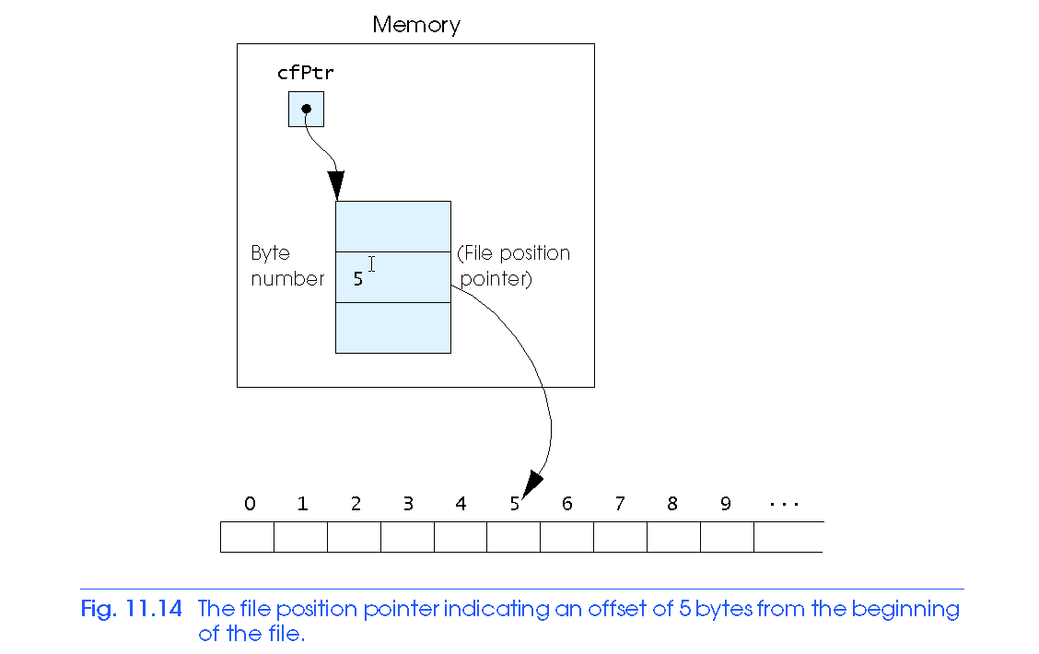
Writing Data Randomly to a Randomly Accessed File

Slide 38
Reading Data Randomly from a Randomly Accessed File
fread
Reads a specified number of bytes from a file into memory
fread( &client, sizeof (struct clientData), 1, myPtr );
Can read several fixed-size array elements
Provide pointer to array
Indicate number of elements to read
To read multiple elements, specify in third argument

Slide 39
Reading a random access file sequentially
/* Fig. 11.15: fig11_15.c
#include <stdio.h>
/* clientData structure definition */
struct clientData {
int acctNum; /* account number */
char lastName[ 15 ]; /* account last name */
char firstName[ 10 ]; /* account first name */
double balance; /* account balance */
}; /* end structure clientData */
int main( void )
{
FILE *cfPtr; /* credit.dat file pointer */
/* create clientData with default information */
struct clientData client = { 0, "", "", 0.0 };
/* fopen opens the file; exits if file cannot be opened */
if ( ( cfPtr = fopen( "credit.dat", "rb" ) ) == NULL ) {
printf( "File could not be opened.\n" );
} /* end if */

Slide 40
else {
printf( "%-6s%-16s%-11s%10s\n", "Acct", "Last Name",
"First Name", "Balance" );
/* read all records from file (until eof) */
while ( !feof( cfPtr ) ) {
fread( &client, sizeof( struct clientData ), 1, cfPtr );
/* display record */
if ( client.acctNum != 0 ) {
printf( "%-6d%-16s%-11s%10.2f\n",
client.acctNum, client.lastName,
client.firstName, client.balance );
} /* end if */
} /* end while */
fclose( cfPtr ); /* fclose closes the file */
} /* end else */
return 0; /* indicates successful termination */
} /* end main */

Slide 41
Output
Acct Last Name First Name Balance
29 Brown Nancy -24.54
33 Dunn Stacey 314.33
37 Barker Doug 0.00
88 Smith Dave 258.34
96 Stone Sam 34.98

Slide 42
Case Study: A Transaction Processing Program
This program
Demonstrates using random access files to achieve instant access processing of a bank’s account information
We will
Update existing accounts
Add new accounts
Delete accounts
Store a formatted listing of all accounts in a text file

Slide 43
/* Fig. 11.16: fig11_16.c
This program reads a random access file sequentially, updates data
already written to the file, creates new data to be placed in the
file, and deletes data previously in the file. */
#include <stdio.h>
/* clientData structure definition */
struct clientData {
int acctNum; /* account number */
char lastName[ 15 ]; /* account last name */
char firstName[ 10 ]; /* account first name */
double balance; /* account balance */
}; /* end structure clientData */
/* prototypes */
int enterChoice( void );
void textFile( FILE *readPtr );
void updateRecord( FILE *fPtr );
void newRecord( FILE *fPtr );
void deleteRecord( FILE *fPtr );

Slide 44
int main( void )
{
FILE *cfPtr; /* credit.dat file pointer */
int choice; /* user's choice */
/* fopen opens the file; exits if file cannot be opened */
if ( ( cfPtr = fopen( "credit.dat", "rb+" ) ) == NULL ) {
printf( "File could not be opened.\n" );
} /* end if */
else {
/* enable user to specify action */
while ( ( choice = enterChoice() ) != 5 ) {
switch ( choice ) {
/* create text file from record file */
case 1:
textFile( cfPtr );
break;
/* update record */
case 2:
updateRecord( cfPtr );
break;

Slide 45
/* create record */
case 3:
newRecord( cfPtr );
break;
/* delete existing record */
case 4:
deleteRecord( cfPtr );
break;
/* display message if user does not select valid choice */
default:
printf( "Incorrect choice\n" );
break;
} /* end switch */
} /* end while */
fclose( cfPtr ); /* fclose closes the file */
} /* end else */
return 0; /* indicates successful termination */
} /* end main */

Slide 46
/* create formatted text file for printing */
void textFile( FILE *readPtr )
{
FILE *writePtr; /* accounts.txt file pointer */
/* create clientData with default information */
struct clientData client = { 0, "", "", 0.0 };
/* fopen opens the file; exits if file cannot be opened */
if ( ( writePtr = fopen( "accounts.txt", "w" ) ) == NULL ) {
printf( "File could not be opened.\n" );
} /* end if */
else {
rewind( readPtr ); /* sets pointer to beginning of file */
fprintf( writePtr, "%-6s%-16s%-11s%10s\n",
"Acct", "Last Name", "First Name","Balance" );
/* copy all records from random-access file into text file */
while ( !feof( readPtr ) ) {
fread( &client, sizeof( struct clientData ), 1, readPtr );

Slide 47
/* write single record to text file */
if ( client.acctNum != 0 ) {
fprintf( writePtr, "%-6d%-16s%-11s%10.2f\n",
client.acctNum, client.lastName,
client.firstName, client.balance );
} /* end if */
} /* end while */
fclose( writePtr ); /* fclose closes the file */
} /* end else */
} /* end function textFile */
/* update balance in record */
void updateRecord( FILE *fPtr )
{
int account; /* account number */
double transaction; /* transaction amount */
/* create clientData with no information */
struct clientData client = { 0, "", "", 0.0 };

Slide 48
/* obtain number of account to update */
printf( "Enter account to update ( 1 - 100 ): " );
scanf( "%d", &account );
/* move file pointer to correct record in file */
fseek( fPtr, ( account - 1 ) * sizeof( struct clientData ),
SEEK_SET );
/* read record from file */
fread( &client, sizeof( struct clientData ), 1, fPtr );
/* display error if account does not exist */
if ( client.acctNum == 0 ) {
printf( "Acount #%d has no information.\n", account );
} /* end if */
else { /* update record */
printf( "%-6d%-16s%-11s%10.2f\n\n",
client.acctNum, client.lastName,
client.firstName, client.balance );
/* request transaction amount from user */
printf( "Enter charge ( + ) or payment ( - ): " );
scanf( "%lf", &transaction );
client.balance += transaction; /* update record balance */

Slide 49
printf( "%-6d%-16s%-11s%10.2f\n",
client.acctNum, client.lastName,
client.firstName, client.balance );
/* move file pointer to correct record in file */
fseek( fPtr, ( account - 1 ) * sizeof( struct clientData ),
SEEK_SET );
/* write updated record over old record in file */
fwrite( &client, sizeof( struct clientData ), 1, fPtr );
} /* end else */
} /* end function updateRecord */
/* delete an existing record */
void deleteRecord( FILE *fPtr )
{
struct clientData client; /* stores record read from file */
struct clientData blankClient = { 0, "", "", 0 }; /* blank client */
int accountNum; /* account number */

Slide 50
/* obtain number of account to delete */
printf( "Enter account number to delete ( 1 - 100 ): " );
scanf( "%d", &accountNum );
/* move file pointer to correct record in file */
fseek( fPtr, ( accountNum - 1 ) * sizeof( struct clientData ),
SEEK_SET );
/* read record from file */
fread( &client, sizeof( struct clientData ), 1, fPtr );
/* display error if record does not exist */
if ( client.acctNum == 0 ) {
printf( "Account %d does not exist.\n", accountNum );
} /* end if */
else { /* delete record */
/* move file pointer to correct record in file */
fseek( fPtr, ( accountNum - 1 ) * sizeof( struct clientData ),
SEEK_SET );
/* replace existing record with blank record */
fwrite( &blankClient,
sizeof( struct clientData ), 1, fPtr );
} /* end else */
} /* end function deleteRecord */

Slide 51
/* create and insert record */
void newRecord( FILE *fPtr )
{
/* create clientData with default information */
struct clientData client = { 0, "", "", 0.0 };
int accountNum; /* account number */
/* obtain number of account to create */
printf( "Enter new account number ( 1 - 100 ): " );
scanf( "%d", &accountNum );
/* move file pointer to correct record in file */
fseek( fPtr, ( accountNum - 1 ) * sizeof( struct clientData ),
SEEK_SET );
/* read record from file */
fread( &client, sizeof( struct clientData ), 1, fPtr );

Slide 52
/* display error if account already exists */
if ( client.acctNum != 0 ) {
printf( "Account #%d already contains information.\n",
client.acctNum );
} /* end if */
else { /* create record */
/* user enters last name, first name and balance */
printf( "Enter lastname, firstname, balance\n? " );
scanf( "%s%s%lf", &client.lastName, &client.firstName,
&client.balance );
client.acctNum = accountNum;
/* move file pointer to correct record in file */
fseek( fPtr, ( client.acctNum - 1 ) *
sizeof( struct clientData ), SEEK_SET );
/* insert record in file */
fwrite( &client,
sizeof( struct clientData ), 1, fPtr );
} /* end else */
} /* end function newRecord */

Slide 53
/* enable user to input menu choice */
int enterChoice( void )
{
int menuChoice; /* variable to store user's choice */
/* display available options */
printf( "\nEnter your choice\n"
"1 - store a formatted text file of acounts called\n"
" \"accounts.txt\" for printing\n"
"2 - update an account\n"
"3 - add a new account\n"
"4 - delete an account\n"
"5 - end program\n? " );
scanf( "%d", &menuChoice ); /* receive choice from user */
return menuChoice;
} /* end function enterChoice */

Slide 54
Output
After choosing option 1 accounts.txt contains:
Acct Last Name First Name Balance
29 Brown Nancy -24.54
33 Dunn Stacey 314.33
37 Barker Doug 0.00
88 Smith Dave 258.34
96 Stone Sam 34.98
After choosing option 2 accounts.txt contains:
Enter account to update ( 1 - 100 ): 37
37 Barker Doug 0.00
Enter charge ( + ) or payment ( - ): +87.99
37 Barker Doug 87.99
After choosing option 3 accounts.txt contains:
Enter new account number ( 1 - 100 ): 22
Enter lastname, firstname, balance
? Johnston Sarah 247.45

