Slide 1
CSC141- Introduction to Computer Programming
Teacher:
AHMED MUMTAZ MUSTEHSAN
Lecture – 29
Thanks for Lecture Slides:
http://www.deitel.com/Books/C/CHowtoProgram7e/tabid/3635/Default.aspx

Slide 2
File Processing (Continued)

Slide 3
Random-Access Files
Random access files
Access individual records without searching through other records
Instant access to records in a file
Data can be inserted without destroying other data
Data previously stored can be updated or deleted without overwriting
Implemented using fixed length records
Sequential files do not have fixed length records
0
100
200
300
400
500
}
byte offsets
}
}
}
}
}
}
100 bytes
100 bytes
100 bytes
100 bytes
100 bytes
100 bytes

Slide 4
Creating a Randomly Accessed File
Data in random access files
Unformatted (stored as "raw bytes")
All data of the same type (int, for example) uses the same amount of memory
All records of the same type have a fixed length
Data not human readable

Slide 5
Creating a Randomly Accessed File
Unformatted I/O functions
fwrite
Transfer bytes from a location in memory to a file
fread
Transfer bytes from a file to a location in memory
Example:
fwrite( &number, sizeof( int ), 1, myPtr );
&number – Location to transfer bytes from
sizeof( int ) – Number of bytes to transfer
1 – For arrays, number of elements to transfer
In this case, "one element" of an array is being transferred
myPtr – File to transfer to or from

Slide 6
Creating a Randomly Accessed File
Writing structs
fwrite( &myObject, sizeof (struct myStruct), 1, myPtr );
sizeof – returns size in bytes of object in parentheses
To write several array elements
Pointer to array as first argument
Number of elements to write as third argument

Slide 7
Creating a random-access file sequentially
/* Fig. 11.11: fig11_11.c
#include <stdio.h>
/* clientData structure definition */
struct clientData {
int acctNum; /* account number */
char lastName[ 15 ]; /* account last name */
char firstName[ 10 ]; /* account first name */
double balance; /* account balance */
}; /* end structure clientData */
int main( void )
{
int i; /* counter used to count from 1-100 */
/* create clientData with default information */
struct clientData blankClient = { 0, "", "", 0.0 };
FILE *cfPtr; /* credit.dat file pointer */

Slide 8
/* fopen opens the file; exits if file cannot be opened */
if ( ( cfPtr = fopen( "credit.dat", "wb" ) ) == NULL ) {
printf( "File could not be opened.\n" );
} /* end if */
else {
/* output 100 blank records to file */
for ( i = 1; i <= 100; i++ ) {
fwrite( &blankClient, sizeof( struct clientData ), 1, cfPtr );
} /* end for */
fclose ( cfPtr ); /* fclose closes the file */
} /* end else */
return 0; /* indicates successful termination */
} /* end main */

Slide 9
Writing Data Randomly to a Randomly Accessed File
fseek
Sets file position pointer to a specific position
fseek( pointer, offset, symbolic_constant );
pointer – pointer to file
offset – file position pointer (0 is first location)
symbolic_constant – specifies where in file we are reading from
SEEK_SET – seek starts at beginning of file
SEEK_CUR – seek starts at current location in file
SEEK_END – seek starts at end of file

Slide 10
Writing to a random access file
/* Fig. 11.12: fig11_12.c
#include <stdio.h>
/* clientData structure definition */
struct clientData {
int acctNum; /* account number */
char lastName[ 15 ]; /* account last name */
char firstName[ 10 ]; /* account first name */
double balance; /* account balance */
}; /* end structure clientData */
int main( void )
{
FILE *cfPtr; /* credit.dat file pointer */
/* create clientData with default information */
struct clientData client = { 0, "", "", 0.0 };
/* fopen opens the file; exits if file cannot be opened */
if ( ( cfPtr = fopen( "credit.dat", "rb+" ) ) == NULL ) {
printf( "File could not be opened.\n" );
} /* end if */

Slide 11
else {
/* require user to specify account number */
printf( "Enter account number"
" ( 1 to 100, 0 to end input )\n? " );
scanf( "%d", &client.acctNum );
/* user enters information, which is copied into file */
while ( client.acctNum != 0 ) {
/* user enters last name, first name and balance */
printf( "Enter lastname, firstname, balance\n? " );
/* set record lastName, firstName and balance value */
fscanf( stdin, "%s%s%lf", client.lastName,
client.firstName, &client.balance );
/* seek position in file to user-specified record */
fseek( cfPtr, ( client.acctNum - 1 ) *
sizeof( struct clientData ), SEEK_SET );

Slide 12
/* write user-specified information in file */
fwrite( &client, sizeof( struct clientData ), 1, cfPtr );
/* enable user to input another account number */
printf( "Enter account number\n? " );
scanf( "%d", &client.acctNum );
} /* end while */
fclose( cfPtr ); /* fclose closes the file */
} /* end else */
return 0; /* indicates successful termination */
} /* end main */

Slide 13
Output
Enter account number ( 1 to 100, 0 to end input )
? 37
Enter lastname, firstname, balance
? Barker Doug 0.00
Enter account number
? 29
Enter lastname, firstname, balance
? Brown Nancy -24.54
Enter account number
? 96
Enter lastname, firstname, balance
? Stone Sam 34.98
Enter account number
? 88
Enter lastname, firstname, balance
? Smith Dave 258.34
Enter account number
? 33
Enter lastname, firstname, balance
? Dunn Stacey 314.33
Enter account number
? 0

Slide 14
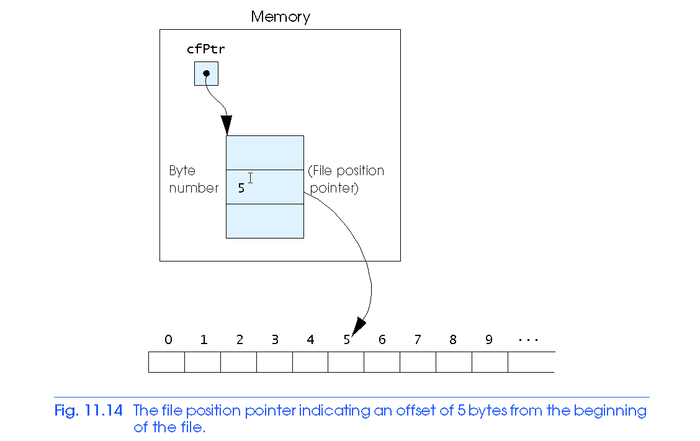
Writing Data Randomly to a Randomly Accessed File

Slide 15
Reading Data Randomly from a Randomly Accessed File
fread
Reads a specified number of bytes from a file into memory
fread( &client, sizeof (struct clientData), 1, myPtr );
Can read several fixed-size array elements
Provide pointer to array
Indicate number of elements to read
To read multiple elements, specify in third argument

Slide 16
Reading a random access file sequentially
/* Fig. 11.15: fig11_15.c
#include <stdio.h>
/* clientData structure definition */
struct clientData {
int acctNum; /* account number */
char lastName[ 15 ]; /* account last name */
char firstName[ 10 ]; /* account first name */
double balance; /* account balance */
}; /* end structure clientData */
int main( void )
{
FILE *cfPtr; /* credit.dat file pointer */
/* create clientData with default information */
struct clientData client = { 0, "", "", 0.0 };
/* fopen opens the file; exits if file cannot be opened */
if ( ( cfPtr = fopen( "credit.dat", "rb" ) ) == NULL ) {
printf( "File could not be opened.\n" );
} /* end if */

Slide 17
else {
printf( "%-6s%-16s%-11s%10s\n", "Acct", "Last Name",
"First Name", "Balance" );
/* read all records from file (until eof) */
while ( !feof( cfPtr ) ) {
fread( &client, sizeof( struct clientData ), 1, cfPtr );
/* display record */
if ( client.acctNum != 0 ) {
printf( "%-6d%-16s%-11s%10.2f\n",
client.acctNum, client.lastName,
client.firstName, client.balance );
} /* end if */
} /* end while */
fclose( cfPtr ); /* fclose closes the file */
} /* end else */
return 0; /* indicates successful termination */
} /* end main */

Slide 18
Output
Acct Last Name First Name Balance
29 Brown Nancy -24.54
33 Dunn Stacey 314.33
37 Barker Doug 0.00
88 Smith Dave 258.34
96 Stone Sam 34.98

Slide 19
Case Study: A Transaction Processing Program
This program
Demonstrates using random access files to achieve instant access processing of a bank’s account information
We will
Update existing accounts
Add new accounts
Delete accounts
Store a formatted listing of all accounts in a text file

Slide 20
/* Fig. 11.16: fig11_16.c
This program reads a random access file sequentially, updates data
already written to the file, creates new data to be placed in the
file, and deletes data previously in the file. */
#include <stdio.h>
/* clientData structure definition */
struct clientData {
int acctNum; /* account number */
char lastName[ 15 ]; /* account last name */
char firstName[ 10 ]; /* account first name */
double balance; /* account balance */
}; /* end structure clientData */
/* prototypes */
int enterChoice( void );
void textFile( FILE *readPtr );
void updateRecord( FILE *fPtr );
void newRecord( FILE *fPtr );
void deleteRecord( FILE *fPtr );

Slide 21
int main( void )
{
FILE *cfPtr; /* credit.dat file pointer */
int choice; /* user's choice */
/* fopen opens the file; exits if file cannot be opened */
if ( ( cfPtr = fopen( "credit.dat", "rb+" ) ) == NULL ) {
printf( "File could not be opened.\n" );
} /* end if */
else {
/* enable user to specify action */
while ( ( choice = enterChoice() ) != 5 ) {
switch ( choice ) {
/* create text file from record file */
case 1:
textFile( cfPtr );
break;
/* update record */
case 2:
updateRecord( cfPtr );
break;

Slide 22
/* create record */
case 3:
newRecord( cfPtr );
break;
/* delete existing record */
case 4:
deleteRecord( cfPtr );
break;
/* display message if user does not select valid choice */
default:
printf( "Incorrect choice\n" );
break;
} /* end switch */
} /* end while */
fclose( cfPtr ); /* fclose closes the file */
} /* end else */
return 0; /* indicates successful termination */
} /* end main */

Slide 23
/* create formatted text file for printing */
void textFile( FILE *readPtr )
{
FILE *writePtr; /* accounts.txt file pointer */
/* create clientData with default information */
struct clientData client = { 0, "", "", 0.0 };
/* fopen opens the file; exits if file cannot be opened */
if ( ( writePtr = fopen( "accounts.txt", "w" ) ) == NULL ) {
printf( "File could not be opened.\n" );
} /* end if */
else {
rewind( readPtr ); /* sets pointer to beginning of file */
fprintf( writePtr, "%-6s%-16s%-11s%10s\n",
"Acct", "Last Name", "First Name","Balance" );
/* copy all records from random-access file into text file */
while ( !feof( readPtr ) ) {
fread( &client, sizeof( struct clientData ), 1, readPtr );

Slide 24
/* write single record to text file */
if ( client.acctNum != 0 ) {
fprintf( writePtr, "%-6d%-16s%-11s%10.2f\n",
client.acctNum, client.lastName,
client.firstName, client.balance );
} /* end if */
} /* end while */
fclose( writePtr ); /* fclose closes the file */
} /* end else */
} /* end function textFile */
/* update balance in record */
void updateRecord( FILE *fPtr )
{
int account; /* account number */
double transaction; /* transaction amount */
/* create clientData with no information */
struct clientData client = { 0, "", "", 0.0 };

Slide 25
/* obtain number of account to update */
printf( "Enter account to update ( 1 - 100 ): " );
scanf( "%d", &account );
/* move file pointer to correct record in file */
fseek( fPtr, ( account - 1 ) * sizeof( struct clientData ),
SEEK_SET );
/* read record from file */
fread( &client, sizeof( struct clientData ), 1, fPtr );
/* display error if account does not exist */
if ( client.acctNum == 0 ) {
printf( "Acount #%d has no information.\n", account );
} /* end if */
else { /* update record */
printf( "%-6d%-16s%-11s%10.2f\n\n",
client.acctNum, client.lastName,
client.firstName, client.balance );
/* request transaction amount from user */
printf( "Enter charge ( + ) or payment ( - ): " );
scanf( "%lf", &transaction );
client.balance += transaction; /* update record balance */

Slide 26
printf( "%-6d%-16s%-11s%10.2f\n",
client.acctNum, client.lastName,
client.firstName, client.balance );
/* move file pointer to correct record in file */
fseek( fPtr, ( account - 1 ) * sizeof( struct clientData ),
SEEK_SET );
/* write updated record over old record in file */
fwrite( &client, sizeof( struct clientData ), 1, fPtr );
} /* end else */
} /* end function updateRecord */
/* delete an existing record */
void deleteRecord( FILE *fPtr )
{
struct clientData client; /* stores record read from file */
struct clientData blankClient = { 0, "", "", 0 }; /* blank client */
int accountNum; /* account number */

Slide 27
/* obtain number of account to delete */
printf( "Enter account number to delete ( 1 - 100 ): " );
scanf( "%d", &accountNum );
/* move file pointer to correct record in file */
fseek( fPtr, ( accountNum - 1 ) * sizeof( struct clientData ),
SEEK_SET );
/* read record from file */
fread( &client, sizeof( struct clientData ), 1, fPtr );
/* display error if record does not exist */
if ( client.acctNum == 0 ) {
printf( "Account %d does not exist.\n", accountNum );
} /* end if */
else { /* delete record */
/* move file pointer to correct record in file */
fseek( fPtr, ( accountNum - 1 ) * sizeof( struct clientData ),
SEEK_SET );
/* replace existing record with blank record */
fwrite( &blankClient,
sizeof( struct clientData ), 1, fPtr );
} /* end else */
} /* end function deleteRecord */

Slide 28
/* create and insert record */
void newRecord( FILE *fPtr )
{
/* create clientData with default information */
struct clientData client = { 0, "", "", 0.0 };
int accountNum; /* account number */
/* obtain number of account to create */
printf( "Enter new account number ( 1 - 100 ): " );
scanf( "%d", &accountNum );
/* move file pointer to correct record in file */
fseek( fPtr, ( accountNum - 1 ) * sizeof( struct clientData ),
SEEK_SET );
/* read record from file */
fread( &client, sizeof( struct clientData ), 1, fPtr );

Slide 29
/* display error if account already exists */
if ( client.acctNum != 0 ) {
printf( "Account #%d already contains information.\n",
client.acctNum );
} /* end if */
else { /* create record */
/* user enters last name, first name and balance */
printf( "Enter lastname, firstname, balance\n? " );
scanf( "%s%s%lf", &client.lastName, &client.firstName,
&client.balance );
client.acctNum = accountNum;
/* move file pointer to correct record in file */
fseek( fPtr, ( client.acctNum - 1 ) *
sizeof( struct clientData ), SEEK_SET );
/* insert record in file */
fwrite( &client,
sizeof( struct clientData ), 1, fPtr );
} /* end else */
} /* end function newRecord */

Slide 30
/* enable user to input menu choice */
int enterChoice( void )
{
int menuChoice; /* variable to store user's choice */
/* display available options */
printf( "\nEnter your choice\n"
"1 - store a formatted text file of acounts called\n"
" \"accounts.txt\" for printing\n"
"2 - update an account\n"
"3 - add a new account\n"
"4 - delete an account\n"
"5 - end program\n? " );
scanf( "%d", &menuChoice ); /* receive choice from user */
return menuChoice;
} /* end function enterChoice */

Slide 31
Output
After choosing option 1 accounts.txt contains:
Acct Last Name First Name Balance
29 Brown Nancy -24.54
33 Dunn Stacey 314.33
37 Barker Doug 0.00
88 Smith Dave 258.34
96 Stone Sam 34.98
After choosing option 2 accounts.txt contains:
Enter account to update ( 1 - 100 ): 37
37 Barker Doug 0.00
Enter charge ( + ) or payment ( - ): +87.99
37 Barker Doug 87.99
After choosing option 3 accounts.txt contains:
Enter new account number ( 1 - 100 ): 22
Enter lastname, firstname, balance
? Johnston Sarah 247.45

