Slide 1


Macroeconomics
Course instructor: Prof. Dr. Qaisar Abbas

Slide 2

Course objectives
Introduction to Macroeconomics
Learning the key concepts of Macroeconomics
Application of Macroeconomic knowledge in real life situations

Slide 3
Textbooks
Core Textbook
Macroeconomics by N. Gregory Mankiw- Latest edition
Supplementary reading
Economics by Samuelson Nordhaus- latest edition

Slide 4
Course Outline
The Science of Macroeconomics
2. The Data of Macroeconomics
3. National Income: Where It Comes From and Where It Goes
4. Economic Growth
5. Unemployment
6. Money and Inflation
7. The Open Economy
8. Introduction to Economic Fluctuations
9. Aggregate Demand I

Slide 5
Course Outline
10. Aggregate Demand II
11. Aggregate Supply
12. Macroeconomic Policy debate
13. The open economy in the short run
14. The theory of real Business cycles
15. Consumption
16. The debates over government debt
17. Investment
18. Money Supply and Money Demand

Slide 6
Grading
Quiz 10%
Assignments 15%
First Sessional 10%
Second Sessional 15%
Final 50%

Slide 7
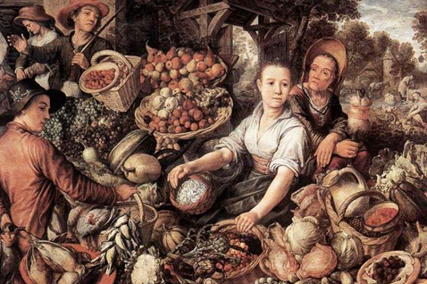
Lecture 1
The Science of Macroeconomics
Instructor: Prof. Dr.Qaisar Abbas

Slide 8
Lecture Contents
The issues macroeconomists study
The tools macroeconomists use
Some important concepts in macroeconomic analysis

Slide 9
Macroeconomics
Def
The field of economics that studies the behavior of the aggregate economy.
Macroeconomics examines economy-wide phenomena such as changes in unemployment, national income, rate of growth, gross domestic product, inflation and price levels.

Slide 10
Important issues in macroeconomics
Why does the cost of living keep rising?
Why are millions of people unemployed, even when the economy is booming?
Why are there recessions? Can the government do anything to combat recessions? Should it??
Notes:
This slide and the next contain a list of some topical issues that macro can help students understand. Feel free to substitute others as new issues emerge.

Slide 11
Important issues in macroeconomics
What is the government budget deficit? How does it affect the economy?
Why does the U.S. have such a huge trade deficit?
Why are so many countries poor? What policies might help them grow out of poverty?

Slide 12
U.S. Gross Domestic Product in billions of chained 1996 dollars
long-run upward trend…
Notes:
This graph shows data on U.S. Gross Domestic Product. For now, it suffices for students to know that GDP is a measure of the economy’s total output and total income, and that the data in this chart have been adjusted to take out the effects of inflation. (In Chapter 2, students will learn the exact definition of GDP, how it’s measured, and how it’s corrected for inflation).
There are two main points students should get from this graph.
First, over the long run, there’s a clear upward trend. One of the most important issues in macroeconomics is understanding this long run growth: what determines how fast a country grows over the long run, how do government policies affect the growth rate, and how could we achieve faster growth? This topic is critical, because it’s very tightly linked to our standard of living.
(continued next slide….)

Slide 13
U.S. Gross Domestic Product in billions of chained 1996 dollars
longest economic expansion on record
Recessions
Notes:
Second, the economy doesn’t always grow smoothly: over the short run, the economy sometimes experiences periods of falling GDP, called recessions. What students see in this graph as little downward blips correspond to periods during which hundreds of thousands of workers lose their jobs.
Periods of rising GDP are called “expansions.” In March 2001, the U.S. completed the longest expansion on record. When the economy is expanding, firms are producing more goods and services, and therefore hiring more workers. Consumer incomes are rising, and consumers are spending more.

Slide 14
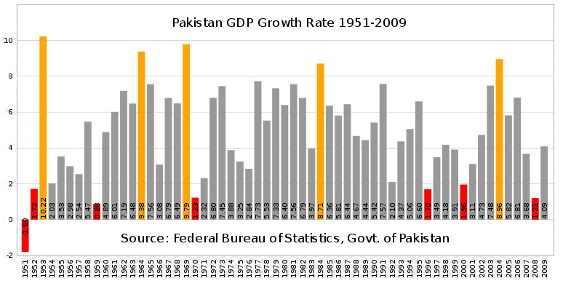
GDP of Pakistan

Slide 15
Why learn macroeconomics?
The macro economy affects society’s well-being.
  example:
  Unemployment and social problems
  The macro economy affects your well-being.
    example 1:
    Unemployment and earnings growth
    example 2:
    Interest rates and mortgage payments
3. The macro economy affects politics & current events.
  example:
  Inflation and unemployment in election years

Slide 16
Inflation and Unemployment in Election Years, USA
year U rate inflation rate elec. outcome
1976 7.7% 5.8% Carter (D)
1980 7.1% 13.5% Reagan (R)
1984 7.5% 4.3% Reagan (R)
1988 5.5% 4.1% Bush I (R)
1992 7.5% 3.0% Clinton (D)
1996 5.4% 3.3% Clinton (D)
2000 4.0% 3.4% Bush II (R)
Notes:
I’d also suggest you briefly define the inflation rate (as the percentage increase in the cost of living) to help students understand this slide.
Main point of this data: The state of the economy has a huge impact on election outcomes. When the economy is doing poorly, there tends to be a change in the party that controls the White House.
1976: The rates of inflation (π) and unemployment (u) both high. Incumbent (Ford, R) loses.
1980: u still high, π even higher. Incumbent (Carter, D) loses.
1984: u still high, but π much lower. Incumbent (Reagan) wins.
1988: π the same, u much lower. Incumbent party wins.
1992: π low, but u much higher (and was higher yet in 1991). Incumbent loses.
1996: u much lower, incumbent wins.
2000: Economy doing great, and incumbent party candidate (Gore, D) wins majority of popular vote, but loses electoral college to challenger.

Slide 17
Inflation and Unemployment in Election Years, Pakistan
year U rate inflation rate elec. outcome
1988 3.142% 8.835% PPP
1990 6.3% 9.051% IJI
1993 5.283% 9.825% PPP
1997 5.755% 11.803% PML
2002 8.051% 2.504% PML (Q)
6.195% 11.998% PPP
Source: IMF
Notes:
I’d also suggest you briefly define the inflation rate (as the percentage increase in the cost of living) to help students understand this slide.
Main point of this data: The state of the economy has a huge impact on election outcomes. When the economy is doing poorly, there tends to be a change in the party that controls the White House.
1976: The rates of inflation (π) and unemployment (u) both high. Incumbent (Ford, R) loses.
1980: u still high, π even higher. Incumbent (Carter, D) loses.
1984: u still high, but π much lower. Incumbent (Reagan) wins.
1988: π the same, u much lower. Incumbent party wins.
1992: π low, but u much higher (and was higher yet in 1991). Incumbent loses.
1996: u much lower, incumbent wins.
2000: Economy doing great, and incumbent party candidate (Gore, D) wins majority of popular vote, but loses electoral college to challenger.

Slide 18
Economic models
…are simplified versions of a more complex reality
  irrelevant details are stripped away
Used to
  show the relationships between economic variables
  explain the economy’s behavior
  devise policies to improve economic performance

Slide 19
Example of a model:
The supply & demand for new cars
Explains the factors that determine the price of cars and the quantity sold.
Assumes the market is competitive: each buyer and seller is too small to affect the market price
Variables:
  Q ^{d} = quantity of cars that buyers demand
  Q ^{s} = quantity that producers supply
  P = price of new cars
  Y = aggregate income
  P_{s} = price of steel (an input)
Notes:
Students will realize that the auto market is not competitive. However, if all we want to know is how an increase in the price of steel or a fall in consumer income affects the price and quantity of autos, then it’s fine to use this model.
In general, making unrealistic assumptions is okay, even desirable, if they simplify the analysis without affecting its validity.

Slide 20
The demand for cars
shows that the quantity
of cars consumers demand
is related to the price of cars
and aggregate income.

Slide 21
Digression: Functional notation
General functional notation shows only that the variables are related:
A list of the variables
that affect Q ^{d}

Slide 22
Digression: Functional notation
General functional notation shows only that the variables are related:
A specific functional form shows the precise quantitative relationship:
Notes:
We often aren’t concerned with the exact quantitative relationship between variables, so we will often just use the general functional notation.

Slide 23
The market for cars: demand
P
Price
of cars
The demand curve shows the relationship between quantity demanded and price, other things equal.
D
Q Quantity of cars

Slide 24
The market for cars: supply
P
Price
of cars
S
The supply curve shows the relationship between quantity supplied and price, other things equal.
D
Q Quantity of cars

Slide 25
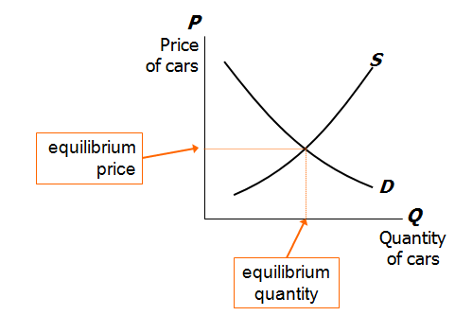
The market for cars: equilibrium

Slide 26
The effects of an increase in income
P
Price
of cars
S
An increase in income increases the quantity
of cars consumers demand at each price…
P₂
P₁
D₂
D₁
Q Quantity of cars
…which increases the equilibrium price and quantity.
Q₁
Q₂

Slide 27
The effects of a steel price increase
P
Price
of cars
S₂
S₁
An increase in P_{s} reduces the quantity of cars producers supply at each price…
P₂
P₁
D
…which increases the market price and reduces the quantity.
Q Quantity of cars
Q₂
Q₁

Slide 28
Endogenous vs. exogenous variables
The values of endogenous variables are determined in the model.
The values of exogenous variables are determined outside the model: the model takes their values & behavior as given.
In the model of supply & demand for cars,

Slide 29
A Multitude of Models
No one model can address all the issues we care about. For example,
  If we want to know how a fall in aggregate income affects new car prices, we can use the S/D model for new cars.
  But if we want to know why aggregate income falls, we need a different model.

Slide 30
A Multitude of Models
So we will learn different models for studying different issues (e.g. unemployment, inflation, long-run growth).
For each new model, you should keep track of
  its assumptions,
  which of its variables are endogenous and which are exogenous,
  the questions it can help us understand,
  and those it cannot.

Slide 31
Prices: Flexible Versus Sticky
Market clearing: an assumption that prices are flexible and adjust to equate supply and demand.
In the short run, many prices are sticky---they adjust only sluggishly in response to supply/demand imbalances.
For example,
  labor contracts that fix the nominal wage for a year or longer
  magazine prices that publishers change only once every 3-4 years

Slide 32
Prices: Flexible Versus Sticky
The economy’s behavior depends partly on whether prices are sticky or flexible:
If prices are sticky, then demand won’t always equal supply. This helps explain
  unemployment (excess supply of labor)
  the occasional inability of firms to sell what they produce
Long run: prices flexible, markets clear, economy behaves very differently.

Slide 33
Summary
Macroeconomics is the study of the economy as a whole, including
  growth in incomes
  changes in the overall level of prices
  the unemployment rate
Macroeconomists attempt to explain the economy and to devise policies to improve its performance.

Slide 34
Summary
Economists use different models to examine different issues.
Models with flexible prices describe the economy in the long run; models with sticky prices describe economy in the short run.
Macroeconomic events and performance arise from many microeconomic transactions, so macroeconomics uses many of the tools of microeconomics.

