Slide 1
CSC241: Object Oriented Programming
Lecture No 16

Slide 2
Previous lecture
Abstract class
Public and private Inheritance
Difference come when creating objects of derived class
Level of inheritance
Object of class C can
access public member of
class B and A
class A
{ };
class B : public A
{ };
class C : public B
{ };

Slide 3
Today’s Lecture
Multiple inheritance
Example program: employ and student class
Constructor in multiple inheritance
Example program
Aggregation
Composition

Slide 4
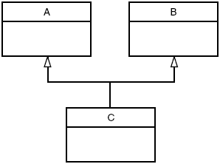
Multiple inheritance
A class can be derived from more than one base class. This is called multiple inheritance
class A {
};
class B {
};
class C : public A, public B{
};

Slide 5
Cont.
Suppose
we need to record the educational experience of some of the employees in the EMPLOY program
In a different project, we’ve already developed a class called student that models students with different educational backgrounds
Instead of modifying the employee class to incorporate educational data, we will add this data by multiple inheritance from the student class
The student class stores the name of the school or university last attended and the highest degree received
Educational information is not relevant to every class of employee

Slide 6
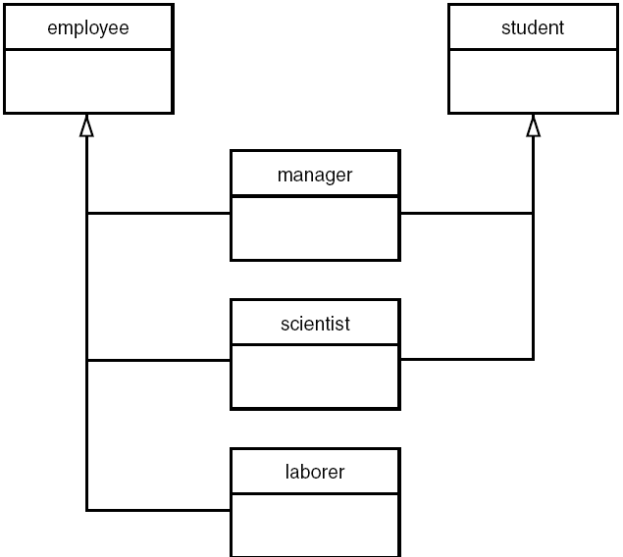

Slide 7
Miniprogram showing relationships
class student
{ };
class employee
{ };
class manager : private employee, private student
{ };
class scientist : private employee, private student
{ };
class laborer : public employee
{ };

Slide 8
const int LEN = 80;
class employee{
private:
char name[LEN];
unsigned long number;
public:
void getdata(){
cout << “\n Enter last name: “;
cin >> name;
cout << “ Enter number: “;
cin >> number;
}
void putdata() const {
cout << “\n Name: “ << name;
cout << “\n Number: “ << number;
}
};
const int LEN = 80;
class student {
private:
char school[LEN];
char degree[LEN];
public:
void getedu() {
cout << “ Name of school : “;
cin >> school;
cout << “Highest degree : ”;
cin >> degree;
}
void putedu() const {
cout << “School: “ << school;
cout << “Degree earned: “
<< degree;
}
};

Slide 9
class manager : private employee, private student {
private:
char title[LEN];
double dues;
public:
void getdata() {
employee::getdata();
cout << “ Enter title: “; cin >> title;
cout << “ Enter golf club dues: “; cin >> dues;
student::getedu();
}
void putdata() const {
employee::putdata();
cout << “\n Title: “ << title;
cout << “\n Golf club dues: “ << dues;
student::putedu();
}
};

Slide 10
class scientist : private employee, private student
{
private:
int pubs;
public:
void getdata() {
employee::getdata();
cout << “ Enter number of pubs: “; cin >> pubs;
student::getedu();
}
void putdata() const {
employee::putdata();
cout << “\n Number of publications: “ << pubs;
student::putedu();
}
};
class laborer : public employee {
};

Slide 11
main(){
manager m1;
scientist s1, s2;
laborer l1;
cout << “\nEnter data: manager 1”;
m1.getdata();
cout << “\nEnter data : scientist 1”;
s1.getdata();
cout << “\nEnter data : laborer 1”;
l1.getdata();
cout << “\nData on manager 1”;
m1.putdata();
cout << “\nData on scientist 1”;
s1.putdata();
cout << “\nData on laborer 1”;
l1.putdata();
}
Program Output
Enter data manager 1
Enter last name: Bradley
Enter number: 12
Enter title: Vice-President
Enter golf club dues: 100000
Enter name of school : Yale
Enter degree earned: MS
Enter data for scientist 1
Enter last name: Twilling
Enter number: 764
Enter number of pubs: 12
Enter name of school : MIT
Enter degree earned PhD
Enter data for laborer 1
Enter last name: Jones
Enter number: 48323
Go to program

Slide 12
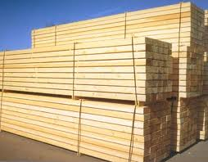
Constructors in Multiple Inheritance
Suppose we’re writing a program for building contractors, and that models lumber-supply items.
A class that represents a quantity of lumber of a certain type: e.g. 100 8-foot-long construction grade 2.4s

Slide 13
Lumber class
Class store various kinds of data about each such lumber item. E.g.
Length
Number of such pieces of lumber
Unit cost
Description of the lumber: dimensions of cross-section of lumber
Grade of lumber: rough-cut, construction grade, surface-four-side

Slide 14
Cont.
It convenient to create a Type class to hold
Description of the lumber (Dimensions) e.g. 2x6
Grade of lumber e.g. construction
class Type {
private:
string dimensions;
string grade;
public:
Type() : dimensions(“N/A”), grade(“N/A”) { }
Type(string di, string gr) : dimensions(di), grade(gr)
{ }
void gettype() {
cout << “ Enter dimension”;
cin >> dimensions;”
cout << “ Enter grade “;
cin >> grade;
}
void showtype() const {
cout << dimensions <<“:”grade;
}
};

Slide 15
class Distance {
private:
int feet;
float inches;
public:
Distance() : feet(0), inches(0.0)
{ }
Distance(int ft, float in) : feet(ft), inches(in)
{ }
void getdist() {
cout << “\nEnter feet: “; cin >> feet;
cout << “Enter inches: “; cin >> inches;
}
void showdist() const {
cout << feet << “ : ” << inches ;
}
};

Slide 16
class Lumber : public Type, public Distance {
private:
int quantity; double price;
public:
Lumber() : Type(), Distance(), quantity(0), price(0.0) { }
Lumber( string di, string gr, int ft, float in, int qu, float prc )
:Type(di, gr), Distance(ft, in), quantity(qu), price(prc) { }
void getlumber() {
Type::gettype(); Distance::getdist();
cout << “ Enter quantity: “; cin >> quantity;
cout << “ Enter price per piece: “; cin >> price;
}
void showlumber() const {
Type::showtype();
cout << “\n Length: “; Distance::showdist();
cout << “\n Price for “ << quantity << “$” << price * quantity;
}
};
Go to program

Slide 17
Ambiguity in Multiple Inheritance
Two base class may have same function names, while derived class has no function with that name
class A {
public:
void show() { cout << “Class A”; }
};
class B{
public:
void show() { cout <<“Class B”;}
};
class C : public A, public B
{ };
main()
{
C objC;
objC.show();
objCA::show();
objCB::show();
}
Both B and C contain a copy of func(), inherited from A.
The compiler can’t decide which copy to use, and signals an error

Slide 18
Cont.
class A {
public:
void show() { cout << “Class A”; }
};
class B : public A
{ };
class C : public A
{ };
class D : public B, public C
{ };
class A
show()
class B
show()
class C
show()
class D
show()
main() {
D objD;
objD.show();
}

Slide 19
Aggregation and Composition
Inheritance gives us an 'is-a' relationship.
B is a kind of A. This is because B has all the characteristics of A and in addition some of its own
Aggregation gives us a 'has-a' relationship
Aggregation would make sense in this situation, a Customer 'has-a' Address.

Slide 20
Aggregation: Classes Within Classes
E.g. an invoice has an item line,
Aggregation is also called a “part-whole” relationship
In Object oriented programming, aggregation occur when one object is an attribute of another
class A{
};
class B{
A objA;
};

Slide 21
Cont.
A composition hierarchy defines how an object is composed of other objects in a fixed relationship.
Aggregate object cannot exist without its components
an object of a container class which is able to contain other objects. Its existence is independent of whether it actually contains anything. Contained objects will probably be dynamic and vary over time.
E.g. a car boot is a container which is able to contain some or no objects

Slide 22
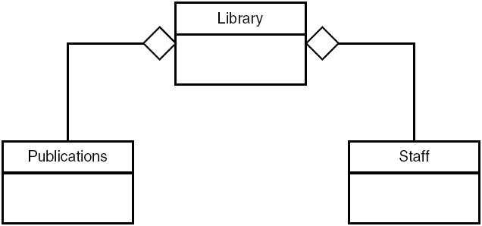
UML class diagram showing aggregation

Slide 23
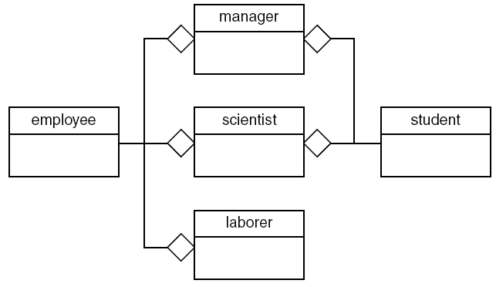
Aggregation in the EMPLOY Program
class student {
};
class employee {
};
class manager {
student stu;
employee emp;
};
class scientist {
student stu;
employee emp;
};
class laborer {
employee emp;
};
Go to program

