Slide 1
CSC241: Object Oriented Programming
Lecture No 19

Slide 2
Previous Lecture
Default copy constructor
Memory management
String class using new operator
Pointer to object
Array of pointers to objects
Polymorphism
Two examples
Animal : frog, fish, bird
Shape: circle, triangle, rectangle

Slide 3
Today’s Lecture
Polymorphism
Example
Virtual function
Static and dynamic binding
Abstract class and pure virtual functions

Slide 4
Polymorphism – Example 2
Suppose you have a objects of different classes
All are inherited from a base class
you want to put them all in an array
perform a particular operation on them using the same function call.
Shape
Circle
Square
Triangle

Slide 5
Cont.
0
1
2
3
*ptrArray
shape* ptrArray[4];
ptrArray[0] = new Circle;
ptrArray[1] = new Triangle;
ptrArray[0] = new Circle;
ptrArray[0] = new Square;
for(int j=0; j<4; j++)
ptrarr[j]->draw();
circle
square
triangle
circle

Slide 6
Condition for polymorphism
Following condition must be meet in order to achieve polymorphic behaviour
First, all the different classes of shapes, such as circle and triangles, must be inherited from a single base class
Second, the draw() function must be declared to be virtual in the base class.
Shape
draw()
ptrarr[j]->draw();
Circle
draw()
Square
draw()
Triangle
draw()

Slide 7
Example programs
Normal Member Functions Accessed with Pointers
Virtual Member Functions Accessed with Pointers

Slide 8
Normal Member Functions Accessed
class Base {
public:
void show()
{ cout << “Base\n”; }
};
main() {
}
*ptr
Derv1 dv1;
Derv2 dv2;
Base* ptr;
ptr = &dv1;
dv1
dv2
class Derv1 : public Base {
public:
void show()
{ cout << “Derv1\n”; }
};
ptr->show();
ptr = &dv2;
Program Output
ptr->show();
Base
Base
Go to program
class Derv2 : public Base {
public:
void show()
{ cout << “Derv2\n”; }
};
Note: Compiler ignores the contents of the pointer ptr and chooses the member function that matches the type of the pointer

Slide 9
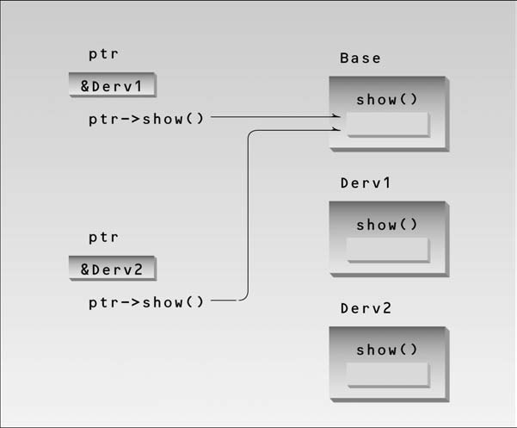
Non-virtual pointer access.

Slide 10
Virtual Member Functions Accessed
class Base {
public:
virtual void show()
{ cout << “Base\n”; }
};
main() {
}
*ptr
Derv1 dv1;
Derv2 dv2;
Base* ptr;
ptr = &dv1;
dv1
dv2
class Derv1 : public Base {
public:
void show()
{ cout << “Derv1\n”; }
};
ptr->show();
ptr = &dv2;
Program Output
ptr->show();
Derv1
Derv2
Go to program
class Derv2 : public Base {
public:
void show()
{ cout << “Derv2\n”; }
};
Note: Compiler selects the function based on the contents of the pointer ptr, not on the type of the pointer

Slide 11
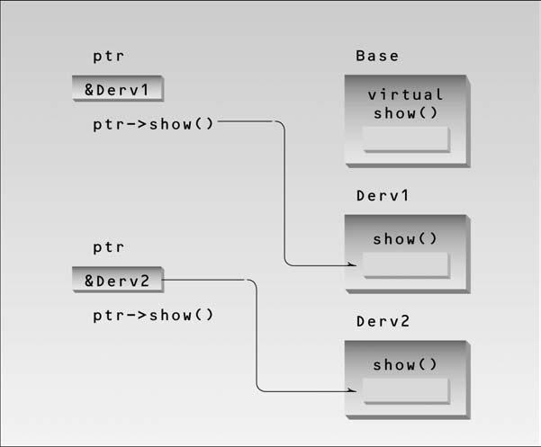
Virtual pointer access

Slide 12
Static binding
When a member function/virtual function is called with the object of that class
For example
dist1.getdist();
derv1.show();
base1.show();
Function invocation is resolved at compile time.
This is called static or early binding
This is not a polymorphic behavior

Slide 13
Dynamic binding
Virtual function can be invoked using base class pointer to a derive class object
shapePtr—>draw()
Now the correct derived class draw function will be selected dynamically (execution time)
This is called dynamic or late binding
At run time, when it knows what class is pointed by shapePtr, the draw function of that class is called

Slide 14
Allowable assignments b/w base and derived class object and pointer
Four ways to aim base and derive class pointer at base and derived class objects
Base class pointer to base class objects
Derived class pointer to derived class objects
Base class pointer to derive class objects
Derive class object is also object of base class
Derive class pointer to base class object.
Not allowed
“is a” relationship applies only from derive class to base class not vice versa

Slide 15
Abstract Classes and Pure Virtual Functions
class Base {
public:
virtual void show() = 0;
};
Pure virtual function
Go to program
0
1
class Derv1 : public Base {
public:
void show()
{ cout << “Derv1\n”; }
};
main() {
Base* arr[2];
}
arr[2]
Derv1 dv1;
Derv2 dv2;
dv1
dv2
arr[0] = &dv1;
arr[1] = &dv2;
class Derv2 : public Base {
public:
void show()
{ cout << “Derv2\n”; }
};
Program Output
arr[0]->show();
arr[1]->show();
Derv1
Base b;
//
Derv2
Note: objects of abstract class cannot be created

Slide 16
Note
After aiming a base-class pointer at a derived-class object, attempting to reference derived-class-only members with the base-class pointer is a compilation error
class B {
public:
virtual void show() = 0;
};
class Derv1 : public B {
public:
void show()
{ cout << “Derv1\n”; }
void display()
{cout<<“hello derv1”; }
};
main(){
B *ptr;
Derv1 dv1;
ptr = &dv1;
ptr—>show();
ptr—>display();
}

Slide 17
Example program: Person class
class person {
protected:
char name[40];
public:
void getName() {
cout << “ Enter name: “;
cin >> name;
}
void putName() {
cout << “Name is: “ << name;
}
virtual void getData() = 0;
virtual bool isOutstanding() = 0;
};
class professor : public person {
private:
int numPubs;
public:
void getData() {
person::getName();
cout << “ Enter publications: “;
cin >> numPubs;
}
bool isOutstanding() {
return (numPubs > 100) ? true :
false;
}
};

Slide 18
Cont.
class student : public person {
private:
float gpa;
public:
void getData() {
person::getName();
cout << “ Enter GPA: “;
cin >> gpa;
}
bool isOutstanding() {
return (gpa > 3.5) ? true : false; }
};
person* persPtr[100];
int n =0;
persPtr[n] = new student;
persPtr[n]->getData();
n++;
persPtr[n] = new professor;
persPtr[n]->getData();
n++;
for(int j=0; j<n; j++){
persPtr[j]->putName();
if( persPtr[j]->isOutstanding() )
cout << “ This person is outstanding\n”;
}
Go to program

Slide 19
Virtual Destructors
A problem can occur when using polymorphism to process dynamically allocated objects of a class hierarchy
E.g. applying delete operator to a base class pointer, which point to derived class objects
B *ptr;
Derv1 dv1;
ptr = &dv1;
delete ptr;
Solution : virtual destructor

Slide 20
Cont.
A virtual destructor in base class makes all derived class destructor virtual
B *ptr; Derv1 dv1;
ptr = &dv1;
delete ptr;
Now destructor for appropriate class is called
When derived class object is destroyed, base class part of derive class object is also destroyed
Base class destructor is executed after derived class destructor

Slide 21
Example – virtual destructor
class Base {
public:
{ cout << “Base destroyed\n”; }
};
class Derv : public Base {
public:
~Derv()
{ cout << “Derv destroyed\n”; }
};
main() {
Base* pBase = new Derv;
delete pBase;
}
Without virtual Destructor
*pBase
Object of Derv
virtual ~Base()
~Base()
Object of Derv
Program Output
Base destroyed
With virtual Destructor
*pBase
Object of Derv
Program Output
Derv destroyed
Base destroyed
Go to program

Slide 22
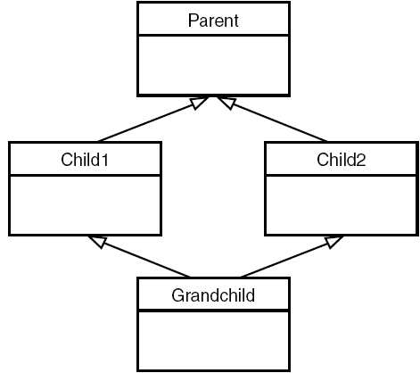
Virtual base classes
A problem can arise if a member function in the Grandchild class wants to access data or functions in the Parent class
When the Child1 and Child2 classes are derived from Parent, each inherits a copy of Parent; this copy is called a subobject

Slide 23
Cont.
class Parent {
protected:
int basedata;
};
class Child1 : public Parent
{ };
class Child2 : public Parent
{ };
class Grandchild : public Child1,
public Child2 {
public:
int getdata()
{ return basedata; }
};
basedata
basedata
basedata
basedata
This situation is ambiguous, and that’s what the compiler reports

Slide 24
Cont.
class Parent {
protected:
int basedata;
};
class Child1 : virtual public Parent
{ };
class Child2 : virtual public Parent
{ };
class Grandchild : public Child1, public Child2 {
public:
int getdata()
{ return basedata; }
};
keyword virtual in these two classes causes them to share a single common
subobject of their base class Parent
Go to program

