Slide 1
CSC241: Object Oriented Programming
Lecture No 15

Slide 2
Previous Lecture
Function overriding
Example program
Stack class – stack2 class
push() and pop()
Distance class – Distsign class
getdist() and setdist()
Class hierarchy
Employee program
Employee class
Scientist class
Manager class
Laberor class

Slide 3
Today’s Lecture
Abstract class
Public and private Inheritance
Example program
Level of inheritance

Slide 4
Abstract base class
Classes used only for deriving other classes, as employee, are sometimes loosely called abstract classes, meaning that no actual instances (objects) of this class are created

Slide 5
public and private Inheritance
Class manager : public employee
The keyword public specifies that objects of the derived class are able to access public member functions of the base class
When this keyword is not used, objects of the derived class cannot access public member functions of the base class
Result is that no member of the base class is accessible to objects of the derived class

Slide 6
Cont.
public inheritance represents is a relationship
Base class : access specifier | Type of inheritance
 | Public inheritance | Protected inheritance | Private inheritance
Public | Public in derived class | Protected in derived class | Private in derived class
Protected | Protected in derived class | Protected in derived class | Private in derived class
Private | Hidden in derived class | Hidden in derived class | hidden in derived class

Slide 7
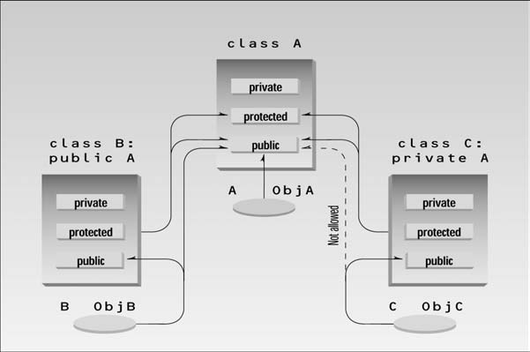

Slide 8
Access Combinations
class A {
private:
int privdataA;
protected:
int protdataA;
public:
int pubdataA;
};
class B : public A {
public:
void access() {
int x;
x = privdataA;
x = protdataA;
x = pubdataA;
}
};
class C : private A {
public:
void access() {
int y;
y = privdataA;
y = protdataA;
y = pubdataA;
}
};
int z;
B objB;
z = objB.privdataA;
z = objB.protdataA;
z = objB.pubdataA;
z = objC.privdataA;
z = objC.protdataA;
z = objC.pubdataA;
Go to program

Slide 9
Cont.
Derived class
Functions can access protected and public member in base class (in case of public, protected and private inheritance)
Objects cannot access private or protected members of the base class (in case of public inheritance)
Objects cannot access public, private or protected member of base class (in case of private or protected inheritance)

Slide 10
Access Specifiers: When to Use What
In most cases a derived class exists to offer an improved—or a more specialized—version of the base class
We’ve seen examples of such derived classes CountDn class that adds the decrement operator to the Counter class and the manager class that is a more specialized version of the employee class
In such cases it makes sense for objects of the derived class to access the public functions of the base class if they want to perform a basic operation

Slide 11
Cont.
The derived class is created as a way of completely modifying the operation of the base class, hiding or disguising its original interface
Examples
Array class that acts like an array but provides protection against out-of-bounds array indexes
Objects of Stack2 should always be treated as if they were stacks, using push() and pop()
In this situation, private inheritance would allow you to hide all the Array class functions from objects of the derived Stack2 class

Slide 12
Levels of Inheritance
A class can be derived from a class that are themselves derived
B is derived from A, and C is
derived from B. The process can
be extended to an arbitrary number
of levels—D could be derived from C,
and so on
As a more concrete example, suppose that we decided to add a special kind of laborer called a foreman to the EMPLOY program
class A
{ };
class B : public A
{ };
class C : public B
{ };

Slide 13
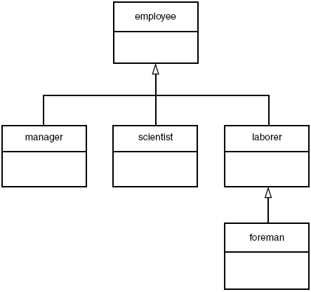
UML class diagram – EMPLOY program
Foremen oversee the widget-stamping operation, supervising groups of laborers

Slide 14
C++ EMPLOY program
class foreman : public laborer {
private:
float quotas;
public:
void getdata()
{
laborer::getdata();
cout << “ Enter quotas: “; cin >> quotas;
}
void putdata() const
{
laborer::putdata();
cout << “\n Quotas: “ << quotas;
}
};
main()
{
laborer l1;
foreman f1;
cout << “\nEnter data for laborer 1”;
l1.getdata();
cout << “\nEnter data for foreman 1”;
f1.getdata();
cout << “\nData on laborer 1”;
l1.putdata();
cout << “\nData on foreman 1”;
f1.putdata();
}
Go to program

Slide 15
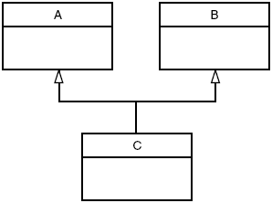
Multiple inheritance
A class can be derived from more than one base class. This is called multiple inheritance
class A {
};
class B {
};
class C : public A, public B{
};

Slide 16
Member Functions in Multiple Inheritance
Suppose
we need to record the educational experience of some of the employees in the EMPLOY program
In a different project, we’ve already developed a class called student that models students with different educational backgrounds
Instead of modifying the employee class to incorporate educational data, we will add this data by multiple inheritance from the student class
The student class stores the name of the school or university last attended and the highest degree received
Educational information is not relevant to every class of employee

Slide 17
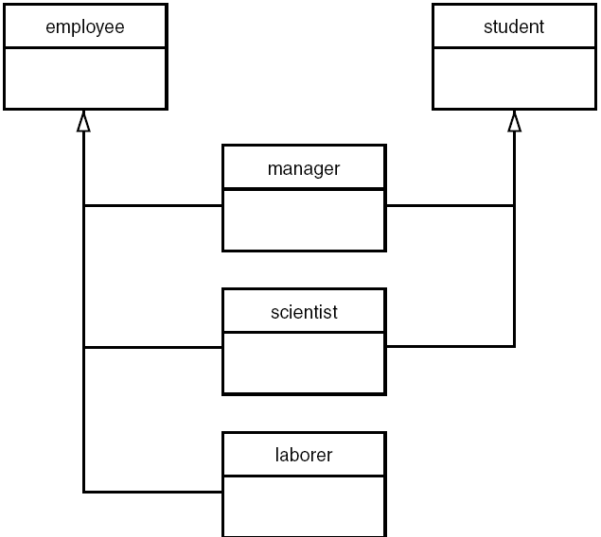

Slide 18
Miniprogram showing relationships
class student
{ };
class employee
{ };
class manager : private employee, private student
{ };
class scientist : private employee, private student
{ };
class laborer : public employee
{ };

