Slide 1
CSC241: Object Oriented Programming
Lecture No 17

Slide 2
Previous lecture
Multiple inheritance
Example program: employ and student class
Constructor in multiple inheritance
Example program
Composition

Slide 3
Today’s lecture
Example program – inheritance
Relationship between class
Association
Aggregation
Composition
Memory management
String class

Slide 4
Example program
Problem statement
Various situations require that pairs of numbers be treated as a unit. For example, each screen coordinate has an x (horizontal) component and a y (vertical) component.
Derive a new class pairStack from Stack that allow to store pair variables on a stack using a single call to a push()
push(st); // st is a structure type variable
retrieve using a single call to pop() function,
st = pop();
Go to program

Slide 5
Association
It is a simple connection or channel between classes
It is a relationship where all objects have their own lifecycle and there is no owner
Example: Department and student
Multiple students can associate with single department
Single student can associate with multiple departments
No ownership
Both can create and delete independently

Slide 6
Aggregation
It is a form of association where all object have their own lifecycle but there is a ownership like parent and child
Represents as “has a” relationship
Implementation details:
Use pointer variables that points to object of other class
Can use a reference variables that points to object of other class
Not responsible for creation/destruction of subclass

Slide 7
Cont.
Example: Employee and Company
A single employee cannot belong to multiple company.
If we delete the company, Employee object will not destroy
Employee e(6, “ali”);
c
e
Company C(“MS”, &e);
name
ali
ID
6
*emp
name
ali
Go to program

Slide 8
Composition
It is a specialize form of aggregation.
It is a strong composition
Parent and child objects have coincident lifetimes
Child object dose not have it's own lifecycle
If parent object gets deleted, then all of it's child objects will also be deleted

Slide 9
Cont.
Composition gives us 'part-of‘ relationship
It is a stronger form of aggregation
It has all the characteristics of aggregation plus two more
The part may belong to only one whole
The life time of the part is same as life time of the whole
For example, it make sense to say that an engine is part-of a car.
The lifetime of the part (Engine) is managed by the whole (Car), in other words, when Car is destroyed, Engine is destroyed along with it.

Slide 10
Cont.
Implementation details
Use normal member variables
Can use pointer values if composition class automatically handles allocation/deallocation
Responsible for creation/destruction of subclass

Slide 11
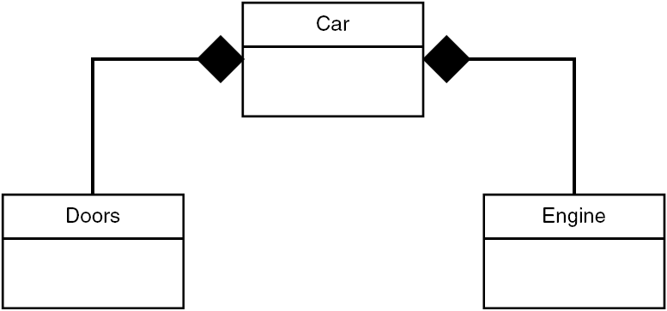
UML representation of Composition

Slide 12
Composition – Example
Relationship between houses and rooms
House can contains multiple room
There is no independent life for room and any room cannot belong to different houses.
If house is deleted room will also be deleted automatically

Slide 13
Implementation details
class House{
char name[30]; Room rooms[2];
….
};
class Room{
char Name[30]; int Length;
int Width;
….
};
house
rooms[2]
0
1
name
Name
Name
Length
Length
Width
Width
Go to program

Slide 14
Summary – inheritance
A class, called derived class can inherit feature of another class called a base class
Derived class can add other feature of its own
Class can be derived publically or privately from base class
A class can be derived from more than one base class – multiple inheritance
Level of inheritance

Slide 15
Cont.
Aggregation is a “has a” or “part-whole” relationship
Aggregation in C++: One class contains object of another class
Composition represents 'part-of‘ relationship

Slide 16
A String Class Using new
class String {
private:
char* str;
public:
String(char* s) {
int length = strlen(s);
str = new char[length+1];
strcpy(str, s);
}
~String() {
cout << “Deleting str.\n”;
delete[ ] str;
}
void display() {
cout << str << endl;
}
};
main() {
String s1 = “Information Technology.”;
cout << “s1=”; //display string
s1.display();
}
Program Output
s1=Information Technology.
Deleting str
S1
*str
Information Technology.

Slide 17
A problem with String class
If you copy one String object to another, say with a statement like s2 = s1,
Both objects now point to the same string in memory.
But if you delete one string, the destructor will delete the char* string, leaving the other object with an invalid pointer
S1
*str
Information Technology.
S2
*str
S1
*str
S2
*str

