Slide 1
CSC241: Object Oriented Programming
Lecture No 22

Slide 2
Previous Lecture
Friend function
example program: Distance class
Friend function for functional notation
Friend classes
static functions
Assignment operator and copy initialization

Slide 3
Today’s Lecture
Example program
Copy initialization
Assignment operator overloaded
Memory efficient string class
Dynamic Type Information

Slide 4
The Copy Constructor
Distance d2 = d1;
It is similar to what assignment operator (d2 = d1) does
The difference is that copy initialization also creates a new object
d2
d1
feet
7
feet
7
inches
6.5
inches
6.5

Slide 5
Example program – assignment and copy constructor
class alpha {
private:
int data;
public:
alpha() { }
alpha(int d)
{ data = d; }
alpha(alpha& a) {
data = a.data;
cout << “\nCopy constructor invoked”;
}
void display()
{ cout << data; }
void operator = (alpha& a) {
data = a.data;
cout << “\nAssignment operator invoked”;
}
};
a2 = a1;
alpha a3(a1);
Program Output
Assignment operator invoked
Copy constructor invoked

Slide 6
When Copy constructor is invoked
Copy constructor may be invoked when an object is defined
e.g. alpha a3 = a2; or alpha a3(a2);
when arguments are passed by value to functions.
void func(alpha a) { . . . }
called by the statement
func(a1);
when values are returned from functions
alpha func();
a2 = func();
Alpha a = a1;

Slide 7
Why Not alpha(alpha a) Constructor?
Do we need to use a reference in the argument to the copy constructor? alpha(alpha &a)
Could we pass by value instead? alpha(alpha a)
No, the compiler complains that it is out of memory if we try to compile
Why?
Because when an argument is passed by value, a copy of it is constructed What makes the copy?
The copy constructor. But this is the copy constructor, so it calls itself
It calls itself over and over until the compiler runs out of memory.

Slide 8
A Memory-Efficient String Class
Defects with the String Class
String object contains an array of char
s2 = s1;
problem with this is that the same string now exists in two (or more) places in memory
An efficient approach
String object contain its own char*
s2 = s1;
This is efficient, since only a single copy of the string itself needs to be stored in memory
S1
This is a long string in memory
S2
This is a long string in memory
S1
S2
This is a long string in memory

Slide 9
Problem with efficient approach
If we use this system we need to be careful when we destroy a String object
Consider a situation in which several objects are point to same string
S1
S2
S3
If one string object is deleted, it will also delete the string it is pointing
Other object point to memory that does not contain the string
This is a long string in memory

Slide 10
Cont.
To use pointers to strings in String objects,
it is required to keep track of how many String objects point to a particular string
so that array of character will be delete when the last string object that points to it is deleted
S1
S2
S3
This is a long string in memory

Slide 11
Solution: A String-Counter Class
Problem statement:
Several String objects pointing to the same string and we want to keep a count of how many Strings object point to the string.
Where will we store this count?
Cumbersome for each object to maintain a count of how many pointer objects are pointing to the same string
static variable ?? – No this requires overhead

Slide 12
Cont.
It’s more efficient to create a new class to store the count
Each object of this class, which we call strCount, contains a count and also a pointer to the string

Slide 13
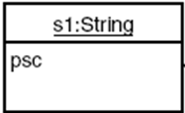
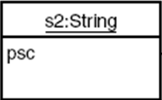
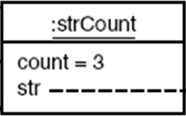
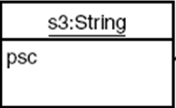
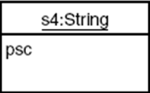
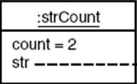
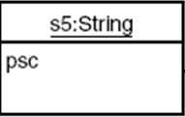
String and strCount objects.
String s1 = “This is long string in memory”;
s2 = s1;
s3 = s1;
delete s1;
3
2
1
String s4 = “This is different string ”;
s5 = s4;
delete s5;
delete s4;
2
1
0

Slide 14
Example program
class String {
private:
strCount* psc;
public:
String()
{ psc = new strCount(“\0”); }
String(char* s) {
psc = new strCount(s); }
String(String& S) {
psc = S.psc;
(psc->count)++;
}
~String() {
if(psc->count==1)
delete psc;
else
(psc->count)--;
}
class strCount {
private:
int count;
char* str;
friend class String;
strCount(char* s) {
int length = strlen(s);
str = new char[length+1]; strcpy(str, s);
count=1;
}
~strCount()
{ delete[] str; }
};

Slide 15
Cont.
void display() {
cout << psc->str;
cout <<“addr=” << psc ;
}
void operator = (String& S) {
if(psc->count==1)
delete psc;
else,
(psc->count)--;
psc = S.psc;
(psc->count)++;
}
};

Slide 16
Cont.
main() {
}
void operator = (String& S) {
if(psc->count==1)
delete psc;
else,
(psc->count)--;
psc = S.psc;
(psc->count)++;
}
String(String& S) {
psc = S.psc;
(psc->count)++;
}
String(char* s) {
psc = new strCount(s); }
String()
{ psc = new strCount(“\0”); }
String s3 = “hello world.”;
~strCount()
{ delete[] str; }
cout << “\ns3=”; s3.display();
strCount(char* s) {
int length = strlen(s);
str = new char[length+1]; strcpy(str, s);
count=1;
}
String s1;
s1 = s3;
Go to program
cout << “\ns1=”; s1.display();
String s2(s3);
S3
S1
S2
cout << “\ns2=”; s2.display();
psc:
psc:
psc:
7550
:strcount
:strcount
Program Output
count:
count:
1
2
3
1
s3= hello world. addr=7550
str:
str:
s1= hello world. addr=7550
hello world
\0
s2= hello world. addr=7550

