Slide 1
CSC241: Object Oriented Programming
Lecture No 26

Slide 2
Previous Lecture
Intro to Generic Programming
Template
Function template – single template argument

Slide 3
Today’s Lecture
Functional templates
Example program
multiple arguments
Macros vs template
Class templates

Slide 4
Example program
Write a program that can sort int, float, double, character type of array in ascending order and then display it.
Write a program

Slide 5
Function Templates – Multiple Arguments
Suppose a function to search an array for a specific value
This function takes three arguments:
two that are template arguments
one of a basic type
Function returns the array index for that value if it finds it, or –1 if it can’t find it

Slide 6
template <class atype>
int find(atype* array, atype value, int size)
{
for(int j=0; j<size; j++)
if(array[j]==value)
return j;
return -1;
}
char chrArr[] = {‘a’, ‘b’, ‘c’, ‘d’, ‘e’, ‘f’};
char ch = ‘d’;
int intArr[] = {1, 3, 5, 9, 11, 13};
int in = 6;
long lonArr[] = {1, 3, 5, 9, 11, 13};
long lo = 11;
double dubArr[] = {1.0, 3.0, 5.0, 9.0, 11.0, 13.0};
double db = 4.5;
main() {
cout << “\n d in chrArray: index=” << find(chrArr, ch, 6);
cout << “\n 6 in intArray: index=” << find(intArr, in, 6);
cout << “\n11 in lonArray: index=” << find(lonArr, lo, 6);
cout << “\n 4 in dubArray: index=” << find(dubArr, db, 6);
}
Program Output
d in chrArray: index=3
6 in intArray: index=-1
11 in lonArray: index=4
4 in dubArray: index=-1
Go to program

Slide 7
Template Arguments Must Match
When a template function is invoked, all instances of the same template argument must be of the same type.
For example, in find(), if the array name is of type int, the value to search for must also be of type int.
Following code give and error message
int intarray[] = {1, 3, 5, 7};
float f1 = 5.0;
int value = find(intarray, f1, 4);
because the compiler expects all instances of atype to be the same type. It can generate a function
find( int*, int, int);
but it can’t generate
find( int*, float, int);

Slide 8
More Than One Template Argument
template <class atype, class btype>
btype find( atype * array, atype value, btype size)
{
for(btype j=0; j<size; j++) //note use of btype
{
if(array[j]==value)
return j;
}
return (btype)(-1);
}
int a[5] = {4, 3, 2, 6, 7}, y, b=3;
y = find (a, b, 5);
int a[5] = {4, 3, 2, 6, 7}, y;
float b=3.5;
y = find (a, b, 5);

Slide 9
Why not marcos?
Macros can be used to create different versions of a function for different data types.
#define abs(n) ( (n<0) ? (-1*n) : (n) )
It performs a simple text substitution and can thus work with any type
Problem:
macros do not perform any type checking
Compiler wouldn’t check if several argument of marcos are of same type or not
Return value type is not specified

Slide 10
What type works?
How to determine that a template function can be instantiated for a particular data type?
E.g. can find() function works with c-strings type
For that, check the operator in find function
find() function would not work for c-strings
int find(atype* array, atype value, int size) {
for(int j=0; j<size; j++)
if(array[j]==value)
return j;
return -1;
}

Slide 11
Class templates
Class templates are generally used for data storage (container) classes
Stacks, queues and linked lists are examples of data-storage classes
Limitation: store only single basic data
From lecture 13
class Stack {
protected:
int st[3];
int top;
. . .
};
A separate class is created in
following case
To store long type data
To store double type data
To store Distance objects
and etc

Slide 12
Stack class as template
#define MAX 10
template <class Type>
class Stack {
private:
Type st[MAX];
int top;
public:
Stack() { top = -1; }
void push(Type var) {
st[++top] = var;
}
Type pop() {
return st[top--];
}
};
main() {
Stack<float> s1;
s1.push(111.1); s1.push(222.2);
s1.push(333.3);
cout << “1: “ << s1.pop() << endl;
cout << “2: “ << s1.pop() << endl;
cout << “3: “ << s1.pop() << endl;
Stack<long> s2;
s2.push(123123123);
s2.push(234234234);
s2.push(345345345);
cout << “1: “ << s2.pop() << endl;
cout << “2: “ << s2.pop() << endl;
cout << “3: “ << s2.pop() << endl;
}
Template argument
Go to program

Slide 13
Cont.
Stack<float> s1;
Create an object, s1, a stack that stores numbers of type float.
Compiler provides space for member functions with float type
These functions operate exclusively on type float
Stack<long> s2;
creates a different space for data for object s2
Also a new set of member functions that operate on type long are generated

Slide 14
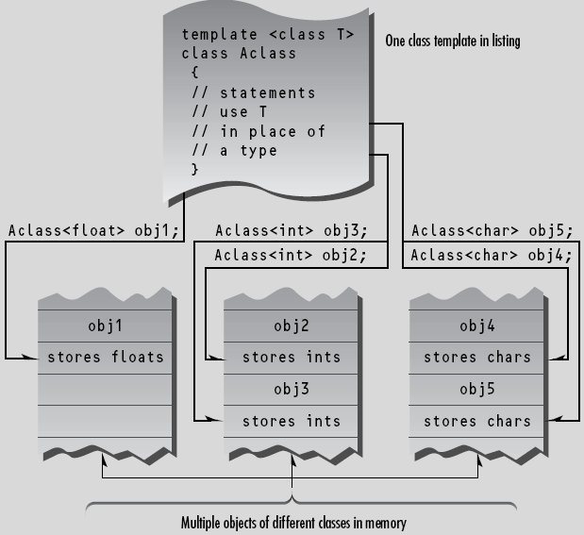

Slide 15
Class Name Depends on Context
template <class Type>
class Stack {
private:
Type st[MAX];
int top;
public:
Stack();
void push(Type var);
Type pop();
};
template<class Type>
Stack<Type>::Stack() {
top = -1;
}
template<class Type>
void Stack<Type>::push(Type var){
st[++top] = var;
}
template<class Type>
Type Stack<Type>::pop(){
return st[top--];
}

Slide 16
Nontype Parameters for Class Templates
Class template Stack used only a type parameter in the template header
template <class Type>
Template header can have integer type arguments that are treated constants
elements is constant and can be used to mention the size of array
template< typename T, int elements >
// nontype parameter elements
Go to program
Stack< double, 100 > s1;

Slide 17
Default Types for Class Templates
A type parameter can specify a default type
specify that a Stack contains String objects by default.
Compiler instantiate a Stack class-template of type Strings
Default type parameters must be the rightmost parameters in a template's type parameter list
template< typename T = string > // defaults to type string
Stack<> jobDescriptions;

Slide 18
explicit specialization
In some cases, it may not be possible to use a particular type with a class template
It is possible that a particular user-defined type will not work with Stack template
explicit specialization is used to make such types workable for stack class
It is a complete replacement for the Stack class template
template<>
class Stack< Employee >
{ // body of class definition };

