Slide 1
CSC241: Object Oriented Programming
Lecture No 27

Slide 2
Previous Lecture
Functional templates
Example program
multiple arguments
Macros vs. template
Class templates
Stack template class
Default and non type parameter for class template
Explicit specialization

Slide 3
Today’s Lecture
Exception
Exception handling
try , catch and throw block
Multiple exceptions

Slide 4
Exceptions
Exceptions are errors that occur at runtime
Exception handling provide a systematic, object-oriented approach to handling errors generated by C++ classes
For example,
running out of memory,
not being able to open a file,
trying to initialize an object to an impossible value,
or using an out-of-bounds index

Slide 5
Why Do We Need Exception handling
C-language programs signal an error by returning a value from the function
For example, disk-file functions often return NULL or 0 to signal an error
if( somefunc() == ERROR_RETURN_VALUE )
//handle the error
else
//proceed normally
if( anotherfunc() == NULL )
//handle the error
else
//proceed normally
if( thirdfunc() == 0 )
//handle the error
else
//proceed normally

Slide 6
Cont.
Problem : Every single call to such a function must be examined by the program
if else block and writing statement to handle error requires more code and make file size larger
More complex problem: classes are used,
errors may take place without a function being explicitly called
How application know if there is error in constructor
SomeClass obj1, obj2, obj3;

Slide 7
Exception syntax
Imagine an application that creates and interacts with objects of a class
Usually the application’s calls to the class member functions cause no problems
Sometimes, the application makes a mistake, causing an error to be detected in a member function
This member function informs the application that an error has occurred
When exceptions are used, this is called throwing an exception.

Slide 8
Cont.
A separate section of code to handle the errors is called exception handler or catch block
catch block catches the exceptions thrown by the member function
In program the code uses objects of the class is enclosed in a try block.
Errors generated in the try block will be caught in the catch block.
Code that doesn’t interact with the class need not be in a try block
The exception mechanism uses three new C++ keywords: throw, catch, and try

Slide 9
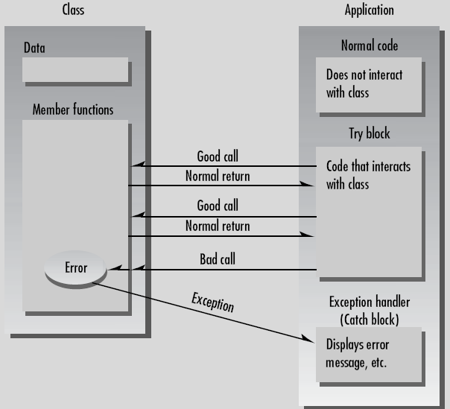
The exception mechanism

Slide 10
Program skeleton
class Aclass {
public:
class AnError //exception class
{ };
void Func() {
if( /* error condition */ )
throw AnError();
}
};
main() {
try {
AClass obj1;
obj1.Func();
}
catch(AClass::AnError) {
//tell user about error
}
}
2
If error occur in Func() an exception is thrown
1
try block contain the code that may cause exception
3
When exception is thrown control is tranfer to catch block

Slide 11
Simple example – Stack
class Stack {
private:
int st[3];
int top;
public:
class Range { };
Stack() { top = -1; }
void push(int var) {
if(top >= 3-1)
throw Range();
st[++top] = var;
}
int pop() {
if(top < 0)
throw Range();
return st[top--];
}
};
main() {
Stack s1;
try {
s1.push(11); s1.push(22);
s1.push(33); s1.push(44);
cout << "1: " << s1.pop() << endl;
cout << "2: " << s1.pop() << endl;
cout << "3: " << s1.pop() << endl;
cout << "4: " << s1.pop() << endl;
}
catch(Stack::Range) {
cout << "Exception: Stack Full or Empty";
}
cout << "Arrive here";
}
Go to program

Slide 12
Specifying the Exception Class
class Range {
//note: empty class body
};
Body of the class is empty, so objects of this class have no data and no member functions
Simple example require class name Range to connect a throw statement with a catch block
throw Range();
It will create an object of Range class
Transfer the control to exception handler

Slide 13
Exception Handler (Catch Block)
Exception class name
catch(Stack::Range) {
//code that handles the exception
}
exception class name must include the class in which it is located
It must immediately follow by try block

Slide 14
Sequence of Events
Code is executing normally outside a try block.
Control enters the try block.
If a statement in the try block causes an error in a member function.
Then member function throws an exception.
Control transfers to the exception handler (catch block) following the try block

Slide 15
Multiple exceptions
Stack class only throw one exception in both cases, either stack is empty or full
It can be modified to throw an any number of exceptions
Stack class can be modify to throw separate exceptions for attempting to
push data on a full stack and
attempting to pop data from an empty stack.

Slide 16
Multiple exceptions
class Stack {
private:
int st[3]; int top;
public:
class Full { };
class Empty { };
Stack() { top = -1; }
void push(int var) {
if(top >= 3-1)
throw Full();
st[++top] = var;
}
int pop() {
if(top < 0)
throw Empty();
return st[top--];
}
};
main() {
Stack s1;
try {
s1.push(11); s1.push(22);
s1.push(33); s1.push(44);
cout << "1: " << s1.pop() << endl;
cout << "2: " << s1.pop() << endl;
cout << "3: " << s1.pop() << endl;
cout << "4: " << s1.pop() << endl;
}
catch(Stack::Full) {
cout << "Exception: Stack Full";
}
catch(Stack::Empty) {
cout << "Exception: Stack Empty";
}
}
Go to program

Slide 17
Note
A separate catch block is used for each exception
Only one catch block is activated for a given exception
A group of catch blocks, or a catch ladder is executed a little like a switch statement

