Slide 1
CSC241: Object Oriented Programming
Lecture No 29

Slide 2
Previous Lecture
Exception in Distance class
Re-throwing an exception
Exception with arguments
bad_alloc class
set_new_handler function

Slide 3
Today’s Lecture
Handler function
Standard library Exception Hierarchy
Example program
Queue class using array
A linked list data storage class

Slide 4
Handler function
This function will be called if new fails
This provides a method to handling all new failure with a uniform approach
set_new_handler function is used to register a handler function
If new fails to allocate memory, then
If handler function is registered then it will be called
If handler function is not registered then

Slide 5
Cont.
If new allocates memory successfully, it returns a pointer to that memory
If new fails to allocate memory, then
If set_new_handler did not register a new-handler function, new throws a bad_alloc exception
If a new-handler function has been registered, the new-handler function is called

Slide 6
Task performed by handler-function
Make more memory available by deleting other dynamically allocated memory and return to operator new to attempt to allocate memory again.
Throw an exception of type bad_alloc.
Call function abort or exit to terminate the program

Slide 7
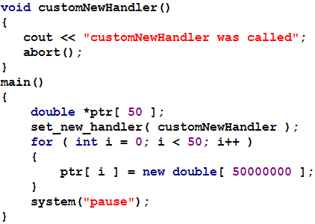
Example

Slide 8
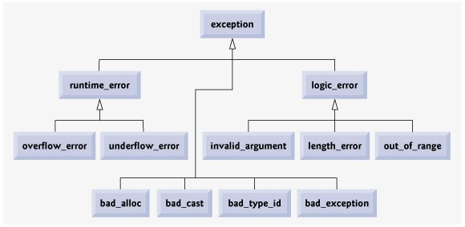
Standard Library Exception Hierarchy

Slide 9
Summary
An exception is an indication of a problem that occurs during a program's execution
Exception handling enables programmers to create programs that can resolve problems that occur at execution
Exception handling enables the programmer to remove error-handling code
try block define a block of code in which exceptions might occur
At least one catch handler must immediately follow a try block

Slide 10
Cont.
catch handler specifies an exception parameter that represents the type of exception the catch handler can process
Point in the program at which an exception occurs is called the throw point
When a try block terminates, local variables defined in the block go out of scope
Common examples of exceptions are
out-of-range array subscripts,
arithmetic overflow,
division by zero,
invalid function parameters and
unsuccessful memory allocations

Slide 11
Cont.
Destructors are called for every object constructed in a try block before an exception is thrown
If an array of objects has been partially constructed when an exception occurs, only the destructors for the constructed array element objects will be called.

Slide 12
Exercise program 1
A queue is a data-storage device.
Queue principle: first-in-first-out
Write a class template for a queue class. Also check if the queue is full or empty and throw an exception if it is
0
1
2
3
4
Insert element
a[5]
10
12
14
a[++rear] = 10;
delete element
if (front ==-1)
front ++;
if(front==-1 || front>rear)
front
-1
1
0
printf(“%d”, a[front]);
a[++rear] = 12;
rear
-1
1
2
front ++;
0
a[++rear] = 14;
Go to program

Slide 13
Exercise program 2
A link list data storage class
It consist of a group of nodes which together represent a sequence
data
ptr
data
ptr
data
ptr
data
ptr
ptr
template<class TYPE>
struct Node
{
TYPE data;
Node* next;
};
template<class TYPE>
class linklist {
private:
Node<TYPE>* first;
public:
void additem(TYPE d);
void display();
};
Go to program

