Slide 1
CSC241: Object Oriented Programming
Lecture No 02

Slide 2
Previous lecture
A simple analogy
A class is a blue print e.g. car engineering drawing
An object has existence e.g. my car
Each object has its attributes (variables) and behavior (functions)
To perform a task describe by class, an object of that class must be created
Class definition begins with keyword class
Class name begins with capital letter
Class definition is enlosed in pair of braces { }

Slide 3
Cont.
Member function that appear after the access specifier public can be called by other function and member functions of that class
Access specifier are always followed by :
Each message sent to an object is a member-function call that tells the object to perform a task
Member function can be access by object of class using dot operator

Slide 4
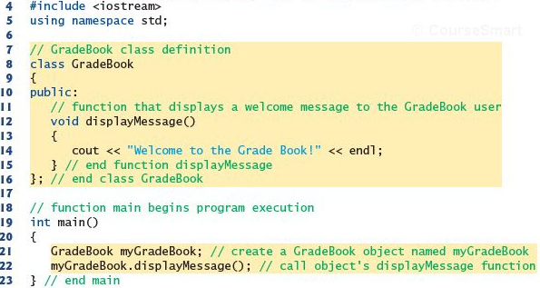
Defining a class with member function

Slide 5
Today’s Lecture
Simple C++ program using cin and cout
Member function with parameters
Set functions and get functions
Constructor

Slide 6
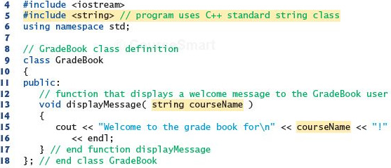
Member function with parameter
Write a program

Slide 7
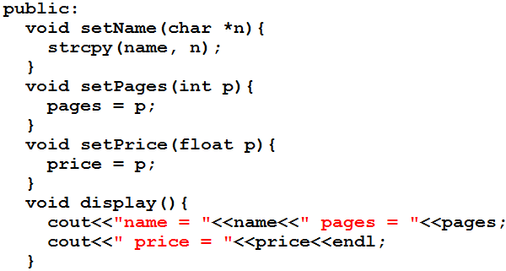
A book class

Slide 8
Class data
The class Book contain three data items
char name[15];
int pages;
float price;
There can be any number of data members in a class just as in structure
Data member are after the keyword private, so they can be accessed from within the class, but not outside

Slide 9
Member function
These functions are included in a class
There are four member functions in class Book
setName(char *n)
setPages(int p)
setPrice(float p)
display()
These functions are followed by a keyword public, so they can be accessed outside the class

Slide 10
Class data and member function
Access specifier label public and private
Function are public and data is private
Data is hidden so that it can be safe from accidental manipulation
Functions operates on data are public so they can be accessed from outside the class

Slide 11
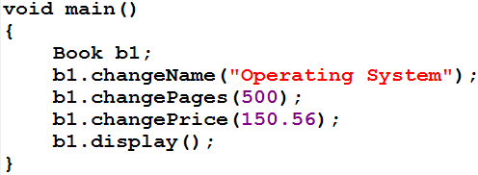
Defining Objects
b1
name
Operating system
pages
500
price
150.56

Slide 12
Cont.
Defining an object is similar to defining a variable of any data type: Space is set aside for it in memory e.g. int x;
Defining objects in this way (book b1;) means creating them
An object is an instance (that is, a specific example) of a class. Objects are sometimes called instance variables.

Slide 13
Calling Member Functions
The next four statements in main() call the member function
b1.setName("Operating System");
b1.setPages(500);
b1.setPrice(150.56);
b1.display();
don’t look like normal function calls
This syntax is used to call a member function that is associated with a specific object
It doesn’t make sense to say
changeName("Operating System");
because a member function is always called to act on a specific object, not on the class in general

Slide 14
Cont.
To use a member function, the dot operator (the period) connects the object name and the member function.
The syntax is similar to the way we refer to structure members, but the parentheses signal that we’re executing a member function rather than referring to a data item.
The dot operator is also called the class member access operator.
Go to program

Slide 15
Data members, set and get functions

Slide 16
Example program – Distance class
Data members
Feet
Inches
Member functions
void setdist(int ft, float in);
void getdist();
void initialize();
void showdist();
Go to program

Slide 17
Distance class – data member initialization
Distance class shows two ways to initialize the data items in an object
void initialize();
void setdist(int ft, float in);
Can an object be initialized whenever it is created, without requiring a separate call to a member function?
Automatic initialization is carried out using a special member function called a constructor.
A constructor is a member function that is executed automatically whenever an object is created.

Slide 18
Constructors
C++ requires a construct call for each object it has created
This ensure that object is initialized properly before it is used
If there is no constructor, the compiler provides a default constructor that is, a constructor with no parameters
Name of constructor function is same as name of class

Slide 19
A counter example
Data member
Count
Member function
Constructor
void inc_count()
int get_count()
Go to program

Slide 20
Automatic initialization
An object of type Counter is first created, we want its count to be initialized to 0
Options are
set_count() function (call it with an argument of 0)
zero_count() function, to set count to 0.
Such functions would need to be executed every time we created a Counter object

Slide 21
Cont.
A programmer may forget to initialize the object after creating it
It’s more reliable and convenient to cause each object to initialize implicitly when it is created
In the Counter class, the constructor Counter() is called automatically whenever a new object of type Counter is created
Counter c1, c2;
creates two objects. Constructor is called with each object separately
Go to program

Slide 22
Constructor Name
First, constructor name must be same as the name of class
This is one way the compiler knows they are constructors
Second, no return type is used for constructors
Why not? Since the constructor is called automatically by the system, there’s no program for it to return anything to; a return value wouldn’t make sense
This is the second way the compiler knows they are constructors

Slide 23
Initializer List
One of the most common tasks a constructor carries out is initializing data members
In the Counter class the constructor must initialize the count member to 0
The initialization takes place following the member function declarator but before the function body.
Initialization in constructor’s function body
Counter()
{ count = 0; }
this is not the preferred approach

Slide 24
Cont.
It’s preceded by a colon. The value is placed in parentheses following the member data.
Counter() : count(0)
{ }
If multiple members must be initialized, they’re separated by commas.
someClass() : m1(7), m2(33), m2(4) ←initializer list { }

Slide 25
Placing a Class in a Separate File
Header file (.h)
Contain definition of class
Not an executable file
Included in .cpp file
main () file (.cpp)
Include .h file containing class definition
Executable file
Go to program

Slide 26
Destructors
Destructor is a function called automatically when an object is destroyed
The most common use of destructors is to deallocate memory that was allocated for the object by the constructor
Go to program

Slide 27
Validating Data with set Functions
A set function should validate the value before assigning to private data member
Set function can return a value or may display a message if invalid data is assign to object
Go to program

