Slide 1
CSC241: Object Oriented Programming
Lecture No 31

Slide 2
Previous Lecture
A linked list data storage class
data
ptr
data
ptr
data
ptr
data
ptr
ptr
template<class TYPE>
class linklist {
private:
Node<TYPE>* first;
public:
void additem(TYPE d);
void del();
void display();
};
template<class TYPE>
struct Node
{
TYPE data;
Node* next;
};

Slide 3
Today’s Lecture
Stream and classes
Input and Output stream
iostream class
ios class
Formatting Flags
Error-Status Bits
File operations

Slide 4
Stream Classes
A stream is a flow of data (sequences of bytes)
In C++ a stream is represented by an object of a particular class
For example, the cin and cout stream objects
Different streams are used to represent different kinds of data flow
For example, the ifstream class represents data flow from input disk files

Slide 5
Advantages of Streams
Simplicity
E.g. using printf and scanf function, there is a need to specify the type of input or output i.e. %d, %f or %c etc.
There are no such formatting characters in streams, since each object already knows how to display itself
Overload existing operators and functions
Use exisiting operator for class in the same way as the built-in types

Slide 6
I/O stream classes
It represent input and output stream
In input stream, the bytes flow from a device (e.g., a keyboard) to main memory
In output stream, bytes flow from main memory to a device (e.g., a display screen, a printer)
We have already use stream class
Extraction operator >> is a member of istream class
Insertion operator << is a member of ostream class
istream and ostream are derived from ios

Slide 7
cout and cin
cout object:
It representing the standard output stream which is usually monitor
It is a predefined object of the ostream_withassign class, which is derived from the ostream class
cin object:
Represent standard input stream which is usually key board
It is a predefined object of istream_withassign class, which is derived from istream

Slide 8
Header files
IOSTREAM
classes used for input and output to the video display and keyboard are declared in header file IOSTREAM
FSTREAM
classes used specifically for disk file I/O are declared in the file

Slide 9
iostream class
iostream class is derived from both istream and ostream by multiple inheritance
Classes derived from it can be used with e.g. disk files, that may be opened for both input and output at the same time

Slide 10
ios class
It is base class of all the stream classes
It contains the majority of the features to operate C++ streams
Three most important features are
Formatting flags,
Error-status flags,
File operation mode

Slide 11
Formatting Flags
It is a set of flag in ios class
Flags act as on/off switches that specify various aspects of input and output format and operation
All the flags can be set using the setf() and unsetf() ios member functions

Slide 12
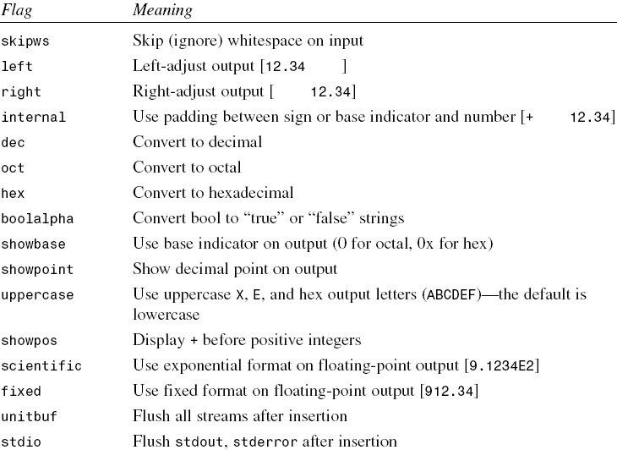
ios formatting flags

Slide 13
Cont.
All flag are the member of ios class so they can be access using scope resolution operator
ios::skipws
Example
float x = 18.0;
cout<< x << endl; cout.setf(ios::showpoint);
cout<< x << endl; cout.setf(ios::scientific);
cout<< x << endl;
Go to program

Slide 14
ios manipulators / functions
Manipulators are formatting instructions inserted directly into a stream
endl
setw(int)
Functions can use to set the formatting flags and perform other tasks
width(w);
Go to program

Slide 15
The istream Class
It is derived from ios, performs input-specific activities, or extraction
Function | Purpose
>> | Formatted extraction for all basic (and overloaded) types.
get(ch); | Extract one character into ch.
get(str) | Extract characters into array str, until ‘\n’.
get(str, MAX) | Extract up to MAX characters into array.

Slide 16
The ostream Class
It handles output or insertion activities.
Function | Purpose
<< | Formatted insertion for all basic (and overloaded) types.
put(ch) | Insert character ch into stream.
flush() | Flush buffer contents and insert newline.
write(str, SIZE) | Insert SIZE characters from array str into file.

Slide 17
Predefined Stream Objects
cin
cout
cerr, an object of ostream_withassign,
for error messages
displayed output immediately, rather than being buffered, as cout is
clog, an object of ostream_withassign,
for log messages
its output is buffered

Slide 18
Stream Errors
cout<<”Enter a number”;
cin >> var;
This approach assumes that nothing will go wrong during the I/O process
This isn’t always the case
What happens if a user enters the string “nine” instead of the integer 9

Slide 19
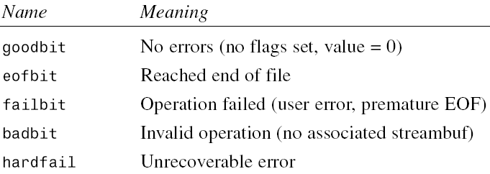
Error-Status Bits
Stream error-status flags reports errors that occurred in an input or output operation
Inputting Numbers
Go to program

Slide 20
Disk File I/O with Streams
Disk I/O stream are
ifstream for input
fstream for both input and output
ofstream for output
These classes are declared in FSTREAM header file
Objects of these classes can be associated with disk files, that use member functions to read and write to files

Slide 21
Formatted File I/O
In formatted I/O, numbers are stored on disk as a series of characters
896.026 take 7 bytes instead of 4-byte
This is inefficient for numbers with many digits
But it is easy to implement

Slide 22
Writing Data
We can write characters, integers, double, and string to a disk file
ofstream outfile(“fdata.txt”);
outfile << ch;
Go to program

Slide 23
Reading Data
ifstream infile(“fdata.txt”);
The file is opened when the object is created
We can then read from it using the extraction (>>) operator
infile >> ch >> j >> d >> str1 >> str2;
Go to program

Slide 24
Strings with Embedded Blanks
Such read operation would not work with string have blank space
To handle such string
specific delimiter character after each string must be written
use the getline()function, rather than the extraction operator, to read
Such scheme require that all line in file terminate at \n character
Don not work with random text file
Go to program

Slide 25
Cont.
Detecting End-of-File
while( !infile.eof() )
while( infile)
Checking the stream object directly
It check for any error condition including EOF

