Slide 1
CSC241: Object Oriented Programming
Lecture No 32

Slide 2
Previous Lecture
Stream and classes
Input and Output stream
iostream class
ios class
Formatting Flags
Error-Status Bits
Formatted File I/O
Reading data
Writing data

Slide 3
Today’s Lecture
File operations
Formatted File I/O
Reading data
Writing data
Character I/O
Binary I/O
Object I/O

Slide 4
Character I/O
put() and get() functions, can be used to output and input single characters
These are member of ostream and istream, respectively
Go to program
Another way is to use rdbuf() function
ifstream infile(“TEST.TXT”);
cout << infile.rdbuf();

Slide 5
Binary I/O
If a large amount of numerical data is to be stored then it’s efficient to use binary I/O,
In binary mode,
number are stored as they are in RAM, rather than as strings of characters
int is stored in 4 bytes, whereas its text version might be “12345”, requiring 5 bytes.
a float is always stored in 4 bytes, while its formatted version might be “6.02314e13”, requiring 10 bytes

Slide 6
binary input and output with integers
Opening file in write mode
Writing whole array from buff to os object
Opening file in read mode
Reading whole array in buff from is object
ofstream os(“edata.dat”, ios::binary);
os.write( reinterpret_cast<char*>(buff), MAX*sizeof(int) );
ifstream is(“edata.dat”, ios::binary);
is.read( reinterpret_cast<char*>(buff), MAX*sizeof(int) );

Slide 7
reinterpret_cast operator
It is used to make it possible for a buffer of type int to look to the read() and write() functions like a buffer of type char
It changes the type of a section of memory
Go to program

Slide 8
Object I/O
An object’s values can be written in and read back from a file
Generally binary mode is use for Object I/O
This writes the same bit configuration to disk that was stored in memory, and
ensures that numerical data contained in objects is handled properly
Example program
Input value from user in an object of class person
writes this object to the disk file

Slide 9
Writing/reading an Object to Disk
class person {
protected:
char name[40];
int age;
public:
void getData() {
cout << “Enter name: “; cin >> name;
cout << “Enter age: “; cin >> age;
}
};
Go to program
main() {
person pers;
pers.getData();
ofstream outfile(“PERSON.DAT”, ios::binary);
outfile.write(reinterpret_cast<char*>(&pers), sizeof(pers));
}

Slide 10
Compatible Data Structures
Reading and writing object can
belong to same class of objects
or if classes are different then they must have same data members (without virtual functions)
Person class object occupy 40 + 4 = 44 bytes
Make sure a class used to read an object is identical to the class used to write it.
Also do not attempt disk I/O with objects that have pointer data members
Go to program

Slide 11
I/O with Multiple Objects
class person {
protected:
char name[40];
int age;
public:
void getData() {
cout <<“Enter name:“; cin >>name;
cout <<“Enter age:“; cin >> age;
}
void showData() {
cout << “\n Name: “ << name;
cout << “\n Age: “ << age;
}
};
main() function:
do {
cout <<“Enter data:”;
// input values in object
// writing object in file
cout<<“Enter another(y/n)“;
cin >> ch;
}
while(ch==’y’);
file.seekg(0);
Go to program

Slide 12
The Mode Bits
It defined in ios, specify various aspects of how a stream object will be opened
Mode Bit | Result
in | Open for reading (default for ifstream)
out | Open for writing (default for ofstream)
ate | Start reading or writing at end of file (AT End)
app | Start writing at end of file (APPend)
trunc | Truncate file to zero length if it exists (TRUNCate)
nocreate | Error when opening if file does not already exist
noreplace | Error when opening for output if file already exists, unless ate or app is set
binary | Open file in binary (not text) mode

Slide 13
File Pointers
Each file object has associated with two integer values called the get pointer and the put pointer.
These are also called the current get position and the current put position,
Various modes bits can be used to set file pointer position
There are times when it is required to perform read and write operation from an arbitrary location in file

Slide 14
Cont.
seekg() and seekp() are used to set the position of get pointer (position of reading from file) and put pointer (position of writing in file)
tellg() and tellp() are used to know/examine the get pointer and put pointer position in file

Slide 15
Example: Modify record
First ask the user which record he intends to modify. E.g. ask to input name of the employee whose record is to be modified
On modifying the record, the existing record gets overwritten by the new record.
We want to modify cgpa of Ali Ahmad from 3.85 to 4.00
Fatima Tariq | 102 | 3.45 | Physics
Ali Ahmad | 105 | 3.85 | Computer science
Fahad Hamid | 109 | 3.75 | Computer science
Tahir Khan | 110 | 3.35 | Bioinformatics
Ali Ahmad | 105 | 4.00 | Computer science

Slide 16
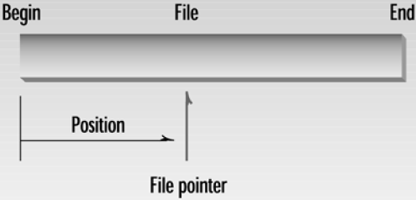
Seek function
It can be used in two forms
Specifying the Position (single argument)
Specifying the Offset (two arguments)
Specifying the Position
It is used to position the get pointer
seekg(0) : set file pointer to the beginning of the file so that reading would start there

Slide 17
Cont.
Specifying the Offset
Two arguments
First argument represents an offset from a particular location in the file,
Second specifies the particular location
There are three possibilities for the second argument:
beg is the beginning of the file,
cur is the current pointer position, and
end is the end of the file
seekp(-10, ios::end);
seekp(-sizeof(pers), ios::cur);

Slide 18
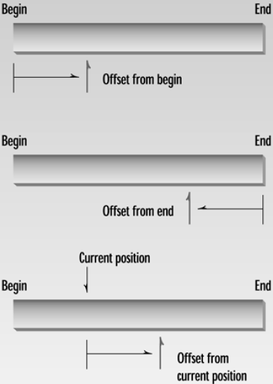

Slide 19
Example program
main() {
person pers;
ifstream infile;
infile.open(“GROUP.DAT”, ios::in | ios::binary);
}
infile.seekg(0, ios::end);
int endposition = infile.tellg();
int n = endposition / sizeof(person);
cout << “\nThere are “ << n << “ persons in file”;
cout << “\nEnter person number: “;
cin >> n;
int position = (n-1) * sizeof(person);
Go to program
infile.seekg(position);
infile.read( reinterpret_cast<char*>(&pers), sizeof(pers) );
pers.showData();

Slide 20
File I/O with Member Functions
Member function of a class can perform read and write operation in file
Go to program

