Slide 1
CSC241: Object Oriented Programming
Lecture No 03

Slide 2
Previous Lecture
Simple C++ program using cin and cout
Member function with parameters
GradeBook class
Book class
Distance class
Set functions and get functions
A little about Constructor

Slide 3
Today’s Lecture
Constructor – example program
Placing class in separate file
Destructor – example program
Constructor with arguments – example program

Slide 4
Example program – Distance class
Data members
Feet
Inches
Member functions
void setdist(int ft, float in);
void getdist();
void initialize();
void showdist();
Go to program

Slide 5
Distance class – data member initialization
Distance class shows two ways to initialize the data items in an object
void initialize();
void setdist(int ft, float in);
Can an object be initialized whenever it is created, without requiring a separate call to a member function?
Automatic initialization is carried out using a special member function called a constructor.
A constructor is a member function that is executed automatically whenever an object is created.

Slide 6
Constructors
C++ requires a construct call for each object it has created
This ensure that object is initialized properly before it is used
If there is no constructor, the compiler provides a default constructor that is, a constructor with no parameters
Name of constructor function is same as name of class

Slide 7
A counter example
Data member
Count
Member function
Constructor
void inc_count()
int get_count()

Slide 8
Automatic initialization
An object of type Counter is first created, we want its count to be initialized to 0
Options are
set_count() function (call it with an argument of 0)
zero_count() function, to set count to 0.
Such functions would need to be executed every time we created a Counter object

Slide 9
Cont.
A programmer may forget to initialize the object after creating it
It’s more reliable and convenient to cause each object to initialize implicitly when it is created
In the Counter class, the constructor Counter() is called automatically whenever a new object of type Counter is created
Counter c1, c2;
creates two objects. Constructor is called with each object separately
Go to program

Slide 10
Constructor Name
First, constructor name must be same as the name of class
This is one way the compiler knows they are constructors
Second, no return type is used for constructors
Why not? Since the constructor is called automatically by the system, there’s no program for it to return anything to; a return value wouldn’t make sense
This is the second way the compiler knows they are constructors

Slide 11
Initializer List
One of the most common tasks a constructor carries out is initializing data members
In the Counter class the constructor must initialize the count member to 0
The initialization takes place following the member function declarator but before the function body.
Initialization in constructor’s function body
Counter()
{ count = 0; }
this is not the preferred approach

Slide 12
Cont.
It’s preceded by a colon. The value is placed in parentheses following the member data.
Counter() : count(0)
{ }
If multiple members must be initialized, they’re separated by commas.
someClass() : m1(7), m2(33), m2(4) ←initializer list { }

Slide 13
Placing a Class in a Separate File
Header file (.h)
Contain definition of class
Not an executable file
Included in .cpp file
main () file (.cpp)
Include .h file containing class definition
Executable file
Go to program

Slide 14
Destructors
Destructor is a function called implicitly when an object is destroyed
The name of the destructor for a class is the tilde character (~) followed by the class name
No arguments and no return type for a destructor
The most common use of destructors is to deallocate memory that was allocated for the object by the constructor
Write a CreatAndDistroy class

Slide 15
Validating Data with set Functions
A set function should validate the value before assigning to private data member
Set function can return a value or may display a message if invalid data is assign to object
Go to program

Slide 16
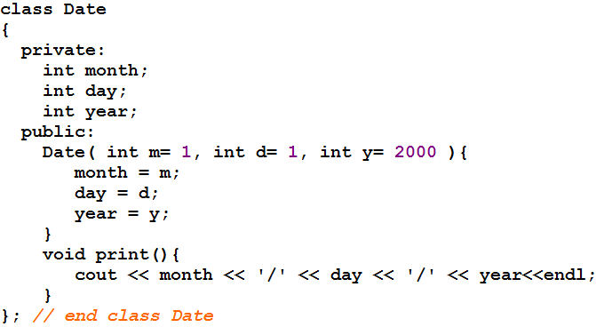
Constructor with default arguments
Go to program

Slide 17
Objects as Function Arguments
class Distance { //Distance class
private:
int feet;
float inches;
public:
Distance() : feet(0), inches(0.0)
{ }
Distance(int ft, float in) : feet(ft), inches(in)
{ }
void getdist(){
cout << “\nEnter feet: “; cin >> feet;
cout << “Enter inches: “; cin >> inches;
}
void showdist(){
cout << feet << “:” << inches<<endl ;
}
void add_dist( Distance, Distance );
};
void Distance::add_dist(Distance d2, Distance d3) {
inches = d2.inches + d3.inches;
feet = 0;
if(inches >= 12.0) {
inches -= 12.0;
feet++;
}
feet += d2.feet + d3.feet;
}
main()
{
Distance dist1, dist3;
Distance dist2(11, 6.5);
dist1.getdist();
dist3.add_dist(dist1, dist2);
cout << “\ndist1 = “; dist1.showdist();
cout << “\ndist2 = “; dist2.showdist();
cout << “\ndist3 = “; dist3.showdist();
}

Slide 18
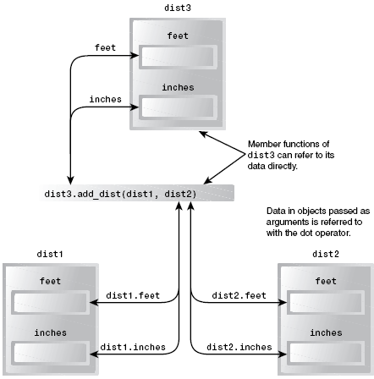

Slide 19
Cont.
main()
{
Distance dist1, dist3;
Distance dist2(11, 6.5);
dist1.getdist();
dist3.add_dist(dist1, dist2);
cout << “\ndist1 = “; dist1.showdist();
cout << “\ndist2 = “; dist2.showdist();
cout << “\ndist3 = “; dist3.showdist();
}
dist1
dist3
17
5
1
0
0
feet
feet
0
inches
7.0
13.5
0.0
inches
0.0
1.5
dist2
feet
11
inches
6.5
void Distance::add_dist(Distance d1, Distance d2) {
inches = d1.inches + d2.inches;
feet = 0;
if(inches >= 12.0) {
inches -= 12.0;
feet++;
}
feet += d1.feet + d2.feet;
}
void showdist(){
cout << feet << “:” << inches<<endl ;
}
void getdist(){
cout << “\nEnter feet: “; cin >> feet;
cout << “Enter inches: “; cin >> inches;
}
d1
d2
feet
5
feet
11
inches
7.0
inches
6.5
dist1 = 5 : 7.0
dist2 = 11 : 6.5
dist3 = 17 : 1.5
Go to program

Slide 20
Overloaded Constructors
It’s convenient to be able to give variables of type Distance a value when they are first created
Distance dist2(11, 6.25);
which defines an object, and initializes it to a value of 11 for feet and 6.25 for inches.
Distance dist1, dist2; then No-argument constructor is called/invoked (the default constructor)
Since there are now two constructors with the same name, Distance(), we say the constructor is overloaded

Slide 21
Member Functions Defined Outside the Class
Such functions, needs to have a prototype/declaration within the class
The function name, add_dist(), is preceded by the class name, Distance, and a new symbol—the double colon (::). This symbol is called the scope resolution operator.
It is a way of specifying what class something is associated with
In this situation, Distance::add_dist() means “the add_dist() member function of the Distance class”
void Distance::add_dist(Distance d2, Distance d3)

Slide 22
Structures and Classes
We used structures as a way to group data and classes as a way to group both data and functions
In fact, you can use structures in almost exactly the same way that you use classes
The only formal difference between class and struct is that in a class the members are private by default, while in a structure they are public by default.

Slide 23
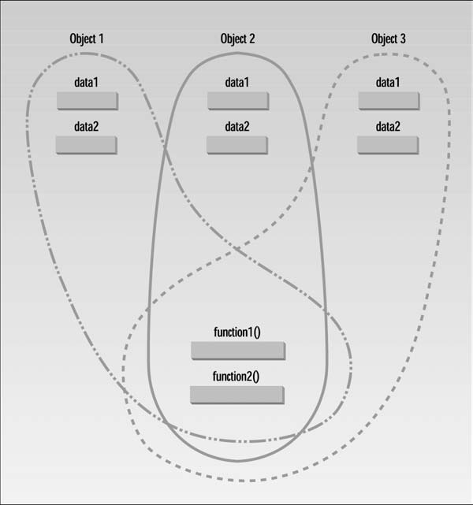
Classes, Objects, and Memory

