Slide 1
CSC241: Object Oriented Programming
Lecture No 04

Slide 2
Previous Lecture
Constructor – example program
Placing class in separate file
Destructor – example program
Constructor with arguments – example program

Slide 3
Today’s Lecture
Overloaded function
Constructor
const (constant)
object
member function
data member
object as function argument
friend function
this pointer

Slide 4
Objects as Function Arguments
class Distance { //Distance class
private:
int feet;
float inches;
public:
Distance() : feet(0), inches(0.0)
{ }
Distance(int ft, float in) : feet(ft), inches(in)
{ }
void getdist(){
cout << “\nEnter feet: “; cin >> feet;
cout << “Enter inches: “; cin >> inches;
}
void showdist(){
cout << feet << “:” << inches<<endl ;
}
void add_dist( Distance, Distance );
};
void Distance::add_dist(Distance d2, Distance d3) {
inches = d2.inches + d3.inches;
feet = 0;
if(inches >= 12.0) {
inches -= 12.0;
feet++;
}
feet += d2.feet + d3.feet;
}
main()
{
Distance dist1, dist3;
Distance dist2(11, 6.5);
dist1.getdist();
dist3.add_dist(dist1, dist2);
cout << “\ndist1 = “; dist1.showdist();
cout << “\ndist2 = “; dist2.showdist();
cout << “\ndist3 = “; dist3.showdist();
}

Slide 5
Overloaded Constructors
It’s convenient to be able to give variables of type Distance a value when they are first created
Distance dist2(11, 6.25);
which defines an object, and initializes it to a value of 11 for feet and 6.25 for inches.
Distance dist1, dist2; then No-argument constructor is called/invoked (the default constructor)
Since there are now two constructors with the same name, Distance(), we say the constructor is overloaded

Slide 6
Member Functions Defined Outside the Class
Such functions, needs to have a prototype/declaration within the class
The function name, add_dist(), is preceded by the class name, Distance, and a new symbol—the double colon (::). This symbol is called the scope resolution operator.
It is a way of specifying what class something is associated with
In this situation, Distance::add_dist() means “the add_dist() member function of the Distance class”
void Distance::add_dist(Distance d2, Distance d3)

Slide 7
Structures and Classes
We used structures as a way to group data and classes as a way to group both data and functions
In fact, you can use structures in almost exactly the same way that you use classes
The only formal difference between class and struct is that in a class the members are private by default, while in a structure they are public by default.

Slide 8
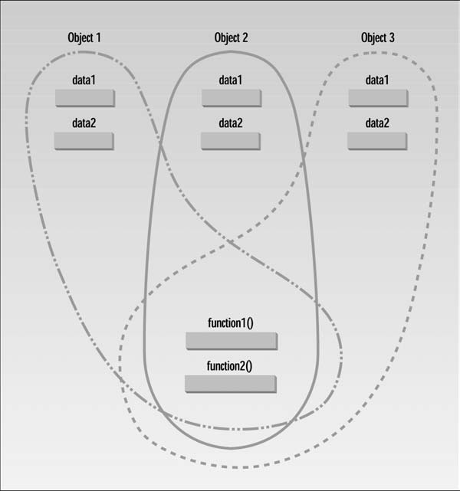
Classes, Objects, and Memory

Slide 9
const (constant) object
Some objects need to be modifiable and some do not
Keyword const is used to specify that an object is not modifiable
Any attempt to modify the object should result in a compilation error
declares a const object noon of class Time and initializes it to 12 noon

Slide 10
const (constant) member function
Constant member function will not allow to modify private data member
class aClass
{
private:
int alpha;
public:
void nonFunc() //non-const member function
{ alpha = 99; } //OK
void conFunc() const //const member function
{ alpha = 99; } //ERROR: can’t modify a member
};

Slide 11
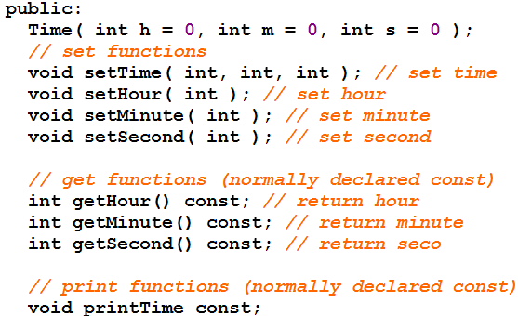
Example – Time class
Data members
Member functions
program

Slide 12
const Objects as Function Arguments
class Distance { //Distance class
private:
int feet;
float inches;
public:
Distance() : feet(0), inches(0.0)
{ }
Distance(int ft, float in) : feet(ft), inches(in)
{ }
void getdist(){
cout << “\nEnter feet: “; cin >> feet;
cout << “Enter inches: “; cin >> inches;
}
void showdist(){
cout << feet << “:” << inches<<endl ;
}
Distance add_dist(const Distance&) const;
};
Distance Distance::add_dist(const Distance& d2) const
{
Distance temp;
inches = 0;
temp.inches = inches + d2.inches;
if(temp.inches >= 12.0) {
temp.inches -= 12.0;
temp.feet = 1;
}
temp.feet += feet + d2.feet;
return temp;
}

Slide 13
Cont.
main()
{
Distance dist1, dist3;
Distance dist2(11, 6.25);
dist1.getdist();
dist3 = dist1.add_dist(dist2);
cout << "\ndist1 = "; dist1.showdist();
cout << "\ndist2 = "; dist2.showdist();
cout << "\ndist3 = "; dist3.showdist();
}
dist1
dist3
5
0
0
feet
feet
17
inches
7.0
0.0
inches
0.0
1.5
d2
dist2
feet
11
inches
6.5
Distance Distance::add_dist(const Distance& d2) const {
Distance temp;
temp.inches = inches + d2.inches;
if(temp.inches >= 12.0) {
temp.inches -= 12.0;
temp.feet = 1;
}
temp.feet += feet + d2.feet;
return temp;
}
temp
void getdist(){
cout << “\nEnter feet: “; cin >> feet;
cout << “Enter inches: “; cin >> inches;
}
void showdist(){
cout << feet << “:” << inches<<endl ;
}
1
feet
17
inches
13.5
1.5
dist1 = 5 : 7.0
dist2 = 11 : 6.5
Go to program
dist3 = 17 : 1.5

Slide 14
Initializing a const Data Member
Constant data member must be initialized using member initializer list
private:
int count;
const int increment;
const data member must be initialized as soon as the object is created

Slide 15
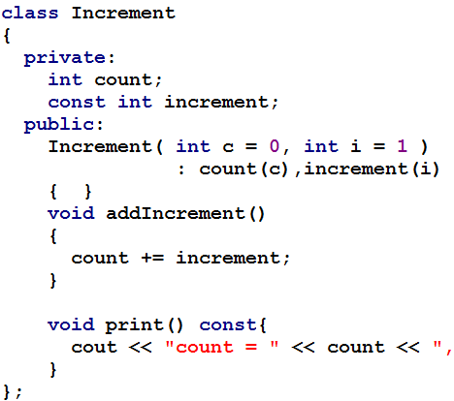
Example
Go to program

Slide 16
Common errors while using const
Following are compilation errors
Defining as const a member function that modifies a data member of an object
Defining as const a member function that calls a non-const member function of the class on the same instance of the class
Invoking a non-const member function on a const object

Slide 17
friend Functions
A friend function of a class is defined outside that class's scope
It has the right to access the non-public (and public) members of the class
Prototypes for friend functions appear in the class definition but friends are not member functions
They are called just like a normal functions

Slide 18
Cont.
Friend function can be declaration can be placed any where in class definition
Place all friendship declarations first inside the class definition's body

Slide 19
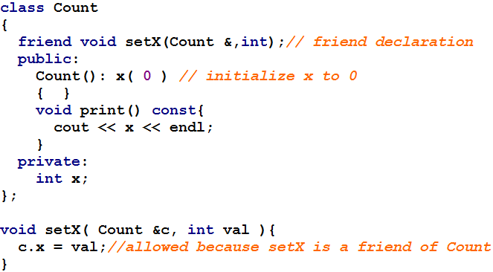
Example – Count class
Go to program

Slide 20
Using this pointer
Object's member functions can manipulate the object's data
How do member functions know which object's data members to manipulate?
Every object has access to its own address through a pointer called this
this pointer is passed (by the compiler) as an implicit argument to each of the object's non-static member functions

Slide 21
Cont.
An object's this pointer is not part of the object itself
The size of the memory occupied by the this pointer is not reflected in the result of a sizeof operation on the object
Objects use this pointer implicitly or explicitly to reference their data members and member functions

Slide 22
Type of this pointer
The type of the this pointer depends on the type of the object
non constant member function of class Employee, the this pointer has type Employee * const
constant member function of the class Employee, the this pointer has the data type const Employee * const

Slide 23
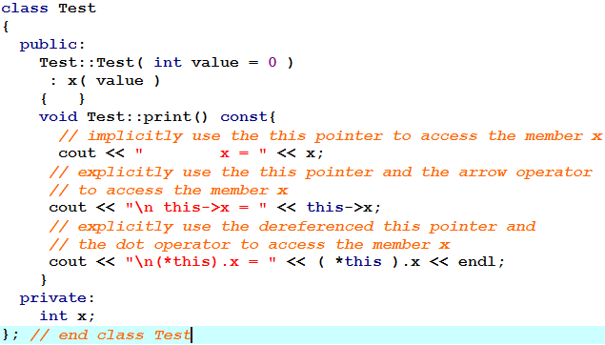
Implicitly and Explicitly Use this Pointer
Go to program

Slide 24
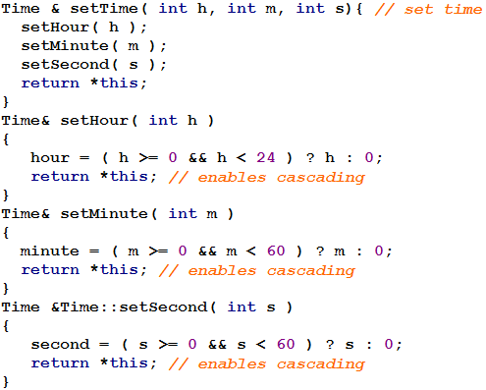
Cascading function calls using this pointer
Multiple member functions are invoked in the same statement

Slide 25
Cont.
Why does the technique of returning *this as a reference work?
The dot operator (.) associates from left to right
so line 14 first evaluates t.setHour( 18 ) then returns a reference to object t
The remaining expression is then interpreted as
t.setMinute( 30 ).setSecond( 22 );
t.setMinute( 30 ) call executes and returns a reference to the object t.
t.setSecond( 22 );
Go to program

Slide 26
static Data Members
Each object of a class has its own copy of all the data members of the class
In certain cases, only one copy of a variable should be shared by all objects of a class
A static data member is used
If a data item in a class is declared as static, only one such item is created for the entire class, no matter how many objects there are

Slide 27
Cont.
A member static variable is visible only within the class, but its lifetime is the entire program
It continues to exist even if there are no objects of the class
A static data item is useful when all objects of the same class must share a common item of information

Slide 28
Uses of static data member
Suppose an object needed to know how many other objects of its class were in the program
In a road-racing game, for example, a race car might want to know how many other cars are still in the race
In this case a static variable count could be included as a member of the class
All the objects would have access to this variable

Slide 29
Example – Race class
class Race
{
private:
static int count;
int carNo;
public:
Race()
{ count++; carNo=0; }
void setCarNo(int no)
{ carNo = no; }
void printData() {
cout<<“Total car = ”<< count;
cout<<“,Car No. = ”<<carNo<<endl;
}
};
int Race::count = 0;
main()
{
Race c1, c2, c3; //create three objects
c1.setCarNo(10); c2.setCarNo(11);
c3.setCarNo(12);
c1.printData();
c2.printData(); c3.printData();
}
Total car = 2, Car No. 10
Total car = 2, Car No. 11
Total car = 3, Car No. 12
main()
{
Race c1, c2; //create three objects
c1.setCarNo(10); c2.setCarNo(11);
c1.printData();
c2.printData();
Race c3; c3.setCarNo(12); c3.printData();
}
Total car = 3, Car No. 10
Total car = 3, Car No. 11
Total car = 3, Car No. 12

Slide 30
Composition – Objects as Members of Classes
An AlarmClock object needs to know when it is supposed to sound its alarm
So why not include a Time object as a member of the AlarmClock class
It is refer as has-a relationship
We will see how an object's constructor can pass arguments to member-object constructors

Slide 31
Example program
Date.h
Date class
manager
firstname
lastname
Employee.h
Employee class
Date birthday
Date hiredate
birthday
day
month
year
hireday
day
month
Source_emp.cpp
Employee manager
year
Go to program

Slide 33
Dynamic Memory Management
C++ enables programmers to control the allocation and deallocation of memory in a program for any built-in or user-defined type
Performed with operators new and delete

