Slide 1
CSC241: Object Oriented Programming
Lecture No 05

Slide 2
Previous Lecture
Overloaded function
Constructor
const (constant)
object
member function
data member
object as function argument
friend function
this pointer

Slide 3
Today’s Lecture
Reference variable
this pointer
Cascading function calls
Dynamic memory allocation
static class member
static functions
static data member
sdaf

Slide 4
C++ Reference variable
C++ references allow you to create a second name for a memory location that you can use to read or modify the original data stored in that location
Syntax
int& foo = ....;
reference to an int
When a reference is created, you must tell it which variable it will become an alias for

Slide 5
Cont.
x
y
int x;
int& y = x;
y = 50;
cout<<x;
cout<<y;
50

Slide 6
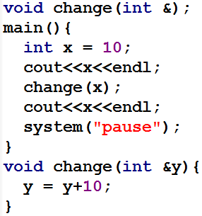
Reference variable – functions
Functions can take reference parameters
x
y
10
20
y = y + 10
y = 10 + 10
y = 20

Slide 7
const Objects as Function Arguments
class Distance { //Distance class
private:
int feet;
float inches;
public:
Distance() : feet(0), inches(0.0)
{ }
Distance(int ft, float in) : feet(ft), inches(in)
{ }
void getdist(){
cout << “\nEnter feet: “; cin >> feet;
cout << “Enter inches: “; cin >> inches;
}
void showdist(){
cout << feet << “:” << inches<<endl ;
}
Distance add_dist(const Distance&) const;
};
Distance Distance::add_dist(const Distance& d2) const
{
Distance temp;
inches = 0;
temp.inches = inches + d2.inches;
if(temp.inches >= 12.0) {
temp.inches -= 12.0;
temp.feet = 1;
}
temp.feet += feet + d2.feet;
return temp;
}

Slide 8
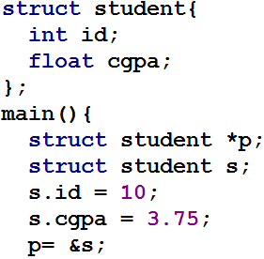
* , -> and dot operator with structure
*p
7550
s
10
3.75
7550
10 3.75
10 3.75
10 3.75
10 3.75
10 3.75

Slide 9
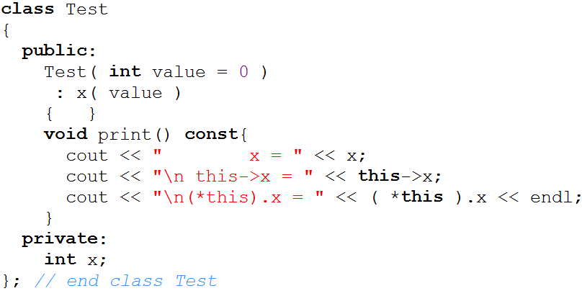
Implicitly and Explicitly Use this Pointer
Go to program

Slide 10
Cascading function calls using this pointer
In cascaded member-function calls invoked multiple functions in the same statement
(Ref. of object t)
(Ref. of object t)

Slide 11
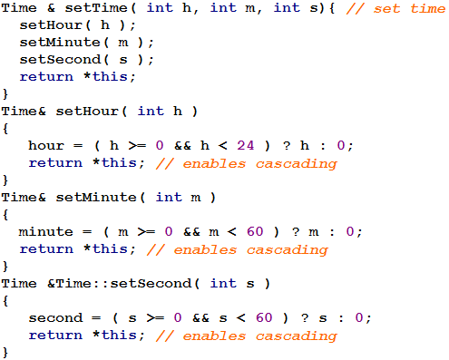
Example – Time class

Slide 12
Cont.
Why does the technique of returning *this as a reference work?
The dot operator (.) associates from left to right
first it evaluates t.setHour( 18 ) then returns a reference to object t
The remaining expression is then interpreted as
t.setMinute( 30 ).setSecond( 22 );
t.setMinute( 30 ) call executes and returns a reference to the object t.
t.setSecond( 22 );
Go to program

Slide 13
Dynamic Memory Management
C++ enables programmers to control the allocation and de-allocation of memory in a program for any built-in or user-defined type
Performed with operators new and delete
E.g. in Employee class
name char array
It has some size e.g. 25
Through dynamic memory we can allocate array space same as the number of character in name

Slide 14
Cont.
Dynamically allocating memory in this fashion causes an array to be created in the free store (heap)
Heap is a region of memory assigned to each program for storing objects created at execution time
Once the memory is allocated in the free store, pointer points to the first byte of that allocated memory
After used, memory can be return to heap by using delete operator

Slide 15
Dynamic memory – basic types
C++ allows you to provide an initializer for a newly created fundamental-type variable
delete ptr;
3.14159
*ptr
704
704

Slide 16
Dynamic memory – array
new operator can be used to allocate arrays dynamically
*gradeArray
704
704
708
712
716
720

Slide 17
Simple example
Example 1:
char pointer
Allocate dynamic memory using new operator
Write string and display it
Delete the dynamic memory using delete operator
Example 2:
struct definition
Allocate dynamic memory
Write string and display structure contents
Delete the dynamic memory
Go to program

Slide 18
Dynamic memory – objects
Consider the following declaration and statement:
hours
0
*timePtr
minutes
0
seconds
0
Go to program

Slide 19
Composition – Objects as Members of Classes
An AlarmClock object needs to know when it is supposed to sound its alarm
So why not include a Time object as a member of the AlarmClock class
It is refer as has-a relationship
We will see how an object's constructor can pass arguments to member-object constructors

Slide 20
Example program
Date.h
Date class
manager
firstname
lastname
Employee.h
Employee class
Date birthday
Date hiredate
birthday
day
month
year
hireday
day
month
Source_emp.cpp
Employee manager
year
Go to program

