Slide 1
Lecture 20

Slide 2
Part Three: Understanding Principles of Marketing
Understanding Market Processes And Consumer Behavior
Developing And Pricing Products
Distributing Products
Promoting Products

Slide 3
Chapter
10
Understanding Marketing Processes and Consumer Behavior

Slide 4
Chapter Outline
What Is Marketing?
Target Marketing/Segmentation
Marketing Research
Understanding Consumer Behavior
Organizational Marketing & Buying Behavior
International Marketing Mix
Small Business & The Marketing Mix

Slide 5



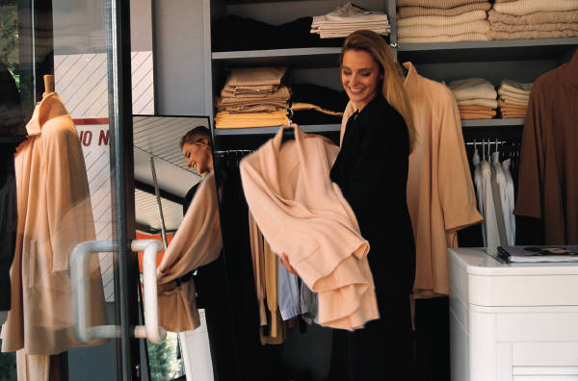

Marketing Mix (4 P’s)
Product
Price
Place
Promotion

Slide 6
Product
Good, Service, Idea To Fill Need Or Want
Product Differentiation
  Creation of a feature or image that makes a product differ from existing products to attract consumers

Slide 7
Price
Price Must Create Profit By:
  Covering Costs
  Attract Customers
High-Low Strategy
  Low = Large Sales Volume
  High = Greater Profit Per Unit Sold

Slide 8
Place
Getting Product From Producer To Consumer
Decisions Include:
  Storage
  Mode Of Transportation

Slide 9
Channels Of Distribution
Producer
Producer
Producer
Wholesaler
Retailer
Retailer
Consumer
Consumer
Consumer

Slide 10
Promotion
Communicate Information
Tools:
  Advertising
    Paid non personal communication used by a identified sponsor to persuade or inform potential buyers about a product
  Personal Selling
    Person to person to sales

Slide 11
Promotion
Communicate Information
Tools:
  Sales Promotion
    One time direct inducement to buyers
  Public Relations
    All efforts directed and building goodwill

Slide 12
Promotion
Heathy Pakistan Mission - Lifebuoy School Programme18-10-2011:The Lifebuoy team’s mission is to change the behavior of 68 Million people by 2015, by promoting the “Lifebuoy way” of using soap during the key moments for prevention of 10 common infections
UNILEVER COMMITS Rs. 25 M TO FLOOD RELIEF IN SOUTHERN PAKISTAN26-09-2011:Unilever PLC, the parent of Unilever Pakistan today committed Rs.25 million to provide immediate relief to millions of people affected by devastating floods in Southern Pakistan.

Slide 13
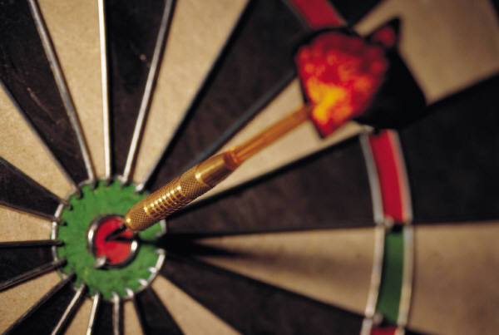
Target Market
Target Market- Group With Similar Needs/Wants That Show Interest in same product
Product Positioning- According To Consumers’ Perception

Slide 14
Segmentation
Dividing Markets In To Categories Of Consumer Type
After Identification Of Segments, Various Strategies Are Adopted
Segment Should Share Some Common Traits That Affect Purchasing Decisions

Slide 15
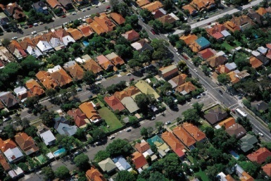
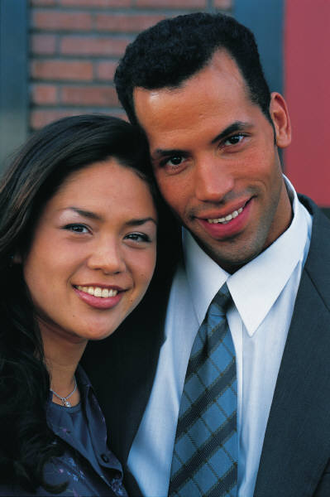

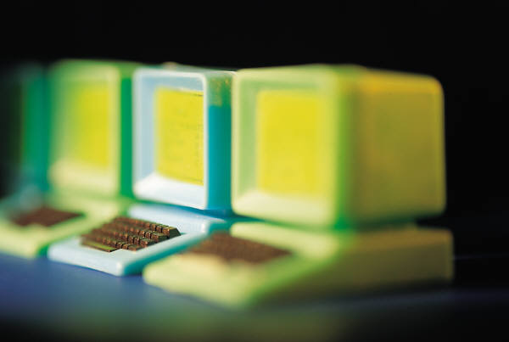
Market
Segmentation Variables
Geographic
Demographic
Psychographic
Behavioral

Slide 16
Geographic Variables
Places Consumers Reside
Countries > Neighborhoods
Water = Boats
Mountains/Rural = Four-Wheel Drive Vehicles
Urban Area = Designer Clothing
Some Products Have Universal Acceptance

Slide 17
Demographic Variables
Age
Income
Gender
Ethnic Background
Marital Status
Race
Religion
Social Class

Slide 18
Psychographic Variables
Lifestyle
Interests
Attitudes
Can Be Changed By Marketing Efforts

Slide 19
Behavioral Variables
Ways In Which Product/Service Is Used
Benefits Expected
Reasons For Purchase
Brand Loyalty vs. Switcher

Slide 20
Marketing Research
Study Consumer Needs/Wants
Determine Ways Sellers Can Satisfy Needs/Wants

Slide 21
Marketing Research
& Process

Slide 22
Research Process
Study Situation
Select Method
Collect Data
Analyze Data
Prepare Report

Slide 23
Research Process
Study The Current Situation
  What is the need and what is being done to meet it
Select A Research Method
  Effectiveness And Cost Of Options
Collect Data
  Secondary Data
  Primary Data
Analyze Data
  Transform data in to information
Prepare A Report
  Sum up methodology and findings

Slide 24
Research Methods
Observation
Surveys
Experimentation
Focus Group

Slide 25
Influences On
Consumer Behavior
Study Of The Decision Process By Which People Buy And Consume products

Slide 26
Influences On
Consumer Behavior
Psychological –motivation,perception,attitude
Personal-lifestyle, personality, economic status
Social-family, opinion leaders, friends
Cultural
  Cultural – way of living that distinguishes one group from the other
  Subculture – smaller groups with shared values
  Social class – ranking of group based on occupation and income
Weak affect of factors because of brand loyalty

Slide 27
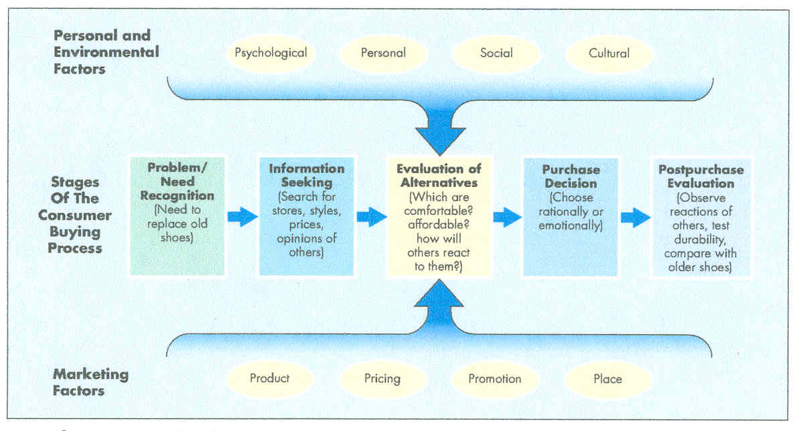
Buying Process

Slide 28
Data
Warehousing- Collecting, Storing, & Retrieving Data
Mining- Searching, Sifting, & Reorganizing Data

Slide 29
Organizational Markets
Industrial – businesses that buy goods to be converted in to other products or goods that are used up during production
Reseller – consists of intermediaries, who buy and resell finished goods
Government/Institutional

Slide 30
Buying Behavior- Organizational
Buyer Differences
  Professional – trained for negotiating
  Specialist
  Experts
Buyer-Seller Relationship
  Frequent
  enduring

Slide 31
Marketing Mix- International
Products- Redesign For Foreign Buyer
Pricing- Cover Increased Cost Of Transport/Selling
Distribution- Delays In Establishing Network For Startup
Promotion- Cultural Differences

Slide 32
Marketing Mix-
Small Business
Products- Limited Buying Market
Pricing- Incorrect Cost Estimation
Distribution- Location Is Critical
Promotion- Local Which Is Cheaper

